Slide 1
Steaming and curving solid wood
Module 3
WULS
Warsaw, 1st December 2021
Notes:
In this module was prepared as part of the All Hands On Deck (AHOD) project, activity IO2A3.
The substantive transmission of the manual is the absolute minimum of sailing knowledge necessary to build a small boat in workshop conditions.
This portion of the message should be assimilated by every hobbyist of sailing.
This is also what every enthusiast of this sport should know to understand roughly the principles of sailing boat construction.
Every sailing enthusiast should improve their skills, looking for the best technique for building their dream boat.
This can be learned in two ways: either through painstaking practice or from public experience. For those who prefer the desire to acquire reliable knowledge over to the written word, further chapters are intended.

Slide 2
Unit 9.
8 hour
Notes:
This unit is about the Bending of steamed wood on moulds (frames) and on hull (planks).
All data will be presented in the next slides.

Slide 3
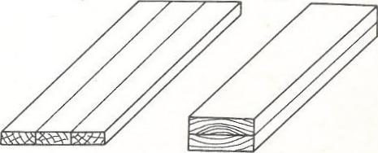
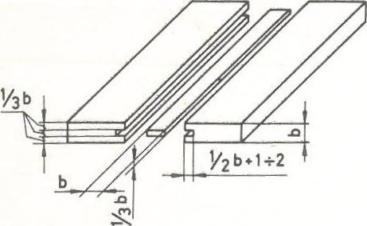
Contact connectors and connection „on a foreign tongue”
a)
b)
Contact connectors
„on a foreign tongue” connection
Notes:
Parallel longitudinal joints are used to connect elements in order to increase their width or thickness. These connections are most often used for butt joints was presented in figure on the left as contact connectors, where can be specified: a) increasing width; b) increasing the thickness.
as well as connection "on a foreign tongue" were presented in figure on the right.

Slide 4
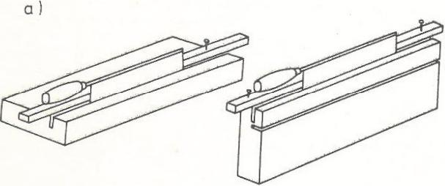
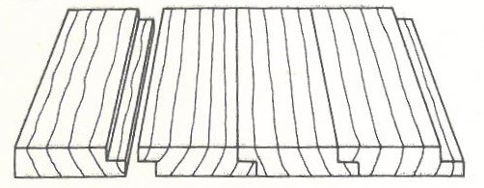
Rebate joint
a) cutting a circle with a ridge,
b) flattening and sanding the frame,
c) ready connection.
a)
b)
c)
Notes:
The rebate joints are most often used for making smooth overlapping plating (on the so-called rebate) or gluing the sides for small boats, and the joints "for a foreign tongue" when making cockpit walls, hatch covers, flap stroke or engine housings on larger yachts. aesthetic appearance and the fact that the joints remain tight even during shrinkage of the wood. When joining long boards with a rebate joint or "on a foreign tongue", you need to use a mechanical circular saw or milling machine, while when making shorter reb joints, you can proceed as shown in figure.
The Rebate joint was presented in figure. On that figure can be specified: a) cutting a circle with a ridge,
b) flattening and sanding the frame, c) ready connection.

Slide 5
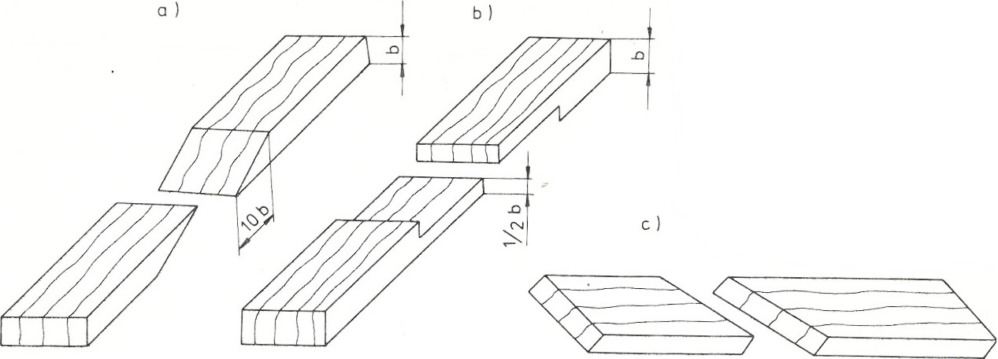
Parallel front connections
a) no-profile miter,
b) simple overlap,
c) contact oblique.
Notes:
Parallel butt joints are used to connect elements lengthwise. Of these connections, three are most often used, namely a bevel without a profile, commonly known as a bevel, an overlap connection, and a skew butt joint. Bevelling is used for joining boards for the keel, stem, sternframe and for joining plywood sheets. The rule should be that the bevel length is equal to or greater than ten times the thickness of the joined element. Frontal parallel connections are shown in Figure.
The Parallel front connections was presented in figure. On that figure can be specified: a) no-profile miter, b) simple overlap, c) contact oblique.

Slide 6
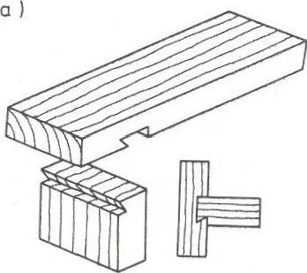
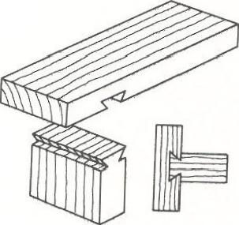
Fin joint
a) unilateral,
b) two-sided.
a)
b)
Notes:
The lap joint is used, for example, when joining stringers, and the butt joint is used to join the straw sheathing to connect "straws" along the length. The most reliable of the corner joints is the fin and groove joint This joint prevents warping of the wood and prevents it from swelling and shrinking.
The fin joints are shown in Figure. On that figure can be specified: a) unilateral, b) two-sided.
When making this connection, the element with the fin is processed first. In this element, at the joint, a perpendicular cut is made with the help of a ridge (along the auxiliary guide bar), and then a miter is made with a flat chisel.

Slide 7
Socket and spigot connection
a) finished tenon and seat,
b) making the nest.
a)
b)
Notes:
When making a fin groove, both the outer and inner edges of the groove are marked on the wood surface. Starting from the inside edges, the slope of the groove is cut with a back saw, and then the wood marked by the saw cut is removed with a chisel. Another solution used is a socket and spigot connection.
The socket and spigot connection are shown in Figure. On that figure can be specified: a) finished tenon and seat, b) making the nest.

Slide 8
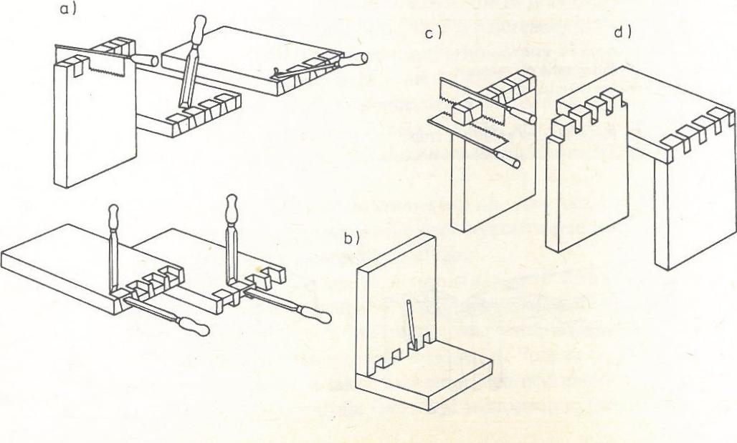
Finger and dovetail joint
a) making dovetails,
b) finger tracing,
c) cutting a dovetail,
d) ready connection.
Notes:
The width of the seat and spigot should be at least one third of the board thickness. Sockets are always made in vertical elements, and pivots in horizontal elements. Still other joints of this kind are the dovetail and dovetail joints. This type of connection is made when connecting elements exposed to high tensile or compressive forces. The workflow for cutting fingers and dovetails is shown in Figure
The finger and dovetail joint are shown in Figure.
On that figure can be specified: a) making dovetails, b) finger tracing, c) cutting a dovetail, d) ready connection.

Slide 9
Correct hammering of nails
Notes:
First, the fingers are machined (with a back and a flat chisel) and then the fingers, which must be fitted to the ready-made joints. Apart from gluing and carpentry joints, many different metal connectors are used in boatbuilding to connect elements. The most frequently used are nails, rivets, screws and bolts, while rivets and screws are also used to connect metal parts. The correct hammering of nails were shown in Figure.
Nails are most often used to fasten the slats to each other with the straw sheathing, to fasten the deck plywood in conjunction with gluing, for example, to connect the boards or plywood across the sides. Nails used to build boats should be copper or zinc plated or cadmium plated. The mere hammering of nails, which seems easy, requires some skill and meeting several conditions. If you want to hammer the nail in, you should put it diagonally in the right, previously marked place, where you can better see the marked point when applying the nail in this way, then position it vertically and hold.
When two boards are joined together perpendicularly, the nail is held correctly if 1/3 of its length is on the upper board and 2/3 on the lower board. If the nail enters the other board from the front side, it does not provide a very tight connection. In order to strengthen this connection, nails should be hammered diagonally, alternately with the left and right bevel.

Slide 10
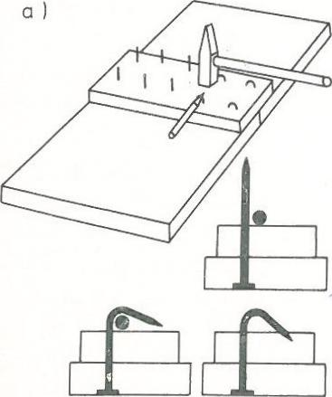
Bending nails with a rod
To avoid the breaks of thin boards or strips, nails is neccecery to drill small holes under the nails or by cutting off the ends of the nails.
Another way is to compress the nails, which is achieved by hitting the sharp end of the nail placed on the washer with its head down several times with a hammer.
Notes:
With thin boards or strips, nails often break. This can be avoided by drilling small holes under the nails or by cutting off the ends of the nails. Another way is to compress the nails, which is achieved by hitting the sharp end of the nail placed on the washer with its head down several times with a hammer.
When nails are to provide an exceptionally strong connection - for example, when joining boards or plywood to the side - nails should be used that are longer than the total thickness of the joined elements. The tips of the nails protruding on the other side are bent into the shape of a hook with a hammer and a round bar, an old file or a thick nail, and then the hook goes into the wood.
The Bending nails with a rod was presented in Figure.

Slide 11
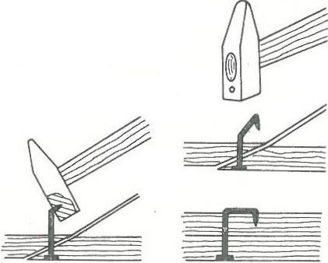
Bending the nails with a hammer with a hole
The bending process can be simplified by drilling a hole in the hammer head slightly larger than the diameter of the nails being bent and then bending them.
Notes:
Nail bending is used not only when joining elements on the overlay, but also in the case of bevelling, when the length of the bevel is less than required. The bending process can be simplified by drilling a hole in the hammer head slightly larger than the diameter of the nails being bent and then bending them as shown in Figure.

Slide 12
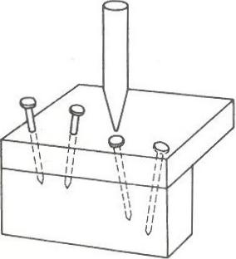
Driving nails
In case when the nail head is to be invisible, then it should be plunged 2-3 mm into the wood with a punch, and the hole should be smoothed.
Notes:
In case when the nail head is to be invisible, then it should be plunged 2-3 mm into the wood with a punch, and the hole should be smoothed. This process is presented in Figure.

Slide 13
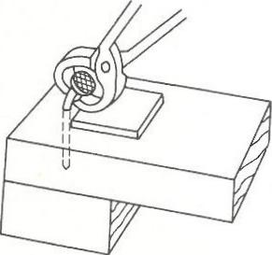
Nail pulling
When removing a curved nail with pliers, a board with dimensions of approximately 5x5 cm should be placed under the pincers next to the nail.
In this way, first of all, better operation of the lever is obtained, and secondly, by distributing the pressure over the entire surface of the board, wood dents are avoided.
Notes:
When removing a curved nail with pliers, a board with dimensions of approximately 5x5 cm should be placed under the pincers next to the nail. In this way, first of all, better operation of the lever is obtained, and secondly, by distributing the pressure over the entire surface of the board, wood dents are avoided. This process is presented in Figure.

Slide 14
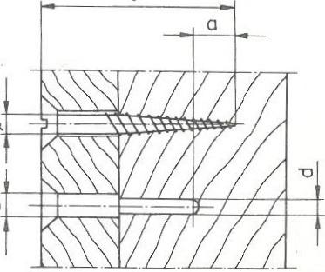
Proper driving of screws into wood
For very large screws a = 0
Notes:
The basic metal fasteners in boatbuilding are screws. The connection with screws is a very durable connection, provided that you follow a few basic rules regarding the selection of the size of the screws and the method of screwing them in. The first rule is that it holds the joint better with more small screws than with fewer large screws. The second rule: screws of different lengths are used for the same elements made of hard and soft wood. Screws are smaller for hardwood than for softwood. According to the third rule, you should never hammer the screws in with a hammer, because they only hold the screw for which the appropriate hole has been drilled.
The drilling operation itself is quite laborious and requires high accuracy. First, a hole is drilled with a diameter slightly smaller (for softwood) or equal (for hardwood) and a depth corresponding to the length of the unthreaded part of the screw. Secondly, a hole is drilled for the threaded part. The diameter of this hole should correspond to the diameter of the screw core, measured approximately in the middle of its length. The third hole is a drilling with a diameter slightly larger than the screw head and the depth depending on how deep the screw head is to be recessed. For the pegs, the cornices must be deeper. The correct way of making holes for screws for very large screws a = 0, was presented in Figure.

Slide 15
Screw connection
Screw diameters [mm] | Hard wood |  | Soft wood
 | D [mm] | d [mm] | D [mm] | d [mm]
2.7 3.0 3.5 4.0 4.5 5.0 5.5 6.0 8.0 | 2.8 3.2 3.6 4.2 4.6 5.2 5.8 6.2 8.2 | tap tap tap 2.5 3.2 3.2 3.5 4.0 4,8 | tap tap tap tap 4.5 5.0 5.5 6.0 8,0 | tap tap tap tap tap tap 3.2 4.0 4.8
Notes:
These holes - called cornices - are drilled only in hardwood and when the screw head is to be pinched, e.g. when making sheathing. The drilling diameters depending on the screw diameter and the type of wood (hard or soft) are given in Table.

Slide 16
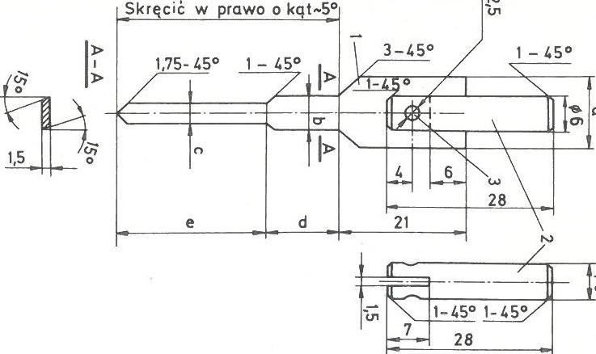
Fig. 48. Triple drilling bit for screws
1 - drill blade, 2 - mandrel, 3 - rivet
Notes:
Drilling holes for screws can also be made with a special, triple drill, with which all three holes of different diameters are made at once. Such a drill should be made of steel sheet with a thickness of 1.5 mm. First, a blade (I) is cut from the sheet, which has three essential dimensions: dimension "a" equal to the diameter of the drill hole under the screw head, dimension "b" equal to the diameter of the unthreaded part of the screw and dimension "c" equal to the diameter of the threaded part of the screw measured in the middle of the length thread. After making the blade, sharpen its edges with a fine saw, and then turn the part of the drill with dimensions "b" and "c" to the right by a small angle of about 5 °. Next, make a mandrel (2) of 30 mm long. This shank is used to fix the drill bit in the drill chuck. At one end of the shank, cut a 1.5 mm wide and 7 mm deep groove with a hacksaw into which the upper part of the drill is inserted and then both parts are drilled out with a drill bit diameter 2.5 mm Both parts are riveted with a rivet 2.5 mm in diameter Special triple drill bit for drilling for screws was presented in figure.

Slide 17
Blade dimensions
Screw diameters [mm] | Blade dimensions [mm]
 | a | b | c | d | e
4 5 6 8 | 8.5 10 12 16 | 3.8 4.8 5.8 7.8 | 3 3.5 4 5.5 | depending on the length of the screw, equal to the length of the unthreaded part of the screw | depending on the length of the screw, equal to the length of the unthreaded part or slightly knit
Notes:
After the drill is made, be sure to harden it by heating a gas stove over the burner and immediately putting it in cold water. Examples of dimensions of such drills for screws with diameters of 4, 5, 6, 8 mm are given in Table.
When you need to use a small number of screws, the best way is to use a screwdriver with a suitable blade, and for more screws - with a carpenter's crank with an appropriate screwdriver bit. The blade of the screwdriver should be selected so that its width is equal to the diameter of the screw head and that it fits into the head groove without play. This prevents the screw heads from being injured and can be tightened tightly. To facilitate the path of the screws, you can coat them with soap or a drop of varnish before screwing them in.

Slide 18
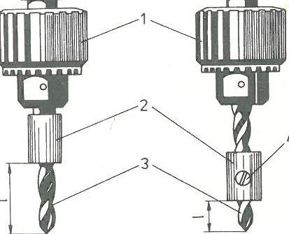
Drilling holes to a certain depth using the limiter
a) fixed limiter,
b) movable limiter (1 - drill spindle, 2 - limiter, 3 - drill, 4 - locking screw)
Notes:
For drilling holes to a specific depth (e.g. for screws), a simple limiter can be made, which will ensure a constant drilling depth. Such a limiter is shown in figure. It is made of hard wood, e.g. oak, beech or ash. It has the shape of a cylinder (2) with a diameter approximately twice the diameter of the drilled hole. Drill a hole in the roller with a drill bit (3), which will then be used to drill the required holes. After drilling, the cylinder should be cut to the required length, then put on the drill bit and you can continue to work with the certainty that all holes will have the same depth. The limiter made of metal has several advantages, first of all, it can be moved on the drill and fixed in any position with a screw (4), and thus the depth of the drilled hole can be freely adjusted.
Drilling holes to a certain depth using the limiter was presented in figure.
On the left was presented drill with fixed limiter, on the right was presented drill with movable limiter
On that figure can be specified: 1 - drill spindle, 2 - limiter, 3 - drill, 4 - locking screw

Slide 19
Driving screws in hard-to-reach places
Notes:
When it is necessary to screw a screw in a hard-to-reach place, where you cannot put your hand in, it is enough to insert the screwdriver blade into the groove in the screw head and fix it with a piece of plaster or adhesive tape. If most of the adhesive sticks to the screwdriver, then after screwing in the screw, the adhesive can be removed together with the screwdriver. The Driving screws in hard-to-reach places was presented in Figure.

Slide 20
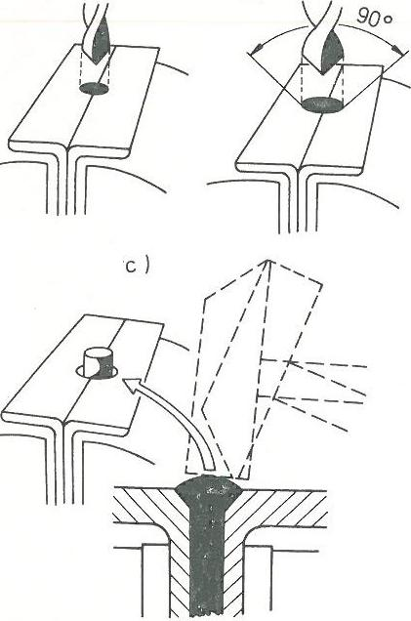
The method of making copper rivets or nails
a) drilling a hole
b) performing a boring for the rivet head
c) making the rivet head.
Notes:
The connection with rivets is inseparable - to remove them, you have to destroy the rivets by cutting their heads. In boatbuilding, riveting is most often used to install the plating and attach the stringers to the frames. Long, nail-like copper rivets and washers made of the same material are used for riveting. Both of these elements can be made by yourself with fairly simple tools.
The method of making copper rivets or nails was presented in Figure. On that figure can be specified: a) drilling a hole, b) performing a boring for the rivet head, c) making the rivet head.
The tool for making rivets and nails is shown in figure. To make it, you need two pieces of steel angle, approximately 4 mm thick and 30 mm wide or more. Place the two pieces of the angle bar together with the sides to each other and twist in a vice, and then drill a hole at the joint with a diameter of 0.5 mm smaller than the diameter of the rivet or nail, and that is shown in the figure as „a”. These holes can be drilled more, which will allow you to make several rivets at the same time. Then use a metal drill bit with a diameter equal to the required diameter of the rivet head to drill the hole needed to form this head, and that was shown in the figure as „b”. Between both parts of the angle bar, cut pieces of copper wire are inserted in such a way that they protrude from the top along the length of about 1.5 times the rivet diameter, and then the whole is tightly twisted in a vice. The last step is shaping the rivet head, which is performed with light blows of the hammer (its sharp and blunt edge) in such a way that it fills the entire boring in the angles without delamination or cracks, and that was shown in the figure as „c.

Slide 21
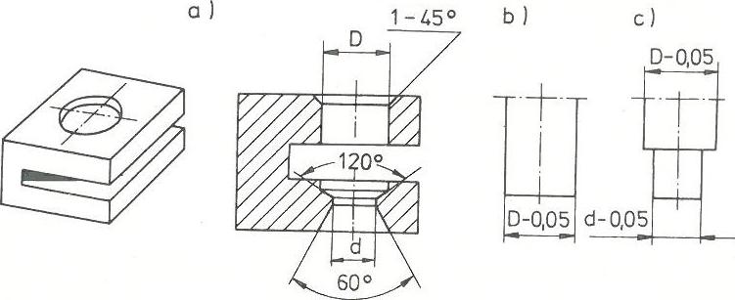
A device for cutting rivet washers
a) die, b) washer cutter, c) hole cutter
Notes:
The rivet washer die is also a tool used in boatbuilding and useful in building a boat. The die of rivet washers should be made of steel and hardened. Two punches should also be made for the die, one of which is used to cut the washer itself, and the other to punch a hole in it and give it a cup-shaped shape. The sheet is inserted into the slot in the die, then the first punch is used to cut the washer, and then the second cutter to cut the hole in the washer. The washer must have a concave shape and an outer diameter approximately four times the diameter of the rivet, and the hole in it must be such that the rivet passes through it tightly. The tool for cutting rivet washers is presented in Figure.
A device for cutting rivet washers was presented in Figure. On that figure can be specified: a) die, b) washer cutter, c) hole cutter

Slide 22
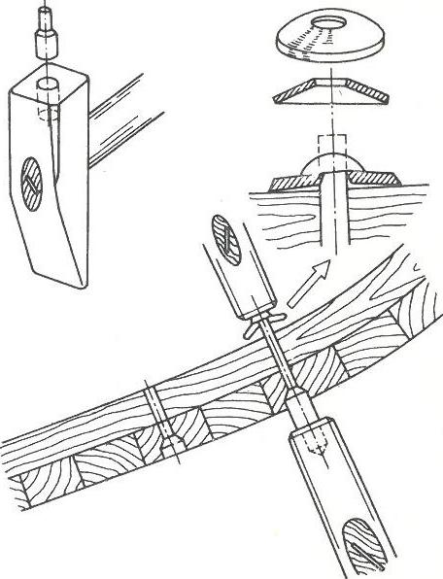
Riveting of wooden elements
a) tapping litter;
b) riveting proces
Notes:
To improve the riveting process, it is worth making one more tool, the so-called a hammer-tapping block that is used to hold the rivet head while riveting. This device is made with an ordinary hammer, whereby it must first be quenched by heating to a high temperature and put aside for some time to cool slowly. In the hammer head, drill a hole with a diameter of 10-15 mm (depending on the diameter of the rivet head) and a depth of about 30 mm. Then, the tapping block itself should be bored with an outer diameter equal to the hole in the hammer, and the other end of the tapping block should be rolled to the diameter of the rivet head. The tapping block is pushed into the hole in the hammer and it is ready for riveting.
The Riveting of wooden elements was presented in Figure.
On that figure can be specified: a) tapping litter; b ) riveting proces
Riveting (e.g. of the sheathing) is performed in such a way that the frame and the sheathing are first drilled through with a bit smaller than the rivet's diameter, and then from the outside with a bit slightly larger than the rivet head. The drilling depth should be 3-6 mm. From the sheathing side, hammer the rivet, put a washer from the inside and pull out the free end of the rivet as far as it will go. One person places a hammer-tapping block under the head of the rivet, and the other person uses a hammer to tap the free end of the rivet. The flattened end of the rivet and the straightening pad pull the joined elements together.

