Slide 1
Ship joining, assembly and caulking (WULS)
Module 4
WULS
Warsaw, 1st December 2021
Notes:
In this module was prepared as part of the All Hands On Deck (AHOD) project, activity IO2A3.
The substantive transmission of the manual is the absolute minimum of sailing knowledge necessary to build a small boat in workshop conditions.
This portion of the message should be assimilated by every hobbyist of sailing.
This is also what every enthusiast of this sport should know to understand roughly the principles of sailing boat construction.
Every sailing enthusiast should improve their skills, looking for the best technique for building their dream boat.
This can be learned in two ways: either through painstaking practice or from public experience. For those who prefer the desire to acquire reliable knowledge over to the written word, further chapters are intended.

Slide 2
Unit 9. Knowledge about influence of aggressive marine environment on joints - corrosion
2 hour
Notes:
In this chapter we can learn how to protect ship structure elements against aggressive influence of sea water. Additionally, we will know what to do when corrosion attacks the boat, especially metal connections.

Slide 3
Corrosion
Agenda
Introduction
What areas of a boat or ship are most vulnerable to seawater?
Galvanic corrosion
How to avoid corrosion? – practical information
Corrosion inhibition
Factors affecting the efficiency of corrosion inhibitor
Recapitulation
Notes:
Brittle oxide layer repeatedly undergoes exfoliation thereby re-establishing the metal-acid contact resulting in the severe dissolution of the metal surface, leading to strong corrosion. Upon coming into contact with non-oxidizing acids (e.g., HCl) steel reacts to form Iron salts (II) (e.g. FeCl₂) as a corrosion product. Likewise, steel encounters corrosion attack in contact with H₂SO₄ leading to the formation of FeSO₄.

Slide 4
Corrosion
Introduction
Steels and its alloys are amongst the most widely used industrial materials.
These materials suffer from extensive corrosion damage upon encountering acidic environments.
In the presence of oxidizing acids such as HNO₃, steel reacts to form an oxide layer (e.g. Fe(NO₃)₃) on the metal surface. This layer initially prevents metal-acid contact to avoid a further reaction.
Notes:
Brittle oxide layer repeatedly undergoes exfoliation thereby re-establishing the metal-acid contact resulting in the severe dissolution of the metal surface, leading to strong corrosion. Upon coming into contact with non-oxidizing acids (e.g., HCl) steel reacts to form Iron salts (II) (e.g. FeCl₂) as a corrosion product. Likewise, steel encounters corrosion attack in contact with H₂SO₄ leading to the formation of FeSO₄.

Slide 5
Corrosion
What areas of a boat or ship are most vulnerable to seawater?
When we think of wooden boat restoration, sanding and carpentry probably immediately come to mind, but when the time comes for repairs, it is usually not the wood itself that causes the problems. Instead, it is the corrosion of metals that causes problems.
Notes:
Structural damage most often occurs in the areas between wood and metal.
The rust from the iron rivets forces plugs in the bottom out.
The wood turns black and softens when in contact with rusty steel frames and stem bolts.
Sometimes you come across mahogany planking in good condition in a 50 cm (1.5-foot) section, and then there's a poor section that is almost coming apart near the steel frame. Iron keels corrode and destroy the wood keel. Keel bolts rust. Propellers and shafts corrode, and support trestles and other parts of the propeller fold. This corrosion is the result of moisture and wear, and the progression is slow and sneaky.

Slide 6
Corrosion
Electrolysis onboard increases risks
It is possible that we will see an increasing problem with galvanic corrosion on our boats since we have, for our convenience, increased the use of electricity on board.
The last twenty-year period has been an electronic age when it comes to gadgets and accessories.
We dragged more and more of our home environment onboard—electronics, stereos, TVs, refrigerators, pressurized water—along with what we already had: old lights and, for some wooden boats, the indispensable electric pump.
In order to get these to work, we need land-voltage installations and sometimes solar panels.
Notes:
This can lead to corrosion problems, which you can read quite a bit about in boating magazines. It is similar to electricity from the shore where there is poorly execute grounding of the pier's electrical system that can cause stray currents. There is talk of some marinas where the water is live with electricity from such stray currents.

Slide 7
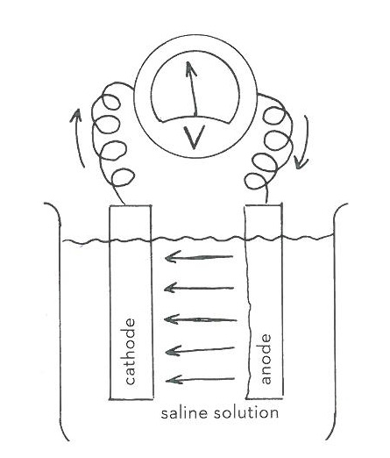
Corrosion
Galvanic corrosion
The principle of galvanic corrosion is shown in schools with the experiment of lowering two metals into a bowl of salt solution and then connecting the metals with a cable (this created a simple battery).
Notes:
Two metals are immersed in an electrolyte and form a battery. The metal that has lower electrical potential becomes the anode, and the one that has more is the cathode. When they are connected through the electrolyte, ions migrate from the anode to the cathode. A galvanic cell has been formed, and the anode is consumed over time.

Slide 8
Corrosion
Galvanic corrosion
Galvanic corrosion doesn't happen with more noble metals. One can thus use a base metal as cathode protection.
The galvanic voltage chain shows the difference in potential between the metals.
The greater the voltage difference, the stronger the battery.
In these days of plastic boats, you are advised to use zinc anodes to protect other metals on board.
In the case of wooden boats, other chemical reactions take place.

Slide 9
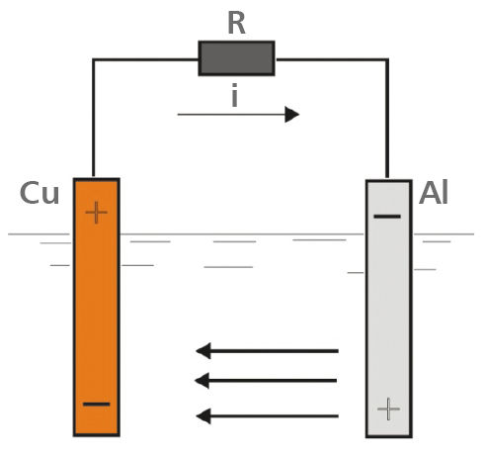
Corrosion
Galvanic corrosion
The phenomenon of corrosion can be very serious, leading to the formation of even holes in the yacht sheathing, joints and propulsion elements.
This is prevented by using the so-called passive or active electrochemical protection.
Passive protection consists in placing a zinc (or magnesium) anode in the ion stream (e.g. near the screw) when protecting aluminum elements.
Then there is a flow of ions from zinc, i.e. a less noble metal, to copper, i.e. a more noble metal, as a result of which the zinc anode is destroyed after some time (material losses appear in it), protecting the steel hull or steel elements of the hull made of materials other than steel .
Source: PL Bulletin of Yacht Technology No. 7/2020
https://btj.com.pl/2020/11/23/korozja-kadlubow-jachtow-i-ich-wyposazenia/
Notes:
As shown in the figure, the current flows under water from the anode (+) aluminum bar to the copper bar, i.e. to the cathode (-). Above the water, from the copper ingot, which this time acts as an anode, to the aluminum ingot, which is the cathode above the water. The current flows only when the circuit is closed, and therefore in real conditions when it is closed somewhere inside the yacht by conductive elements. This is the case, for example, when a steel or aluminum hull is equipped with e.g. a propeller made of a more noble material than steel or aluminum, a propeller shaft made e.g. of bronze or Monel. The phenomenon of electrochemical corrosion occurs not only when the hulls are made of steel or aluminum, but also when there are elements made of steel or aluminum installed in wooden or laminated yachts under the water.

Slide 10
Corrosion
Electrochemical attack of wood
Pure water does not conduct electricity well; lake water does slightly better, while salty ocean water is a good conductor good electrolyte.
When two different metals, such as copper and iron, are immersed in salt water and joined with a pipe, you have a galvanic element.
An electric current with a voltage of 0.3 volts (the difference between copper's 0.3 volt and iron's 0.6 volt) passes through the connection, and salt undergoes electrolysis.
The more noble metal-copper-becomes the cathode, and the base metal-iron-becomes the anode.
During electrolysis, sodium hydroxide, a "caustic soda," is formed at the cathode, and at the anode, chlorine ions are released and unite with the anode metal, which corrodes, and new metal salts are formed.
Notes:
In a hull that is allowed to take in salt water, the wet wood works as the saline solution in the example from the school experiment, and the caustic precipitation is concentrated in the wood around the copper bolt, and iron ions are formed around the iron bolt. The caustic soda and the ions cause the wood to dissolve. The dissolution is faster on the caustic side.

Slide 11
Corrosion
Galvanic supply chain (to ocean water)
← Base metals—anode—corrodes /Noble metals—cathodes—protects→ | Metal | Voltage
 | Titan | +0.06 to -0.05
 | Stainless A4 (passive) | 0.00 to -0.10
 | Monel 400
 | (70% Ni and 30% Cu) | -0.04 to -0.14
 | Silicon bronze | -0.04 to -0.14
 | Stainless A2 (passive) | -0.05 to -0.10
 | Silver | -0.09 to -0.15
 | Nickel 200 | -0.10 to -0.20
 | Stainless A4 (active) | -0.18 to -0.54
 | Nickel bronze
 | (70% Cu and 30% Ni) | -0.18 to -0.23
 | Lead | -0.20 to -0.30
 | Copper (Cu) | -0.30 to -0.40
 | Brass | -0.30 to -0.40
 | Tin | -0.31 to -0.33
 | Aluminum bronze | -0.31 to -0.40
 | Stainless A2 (active) | -0.46 to -0.58
 | Cast iron, steel | -0.6o to -0.71
 | Aluminum alloy | -0.71 to -1.0o
 | Zinc, galvanized steel | -0.98 to -1.03
 | Magnesium | -1.60 to 1.63
Notes:
In a hull that is allowed to take in salt water, the wet wood works as the saline solution in the example from the school experiment, and the caustic precipitation is concentrated in the wood around the copper bolt, and iron ions are formed around the iron bolt. The caustic soda and the ions cause the wood to dissolve. The dissolution is faster on the caustic side.

Slide 12
Corrosion
Weakening of the nail joints
This problem is called nail sickness in England, and is often forgotten in the discussion of corrosion. There are severe attacks on mahogany and oak where steel floors and steel frames have been fastened with bolts or rivets of copper or copper alloys.
The reason for such damage is the interaction of zinc and steel, which increases the voltage difference.
The voltage difference between steel and copper is 0.3 volts, and between zinc and copper it is 0.7 volts.
It happens that deep corrosion pitting can be seen in the undergrowth, which is only twenty-five years old. Such a weakening of the material can result in the knife being easily stabbed into a 2.5 cm thick plank.
Notes:
Different woods have different resistances to electro-chemical effects. Coniferous wood has greater resistance than deciduous.
Among deciduous wood, teak is the most resistant, while mahogany and oak are worse.
When it comes to oak, the attacks are also affected by the fact that oak is corrosive to metals-it has a low pH value and contains tannins.

Slide 13
Boat/yacht corrosion
Wood's corrosiveness
Most woods contain acids; the most common is acetic acid, which ultimately seems to degrade metal attachments.
Moisture increases corrosiveness.
Most woods have a low pH.
Conifers that can withstand electrochemical attacks better cause metal corrosion because of their acidity.
Oregon pine is well known for its discoloration with iron because it is corrosive to iron.

Slide 14
Boat/yacht corrosion
PH – levels in wood
Wood | pH value
Oak | 3.35-3.9
Oregon pine | 3.45-4.2
Larch | 3.45-4.2
Pine | 3.45-4.2
Teak | 4.0
Elm | 4.0
Spruce | 4.65-5.45
Norway spruce | 4.65-5.45
African mahogany | 5.1-6.65
Iroko | 5.4-7.25
Source: John Keaton/Mersey Side Maritime Museum, 1992

Slide 15
Boat/yacht corrosion
Corrosion properties of common metals
Iron and steel corrode easily; hot galvanization gives a longer life span.
For a long time, iron was the most commonly occurring metal on boats and also the biggest source of problems.
In older boats and in workboats, they often used forged steel, and it has better corrosion properties than today's commercial steel.
If the forged steel bolts were burnt with tar, the result was a corrosion-resistant bolt, which had good properties in relation to wood.
Notes:
Nowadays, mostly stainless steel is often used when the iron needs to be replaced during renovation. Copper fares well; you rarely encounter bad copper rivets. In the 195os and 1960s, they used mold protection with copper salts in the wood that corroded the copper rivet; the rivets weakened, and the wood around the rivets became greenish.

Slide 16
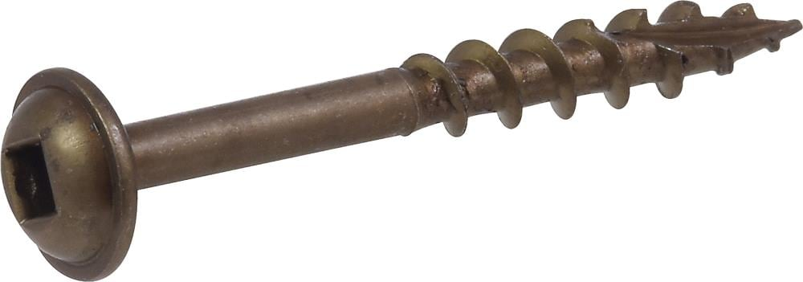
Boat/yacht corrosion
Corrosion properties of common metals
Bronze is an alloy of copper and one or more other metals.
Bronze alloys of copper and silicon, nickel, or tin are good.
Magnesium bronze is worst, from a corrosion standpoint.

Slide 17
Boat/yacht corrosion
Corrosion properties of common metals
Brass is an alloy of copper and zinc, usually with 30-50% zinc.
Over time, especially in ocean water, zinc and copper leach, and a weakened hollow copper remains.
The screw heads come off when the screws are taken out.

Slide 18
Boat/yacht corrosion
Corrosion properties of common metals
Stainless steel has a unique position, and in England it is not recommended underwater in boats because stainless steel appears in two places in the voltage chain:
first, as the most noble metal in its passive form,
second, between iron and brass in its active form.
The passive form is when the stainless steel has a protective oxide layer, which is obtained by polishing.
The active form is obtained under the worst conditions for stainless steel, which are a damp, salty, deoxygenated environment, such as keel bolts that are trapped in humid salty wood—no oxide is formed here.
Notes:
The quality of the stainless is important; in Sweden, the quality used is A4 rust-free, acid-free steel with 3% molybdenum interference: sis 2343. It is the best quality for these conditions. A2, sis 2333, is used more abroad, but also sometimes here in Sweden.

Slide 19
Boat/yacht corrosion
Corrosion properties of common metals – tests
At a test in England in which stainless steel was left in still-standing salt water ¼ 1/64-inch (o.66-mm) corrosion holes were found after 300 days in the A2, while the A4 had an average of 1/128-inch (0.3-mm) holes after 1,500 days.
The Baltic Sea's low salinity should not be a problem for stainless steel; on the Swedish west coast, you have to be more attentive.
Use A4 below the waterline, and on oak A2 can be used underneath glued plugs on the deck.
Aluminium is not a common metal in wooden boats. The metal requires very specialized knowledge to be used safely in corrosive environments. Aluminium masts are the most commonly used, so then the base metal is protected with anodizing.

Slide 20
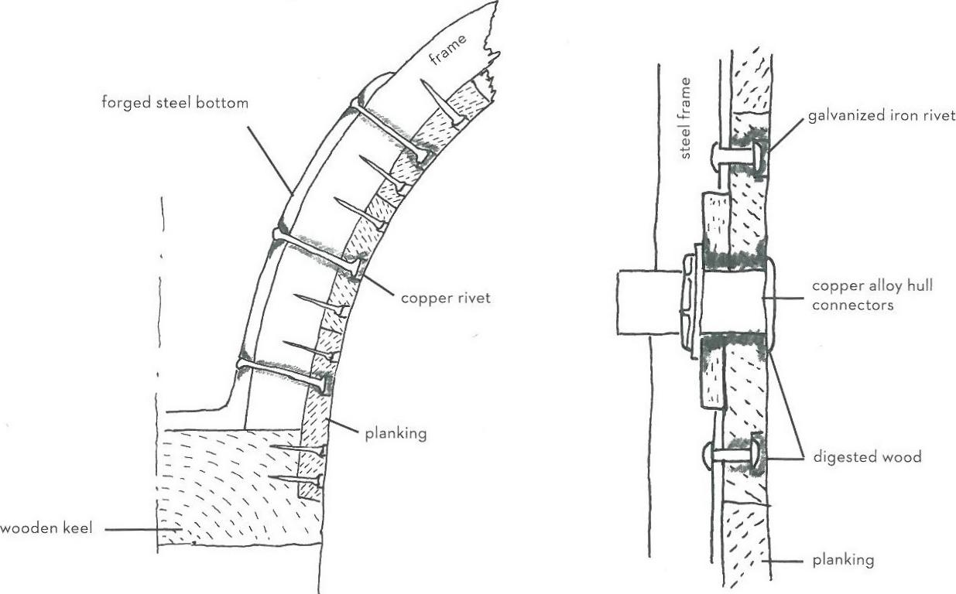
Boat/yacht corrosion
Corrosion properties of common metals
Notes:
The figure shows the effects of an electrochemical attack on wood when joining different metals. Moisture has penetrated through the copper rivet and has led to caustic precipitation of the copper rivet as well as corrosion and iron salt attacks on the steel.

Slide 21
Boat/yacht corrosion
Corrosion properties of common metals
Notes:
Electrochemical attacks occur even if the metals are not joined. Even though the copper alloy hull connectors and the steel frame with its rivets aren't attached, there are still electrochemical effects when the wood becomes conductive via moisture.

Slide 22
Boat/yacht corrosion
How to avoid corrosion?
– practical information

Slide 23
Boat/yacht corrosion
Avoid mixing metals
Mixing of different metals should be avoided in order to avoid galvanic problems.
During renovations, the appropriateness of using different materials—such as stainless steel screws in galvanized steel frames—is often discussed.
It is almost impossible to get hold of hot-dip galvanized rivets of good quality, and the remaining galvanization in the ribs is not sufficient to prevent corrosion of the riveted end of the rivets.
I think that Aq. screws are the best option.
If you use different metals together, you need to avoid direct contact by isolating the metals from each other; dip the screw in some kind of sealant and use a nylon washer under the nut.
Notes:
The oxide layer on the stainless steel results in less galvanic corrosion in stainless steel when coupled to base metals in salt water than what the difference in power potential would allow. Stainless steel is, of course, a much poorer electrical conductor than copper. Stainless steel in contact with a base metal is also subject to less risk of becoming active and corroding.

Slide 24
Boat/yacht corrosion
Avoid mixing metals
The poor conductivity of stainless steel may be one reason that, in practice, there are fewer examples of electrochemical attacks—meaning caustic precipitation on wood—with stainless bolts than with copper bolts.
A test of jointed metals that were placed in salt water shows that there is a potential difference in the voltage chain without stability and conductivity that affects the amount of corrosion.
Notes:
The oxide layer on the stainless steel results in less galvanic corrosion in stainless steel when coupled to base metals in salt water than what the difference in power potential would allow. Stainless steel is, of course, a much poorer electrical conductor than copper. Stainless steel in contact with a base metal is also subject to less risk of becoming active and corroding.

Slide 25
Boat/yacht corrosion
Avoid mixing metals
Mutual interaction of steel and other metal | Corrosion of steel in mm per year | Difference in voltage according to the galvanic voltage chain
Steel on steel | 0.79 mm | 0 volts
Steel on stainless | 0.91 mm | 0.57 volts
Steel on titan | 1.07 mm | 0.48 volts
Steel on copper | 2.54 mm | 0.41 volts
Source: Nigel Warren, Metal Corrosion in Boats, 1991

Slide 26
Boat/yacht corrosion
Practical tips on how to diagnose an electrochemical attack
Keep an eye on the galvanic and the electrolytic effects on surface treatment and wood.
The initial signs are the varnish and paint softening and flaking over the copper rivets.
When the damage has gone further, the wood whitens and becomes porous and cracks from the plug-hole.
Rusty iron rivets with soft wood around them is also a clear sign.
With litmus paper you can also detect the presence of lye and acid, which color the paper blue and red.

Slide 27
Boat/yacht corrosion
How can you prevent the attacks?
Keep the wood as dry as possible.
Good maintenance with a well-oiled bottom and a dense layer of red lead paint or primer prevents moisture penetration.
The bottom paint is not very dense and cannot be included in this layer.
Touch up any cracks in the paint layer with primer each year.
Make sure the boat is well ventilated; let in air through the vents, and leave all shutters ajar when leaving the boat.
Keep the bilge water at the lowest possible level. Sometimes you may need a float switch for the electric pump.
Notes:
Replace plugs that are coming undone. If there is a rusty iron rivet underneath then exchange it for a stainless steel bolt and nut at the same time. Glue the new plug with epoxy and allow the plug to be at least 3/16" (5 mm) thick. When boats were first built, rivets and screws on the bottom were often caulked over with putty, but the putty cracked over time. Polyester putty such as Plastic Padding is not very waterproof and should be avoided.

Slide 28
Boat/yacht corrosion
Review the electrical system
Stray currents increase electrochemical attacks greatly.
An electrical system in a wooden boat that is exposed to moisture will be safer if it is 2-polar.
This means that all appliances that use electricity—everything from light bulbs to the refrigeration compressor—should have insulated positive and negative wiring; the housing must not be connected to a negative charge.
This is in contrast to a car that has negative charge on its body.
Notes:
Often you see discoloration behind old fixtures where the negative charge was on the cover against the wood, and then when the wood gets wet it allows a current to flow when the circuit is closed, and the light is turned on.

Slide 29
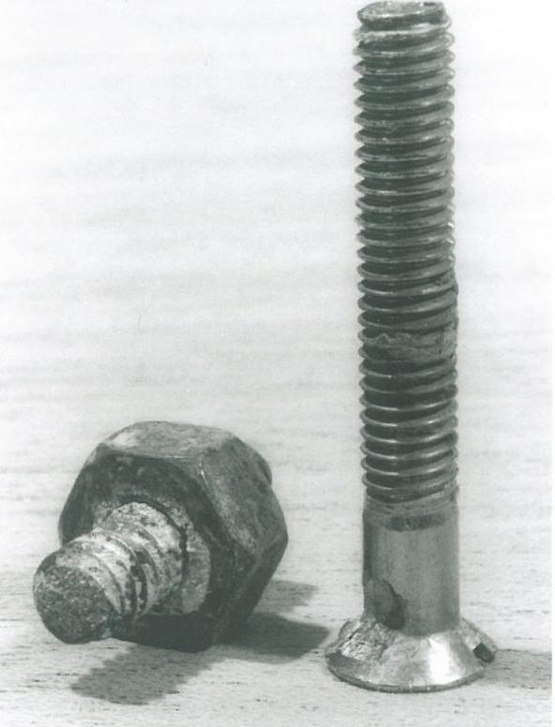
Boat/yacht corrosion
Corrosion and burns
Corrosion and burns in an eight-year-old stainless steel bolt and crystalline surface fractures of a forty-year-old stainless steel screw.

Slide 30
Boat/yacht corrosion
Review the electrical system
There is a system called bonding that combines an entire large metal board with a ground wire that is "connected to" a zinc anode on the outside of the hull.
The zinc anode prevents corrosion of the other metals on board, but if the contacts are broken, through carelessness or oxidation of the couplings, the electrochemical attacks will increase, as the dissimilar metals are no longer connected to the sacrificial anode.
The risk also increases if the boat's power system (usually on the negative side), due to ignorance, is grounded.

Slide 31
Boat/yacht corrosion
Review the electrical system
There is a system called bonding that combines an entire large metal board with a ground wire that is "connected to" a zinc anode on the outside of the hull.
The zinc anode prevents corrosion of the other metals on board, but if the contacts are broken, through carelessness or oxidation of the couplings, the electrochemical attacks will increase, as the dissimilar metals are no longer connected to the sacrificial anode.
The risk also increases if the boat's power system (usually on the negative side), due to ignorance, is grounded.

Slide 32
Boat/yacht corrosion
Fitting anodes
When you take your boat out of the water, you are looking for good amounts of corrosion on the anode, which means it is working.
No corrosion means you have a problem with bonding. If it has corroded more the 50%, however, the anode isn’t big enough and you’ll need to replace it with a larger one.
To take off the anode, remove the 15mm nuts and slide the anode off the studs.
When you put the new anode on, replace the spring washers as these lock the anode on, and use a drop of Locktite to keep the nuts in place.
Notes:
Don’t forget to put the supplied sponge mat between the boat and the flat surface of the anode as this protects the hull when the anode corrodes. There will also be an anode on the prop shaft or on the sail drive. Again, these need to be large enough that they don’t corrode over 50% in the time the boat will be afloat. Make sure the two halves of the shaft anodes are snugged up to a clean shaft, and the screws secured with Locktite.
Don’t forget other metal underwater fittings, such as rudder skeg shoes or refrigerator plates, which often have their own anodes, and some engines also include anodes inside the raw-water cooling system that will need changing.

Slide 33
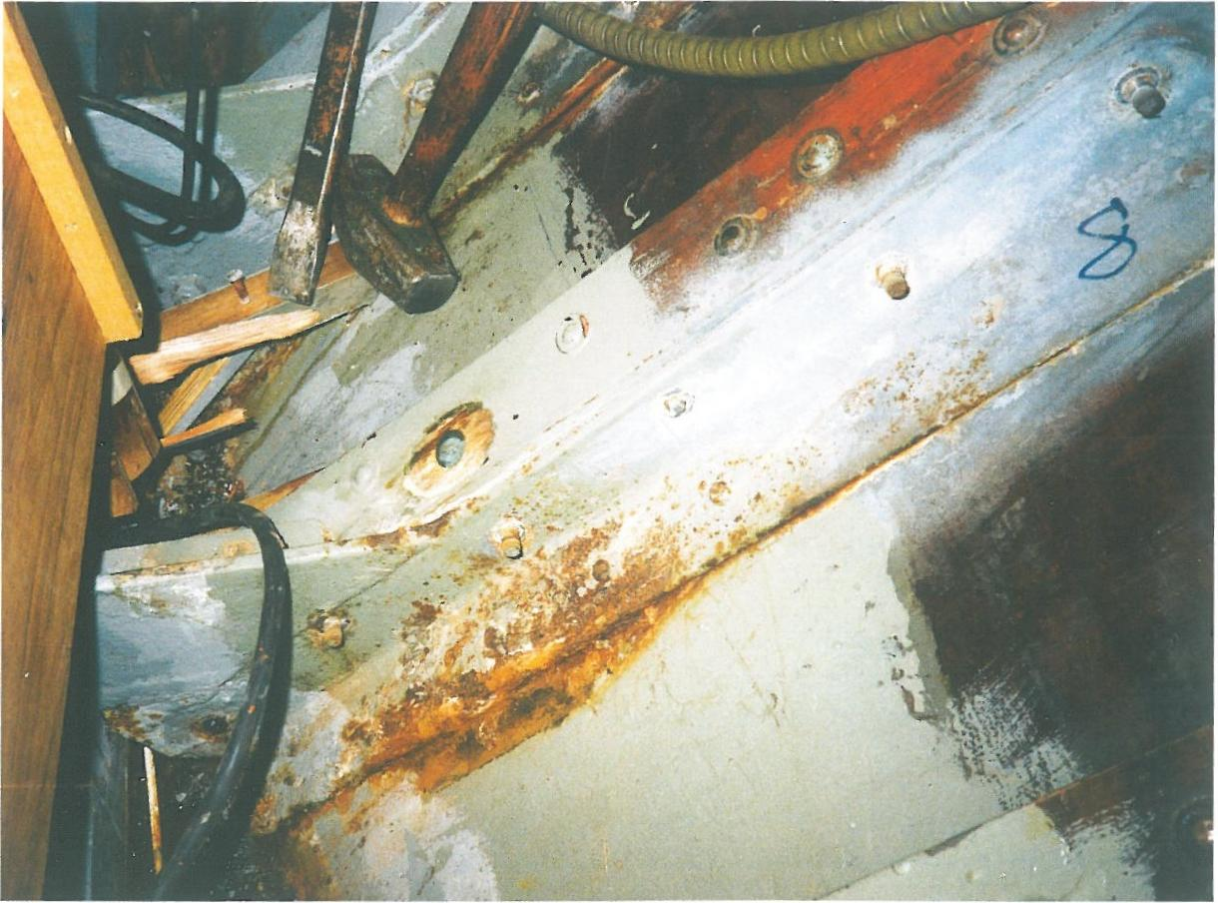
Boat/yacht corrosion
Results of corrosion
For many zinc anodes relative to the need also increases the voltage differences and thereby increase the electrochemical attack on wood.

Slide 34
Boat/yacht corrosion
How corrosion inhibitors work?
What Are Corrosion Inhibitors?
A corrosion inhibitor is a substance applied to an environment that significantly reduces the corrosion rate of materials (especially metals) exposed to that environment.
It is considered „the first line of defense” against corrosion.

Slide 35
Boat/yacht corrosion
How corrosion inhibitors work?
Types Of Corrosion Inhibitors
Anodic Inhibitors
This type of corrosion inhibitor acts by forming a protective oxide film on the surface of the metal. It causes a large anodic shift that forces the metallic surface into the passivation region, which reduces the corrosion potential of the material. Some examples are chromates, nitrates, molybdates, and tungstate.
Cathodic Inhibitors
These inhibitors slows down the cathodic reaction to limit the diffusion of reducing species to the metal surface. Cathodic poison and oxygen scavengers are examples of this type of inhibitor.
Mixed Inhibitors
These are film-forming compounds that reduce both the cathodic and anodic reactions. The most commonly used mixed inhibitors are silicates and phospates used in domestic water softeners to prevent the formation of rust water.

Slide 36
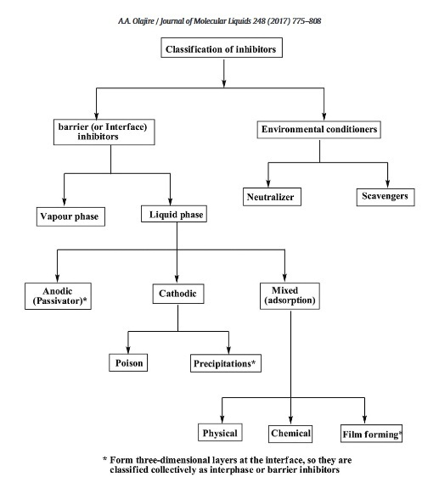
Boat/yacht corrosion
Corrosion inhibition
Metal joint components that have been "infected" by corrosion can be saved by the use of various types of inhibitors.
Source: Olajire, A. A. (2017). Corrosion inhibition of offshore oil and gas production facilities using organic compound inhibitors - A review. Journal of Molecular Liquids, 248, 775–808. doi:10.1016/j.molliq.2017.10.09
Notes:
On metal parts that have already been infected by corrosion you can apply a chemical preparation called rust neutralizer. It penetrates the structure of iron oxides and hydroxides, transforming the structure of rust from completely unstable to one in which further oxidation processes do not occur. The agent is a mixture of organic and inorganic acids that react with rust and not only cover it as it is the case with epoxy resin products.
The product passivates corrosion products into a completely stable form. It stops the rusting process completely. Neutralizer should only be applied on rust. It cannot be used as a protective agent. Rust neutralizer works great in wet conditions. It can be applied to boats, ships, cars, closed profiles.

Slide 37
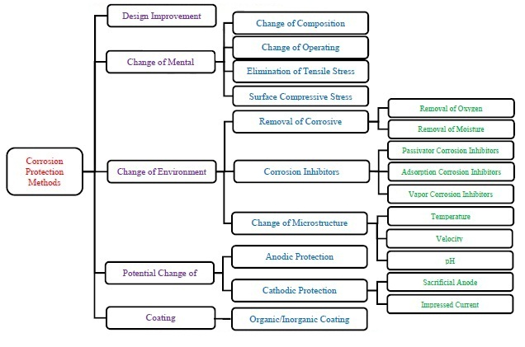
Boat/yacht corrosion
Available corrosion protection methods
HongyuWei, Heidarshenas, B., Zhou, L., Hussain, G., Li, Q., & Ostrikov, K. (Ken). (2020). Green Inhibitors for Steel Corrosion in Acidic Environment: State-of-art. Materials Today Sustainability, 100044. doi:10.1016/j.mtsust.2020.100044

Slide 38
Boat/yacht corrosion
Factors affecting the efficiency of corrosion inhibitor
The corrosion inhibition efficiency (η%) is defined as the ability of an inhibitor to reduce the corrosion rate. It can be derived according to the weight loss values and corrosion rate as follow:
W_{int} and W_{fin} are the initial and final weight of the metallic specimen, respectively.
C_{R}⁰ and C_{R}^{i} are the corrosion rates in the absence and presence of inhibitor molecules, respectively.
Notes:
The corrosion inhibition efficiency of inhibitors depends on several factors including the nature of the corrosive environment, inhibitor concentration, electrolyte temperature, and exposure time to the electrolyte. The efficiency of inhibitors usually increases with concentration. However, after exceeding a specific limit, further increment in the concentration does not influence the corrosion inhibition. This limit is dependent on many variables like the nature of the electrolyte, type of inhibitor, and temperature. At the beginning of the adsorption process, inhibitors tend to be adsorbed on the metal surface in flat or horizontal orientations resulting in increased surface coverage thereby increasing the inhibition efficiency. However, after exceeding an optimum limit, a further increase in the inhibitor’s concentration leads to inter-molecular repulsion. This results in vertical or non-planar adsorption of inhibitor’s molecules on the metal surface thereby having no tangible improvement in the inhibition efficiency.

Slide 39
Boat/yacht corrosion
Recapitulation
Boats will not disappear because of electrochemical attacks on wood that result from mixing metals, but their life span decreases.
A metal construction or a rail of aluminium, however, under unfortunate circumstances, can corrode and collapse in a relatively short period of time if a proper sacrificial anode is not provided.
An increased knowledge of problems with electrochemical attacks allows you to avoid unnecessary mistakes.
Notes:
The electrolyte temperature has a considerable impact on the inhibition efficiency. At room temperature, an inhibitor forms a protective film through physical or chemical adsorption on the metal surface. However, at a higher temperature, the chemisorption mechanism is prevalent whose rate linearly increases with the surrounding temperature; as a result, the rate of forming a protective film increases thus correspondingly enhancing the corrosion inhibition.

Slide 40
Stay safe!

Slide 41
WULS

