Slide 1
Module 7 - Business
Topics of the module:
Boatbuilder perspective: costs and materials
Sales and purchase of ships
The best ways to get money from your boat

Slide 2
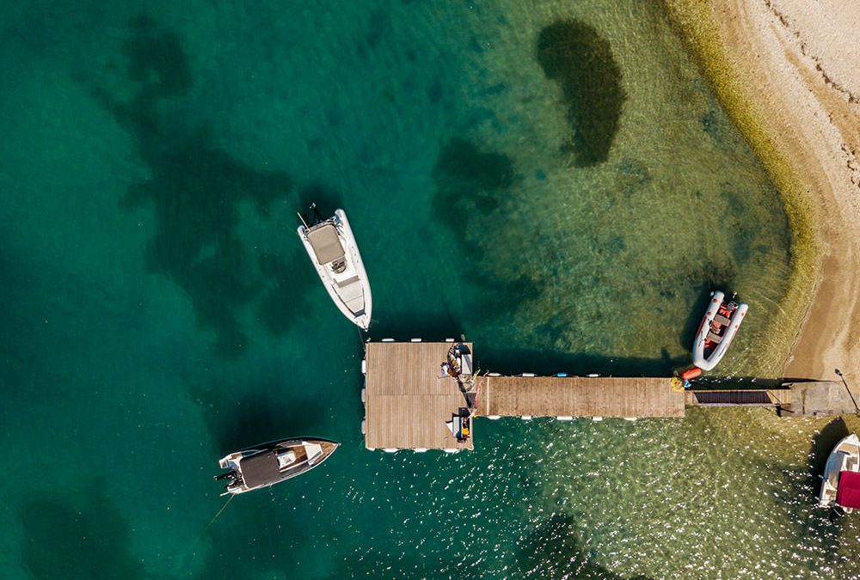
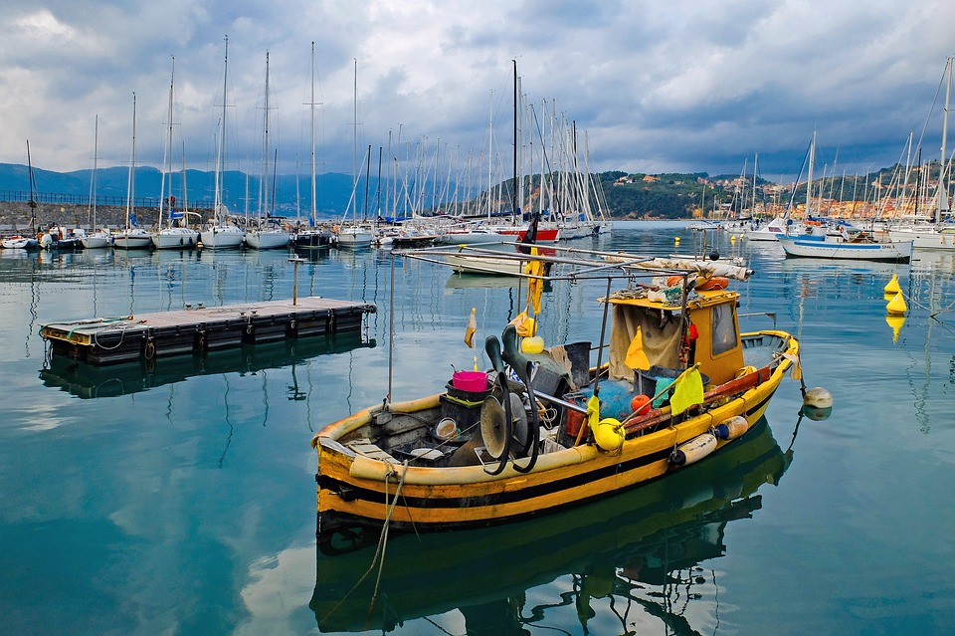
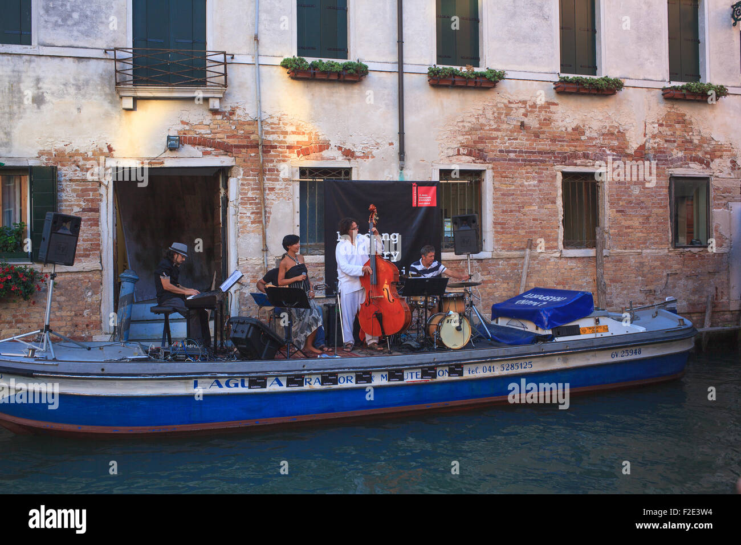


ALL HANDS ON DECK Module 7 - Business
Introduction to the module 7
Business
1. Boatbuilding: materials and costs
2. Sales and purchase of a ship
3. Ways to earn money from your boat

Slide 3
ALL HANDS ON DECK Module 7 - Business
1. Boatbuilding
Introduction: materials and costs
If you want to design a boat or build it from scratch, you must choose tools and materials tailored to your project.
Estimating costs, time and the amount of technology that fits better with your purpose, together with strong motivation, it’s certainly one of the first step you should take for a successful project.

Slide 4

ALL HANDS ON DECK Module 7 - Business
1. Boatbuilding
Materials
Wood is the traditional boat building material used for hull and spar construction. It’s widely available and easily workable. It is a popular material for small boats (such as dinghies and sailboats).
Wood abrasion resistance varies according to the hardness and density of it; also, it can deteriorate if penetrated by freshwater or marine organisms.

Slide 5
ALL HANDS ON DECK Module 7 - Business
1. Boatbuilding
Materials
Fiberglass, Ferrocement and other composite materials are usually less expensive but not the best choice if you want to built your boat from scratch in a crafty and environmental respectful way.
For boats until 8 metres the choice of wood is for the amateur an almost obligatory choice: iron and ferrocement are not suitable for small sizes, aluminum requires sophisticated processing techniques, as for fiberglass, it is penalized by the unpleasantness of the work.

Slide 6
ALL HANDS ON DECK Module 7 - Business
1. Boatbuilding
Recycled materials: plastics
Plastics can be used to build a boat entirely or many parts.
This paper from Qi Fang, Mélanie Despeisse and Xiaoxia Chen, Environmental Impact Assessment of Boatbuilding Process with Ocean Plastic, shows us a sustainable manufacturing process to build boats by recycled plastic from Ocean waste.

Slide 7




ALL HANDS ON DECK Module 7 - Business
1. Boatbuilding
Useful materials
Backing and Support Plates
Wood and Fibers
Core Materials and Vacuum Bagging Materials
Teak
Balsa
Non Skid Pads
Boat Paint
Paint Flake

Slide 8

ALL HANDS ON DECK Module 7 - Business
1. Boatbuilding
Top tip
This short manual will help you through all the phases of boatbuilding, from the design to the implementation.

Slide 9
ALL HANDS ON DECK Module 7 - Business
1. Boatbuilding
Costs
Design and 3D printing: new green Fibers or recycled PET could be used to print out your model or simply a part of your boat.
Access costs to this technology are quite high but not unaffordable if you only need a standardized part or module.
Check this video out: https://www.youtube.com/watch?v=jphG9n8nUSU

Slide 10
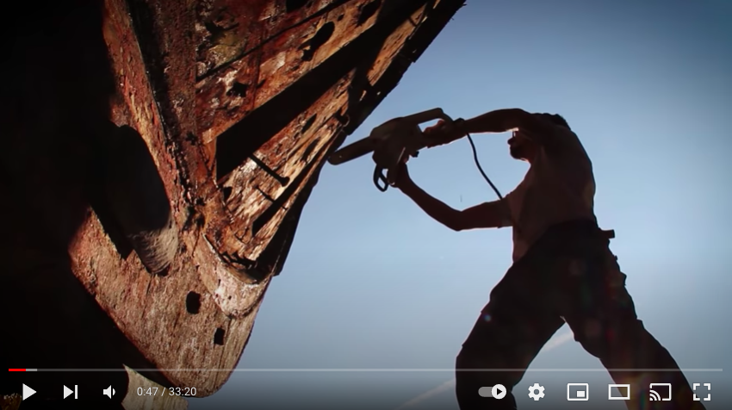
ALL HANDS ON DECK Module 7 - Business
1. Boatbuilding
Costs
Manual craft work: overall this is usually less expensive but highly time consuming.
Check this video out and see how amatour boatbuilders deal with wood processing: https://www.youtube.com/watch?v=NtQDbJXh1oY

Slide 11


ALL HANDS ON DECK Module 7 - Business
1. Boatbuilding
Costs and efforts
Talking of a classical craft project, to get an idea of the time you need to build a 7 meters 30.000 € (market value) boat - if you work only on weekends - it would be 15 hours a week-end.
So it would take from 16 months to 2 years to complete the work, depending on your skills and experience.

Slide 12

ALL HANDS ON DECK Module 7 - Business
1. Boatbuilding
Costs
Costs can also vary if you decide or not to buy a Kit, assembly box that includes all building materials - pre-cut wood or plywood pieces, masts, sail equipment and sails - which greatly simplifies the work. The time savings compared to an integral construction can be estimated between 15 and 25%.

Slide 13

ALL HANDS ON DECK Module 7 - Business
1. Boatbuilding
Video
- In the interview below you can find useful pieces of information on the planning phase, materials and techniques to use in boat building.
https://www.youtube.com/watch?v=_OgmbEfr0ZQ

Slide 14
ALL HANDS ON DECK Module 7 - Business
2. Sales and purchase of ships
Introduction to the theme
There’s a lot to consider when purchase a boat in Europe.
We explain how to go about finding a reputable seller and what to expect during the buying process.
The first thing to decide when buying a boat in Europe is whether you’re going to use a broker or purchase the boat through a private sale. In some cases you may not get a choice depending on the type of boat you’ve found and where it’s being advertised.
There are different things to consider with private or commercial sales in order to make sure you’re covering all the necessary points and avoid common pitfalls.

Slide 15
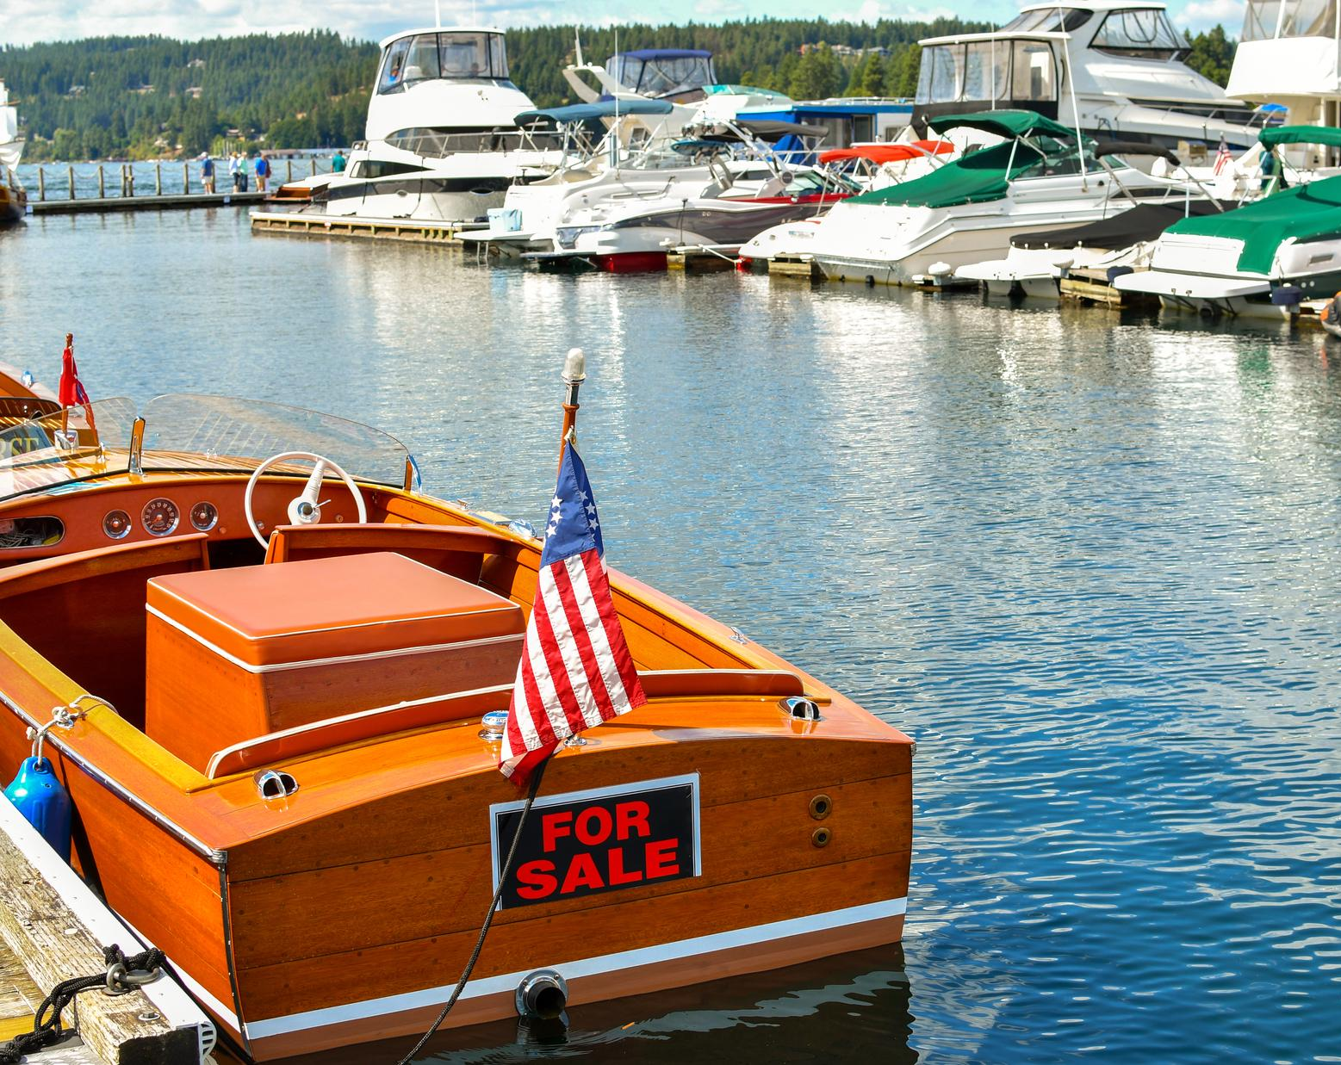
ALL HANDS ON DECK Module 7 - Business
2. Sales and purchase of ships
Using a broker
The most important thing you can do when choosing a broker is to ensure that they are a reputable yacht brokering business.
You don’t want to fall in love with a boat, only to find out that the broker doesn’t have any of the title paperwork, or does not produce an adequate sale contract to govern the sale.
And when it comes to deposits, you want to feel confident about who you’re handing your money over to, as the lawyers specializing in yachting sale and purchase of ships explain.

Slide 16
ALL HANDS ON DECK Module 7 - Business
2. Sales and purchase of ships
Using a broker
Yachting Lawyers are people that take care of all the legal and business aspects of boat ownership and operation. Protecting you, your boat and your business, helping to minimise the risks associated with boat ownership, which saves you time and money in the long run.
You need to contact lawyers who specialize in the field for help and advice on the following matters:
- Boat Sale / Purchase Transactions
- EU/(UK) Boat Registrations & Offshore Flagging
- Boat Finance Help and Advice
- Pleasure Craft Insurance Advice

Slide 17

ALL HANDS ON DECK Module 7 - Business
2. Sales and purchase of ships
Using a broker
Boat Ownership Structuring – EU & Offshore
Company Formations and Business Start-up Advice
EU (& UK) Boat VAT Guidance
Temporary Importation Advice
Yacht Chartering
Multiple Ownership and Boat Syndicate Formations
Boat Fractional Ownership
Business facilitator
Review and preparation of commercial contracts for businesses

Slide 18

ALL HANDS ON DECK Module 7 - Business
2. Sales and purchase of ships
Using a broker
“One of the main issues boat buyers have is that brokers are going to ask you to provide a deposit and if they are not a reputable, well established broker, you will have concerns about how your money is being held and if will it be refunded to you in the event that something goes wrong. Ultimately you want peace of mind and confidence in the broker especially when buying a boat abroad.”

Slide 19
ALL HANDS ON DECK Module 7 - Business
2. Sales and purchase of ships
Using a broker
One of the ways to find a reputable broker in Europe is to use is a member of the Mediterranean Yacht Broker Association (MYBA) https://www.myba-association.com/index.cfm, similar to the British Marine Federation (BMF) in the UK.
The organisation exists to guide brokers on ethical and technical standards and produces standard forms and sale contracts for their brokers to use which are in English.

Slide 20

ALL HANDS ON DECK Module 7 - Business
2. Sales and purchase of ships
Using a broker
Another thing to do is visit the broker’s website and see how they’re advertising their boats. Are brokers using other well-known international websites such as YBW or Yachting Monthly.
Is the broker’s business address and full contact details provided? If you can’t find genuine examples of these then it should ring a few alarm bells.

Slide 21
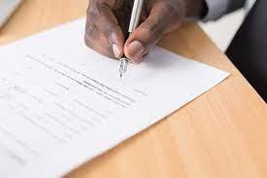
ALL HANDS ON DECK Module 7 - Business
2. Sales and purchase of ships
Going private
There is more risk involved with a private sale, as anybody can sell a boat and you’ve no way of knowing if they’re reputable.
Instead, make sure you take the following guidance on board and if at any point you feel unsure about the sale, contact a specialist Lawyer, who specialise in helping people buy boats at home and abroad and will help guide you through the process.

Slide 22
ALL HANDS ON DECK Module 7 - Business
2. Sales and purchase of ships
Sales contract
When it comes to the contract, all brokers (especially those who are a member of the MYBA) should use a standard sales contract. The MYBA standard contracts are internationally well known.
In the event that you’re dealing with a smaller brokerage that doesn’t use standard sale contracts, you should still expect to be given a sale contract.
This will specify the terms & conditions of the transaction such as sale price, forfeiture and refund of deposit, complete date, place of delivery, what happens if the survey is unsatisfactory etc.

Slide 23
ALL HANDS ON DECK Module 7 - Business
2. Sales and purchase of ships
Sales contract
There are standard forms available online but, unless you’re confident in handling the contract yourself, it would be advisable to seek legal advice first.
One important thing to ask for at this stage when purchasing a boat abroad is to have your contract translated into English in order to perform further checks if needed.
The majority of brokers should be able to provide this service for you but, if not, make sure you get your contract translated before you sign anything.
Having these documents translated into English will also be extremely useful when you come to sell the boat later down the line.

Slide 24

ALL HANDS ON DECK Module 7 - Business
2. Sales and purchase of ships
TOP TIP: Make sure anything you sign is in English
Within the contract it’s important for the person selling the boat to state that they are the legal owner and they have the right to sell it. You’ll also want to see title documentation and evidence that the person selling the boat, does in fact own it.
Examples of title documents include bills of sale, previous sale contract, a builder’s certificate, insurance certificates and registration certificate. If you’re using a broker, then they should hold all this information.

Slide 25

ALL HANDS ON DECK Module 7 - Business
2. Sales and purchase of ships
TOP TIP: Make sure anything you sign is in English
Make sure the owner declares in the contract that they are the legal and beneficial owner, and have the right to sell the boat, which is free from any debts and encumbrances of any kind.
This will help to establish yourself as a bona fide purchaser and will protect you if it turns out a bank or a third party owns the boat for example.

Slide 26

ALL HANDS ON DECK Module 7 - Business
2. Sales and purchase of ships
VAT
If you’re buying a second-hand boat, make sure that VAT (also referred to as IVA in Europe) is accounted for. Ideally you want to see proof of VAT by way of original receipted invoice from the manufacturer or first owner.
If the seller is unable to prove VAT, then you may want to consider whether you wish to proceed with the sale.

Slide 27

ALL HANDS ON DECK Module 7 - Business
2. Sales and purchase of ships
VAT
If the vessel is not VAT paid, you may want to consider paying the VAT on the boat post sale, however seek advice on this before doing so as the rules are different depending on where in Europe the vessel is being purchased.
Making an application to pay the VAT in the UK can be straight forward, but in Europe the law is more complex; VAT is may be payable in the first port of entry, so seek advice if this is something you are thinking about doing.

Slide 28

ALL HANDS ON DECK Module 7 - Business
2. Sales and purchase of ships
Be motivated & enjoy
Hannah Cash, solicitor and founder of YachtingLawyers in London, says:
«Ultimately buying a boat should be a pleasurable, experience and you should be excited about your intended purchase. The moment it becomes stressful and you feel unsure about the purchase, that is the time to proceed with caution and seek legal advice.»

Slide 29

ALL HANDS ON DECK Module 7 - Business
3. The best ways to get money from your boat
Introduction
After your decision you have to spend the next few months reading cruise magazines, looking at boats for sale and devouring books on sailing.
Have you ever heard the buzzwords digital nomad ?
As soon as you look into this phenomenon, you will realize that any laptop-based freelance work can be done remotely.
Be confident that cruising as a young, low budget, working along the "Pardey style" road can be a real possibility.

Slide 30

ALL HANDS ON DECK Module 7 - Business
3. The best ways to get money from your boat
Introduction
Lin and Larry Pardey led the very same lifestyle from the 1970s onwards, sailing around the world while earning a living in different ports through writing.
They didn’t have it easy back then – they had to find work in each country, fill in the paperwork, wait months at a time to cash in their cheques and post off hundreds of pages of their precious work in foreign post offices.

Slide 31
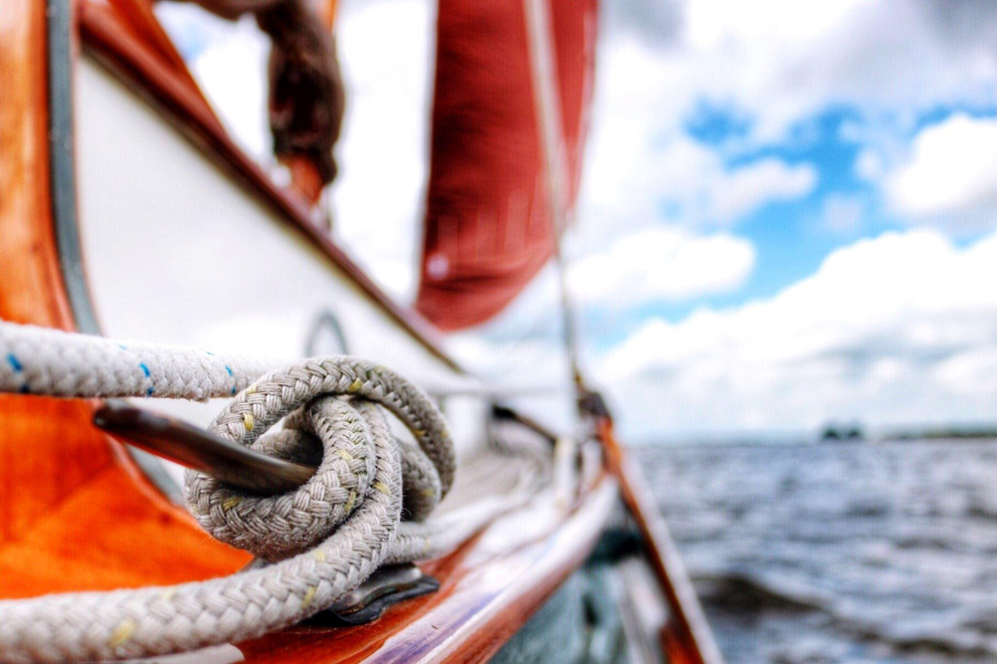
ALL HANDS ON DECK Module 7 - Business
3. The best ways to get money from your boat
The possibility of going cruising and earning money while sailing
This remarkable couple is just one example of the working cruising community.
All over the world, there are average people leading normal lives on the water while making a livelihood – from delivery captains and social media managers, to handymen and accountants.

Slide 32

ALL HANDS ON DECK Module 7 - Business
3. The best ways to get money from your boat
The possibility of going cruising and earning money while sailing.
There are people that found work in new countries for a few months of the year ashore as builders, acupuncturists and dentists or were working from their boats as writers, beauticians and web developers.
Some lived frugally on passive income, such as renting their homes.
Today's technological advances make this lifestyle even more achievable.

Slide 33
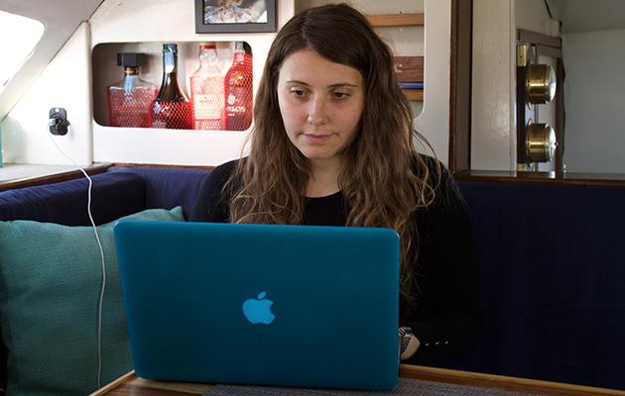
ALL HANDS ON DECK Module 7 - Business
3. The best ways to get money from your boat
The possibility of going cruising and earning money while sailing
This means that it is possible to work on the go, even while sailing, rather than having to stop at a specific port when money is scarce.
It's a huge plus and makes life on board a lot easier.
With house prices steadily rising, remote jobs becoming easier to obtain, the growing phenomenon of minimalism, and the huge popularity of YouTube browsing channels, we believe more and more young people and families will soon switch to water.

Slide 34

ALL HANDS ON DECK Module 7 - Business
3. The best ways to get money from your boat
The possibility of going cruising and earning money while sailing
Setting up our freelance jobs
Although you can save enough money to support yourself for a year and set aside an emergency fund, you will need an income to go on your cruise.
Five months before your departure date, you need to start looking for potential customers.

Slide 35
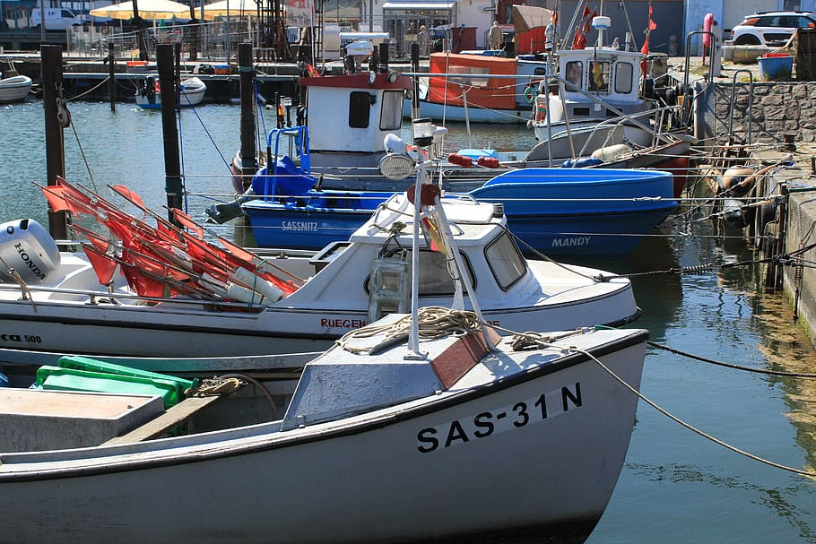
ALL HANDS ON DECK Module 7 - Business
3. The best ways to get money from your boat
Common ways
Short period rental as apartment
Operating Sightseeing tours
Dive and Sailing lesson
Peer-to-peer rental
Special events

Slide 36
ALL HANDS ON DECK Module 7 - Business
3. The best ways to get money from your boat
Useful principles to start a new business
Use Data to diagnose best opportunities for business
Calculate what the customers want
Know your marketplace and evaluate competitors
Size projects achievable with the resources at hand

Slide 37
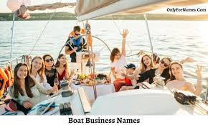
ALL HANDS ON DECK Module 7 - Business
3. The best ways to get money from your boat
The possibility of going cruising and earning money while sailing
Looking for a job in your field as a content marketer can make things easier - you can use your experience, personal connections, and LinkedIn.
Three months later, you could start having regular customers and earning a modest second salary (enough to pay the necessary expenses).

Slide 38

ALL HANDS ON DECK Module 7 - Business
3. The best ways to get money from your boat
Short period rent as an apartment?
Especially during winter, when it is not easy to navigate, when the boat is simply moored on the dock, you may rent a room or the entire boat for short period as an apartment.
Tourist may like the atmosphere of a boat while passing by the town for few days.
You can also profit of easygoing rental platform as Airbnb.

Slide 39
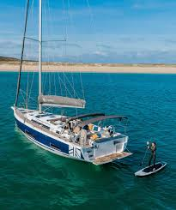
ALL HANDS ON DECK Module 7 - Business
3. The best ways to get money from your boat
Get a license and organize charters and trips
Operating Sightseeing Tours
Quick boat-taxi service
To organize charters and trips you’ll need to have a captain’s license for. This venture only works in tourist towns. If you live or move in a touristic riverside or seaside place this could be a smart way to make money while helping foreigners to discover the city from its waterways.
You may build-up an eco-tour, trasportation service, or simply find sightseers who are willing to pay extra to observe the city from an unusual spot.

Slide 40

ALL HANDS ON DECK Module 7 - Business
3. The best ways to get money from your boat
Sailing Lessons
If you love sailing, then you could think about getting a professional instructor licence and start the training lessons from your own boat.
As instructor you must know the discipline in depth, knowing how to recognize potentials and risks. You must be able to transmit to everyone seek the approach with sailing the passion that animates yourself.

Slide 41
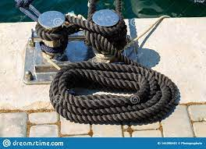
ALL HANDS ON DECK Module 7 - Business
3. The best ways to get money from your boat
Diving
Collaborate with dive companies
Scuba diving and snorkeling excursions count lots of enthusiasts, so it is a great opportunity to bring people on the less accessible spot perfect to suba diving, snorkeling or to catch fish.
You can also establish a partnership with dive companies just to transfer the customers.

Slide 42

ALL HANDS ON DECK Module 7 - Business
3. The best ways to get money from your boat
Evaluate peer-to-peer (P2P) rental
Boat sharing and P2P rental
Probably the simplest, fastest, most realistic way to bring in money utilizing your boat. You can do it privately or using one of the many peer-to-peer web platform (like Airbnb) explicitly designed for boats (Boatsetter, GetMyBoat, SamBoat, or RentABoat). You can sign up and rent your boat.

Slide 43
ALL HANDS ON DECK Module 7 - Business
3. The best ways to get money from your boat
Evaluate peer-to-peer (P2P) rental
Boat sharing and P2P rental
How to take advantage of a rental service platform
You sign up to the choosen platform set the pricing and then the service takes a cut to cover their expenses and insurance.
When someone applies to rent your boat, you get to choose whether to accept or reject the rental.
Then when the appointed date and time arrive, you meet the renters at the dock, show them the boat, hand off the keys, and wish them a safe trip.

Slide 44
ALL HANDS ON DECK Module 7 - Business
3. The best ways to get money from your boat
Offer special events
Wedding cruises
Boat parties
Small concerts (video)
Cooking shows/ dinners
Experiential Tourism is taking space more and more.
Offer a creative or cultural experience on a boat could be very attractive to targets that go beyond mare tourists, help differentiating ways to monetize your boat while giving you the chance to express other interests and skills.

Slide 45
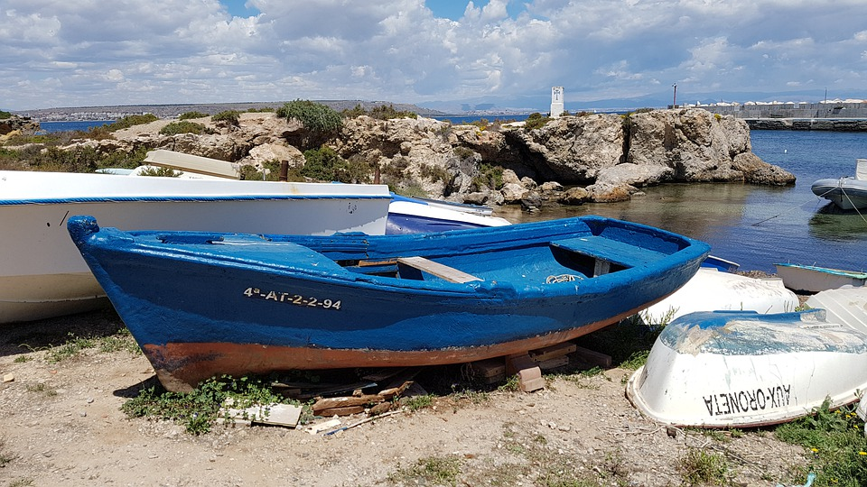
ALL HANDS ON DECK Module 7 - Business
In conclusion
Summary of the contents
This is the end of Module 7.
Now take your time to complete the relevant test.

Slide 46
ALL HANDS ON DECK Module 7 - Business
Bibliography
Environmental Impact Assessment of Boatbuilding Process with Ocean Plastic, Qi Fang, Mélanie Despeisse and Xiaoxia Chen.
http://www.emsa.europa.eu/csn-menu/items.html?cid=122&id=4322
Compulsory reading:
Boatbuilding Guide, By Arthur N. Swinfield, A.M.I.N.A. : https://spccfpstore1.blob.core.windows.net/digitallibrary-docs/files/2b/2b0f91cc1c564fd68d59b1304be1d94d.pdf?sv=2015-12-11&sr=b&sig=KQPvNHr13lWmbRgNxmxEcYXiirSia8%2FjliCfXt9RIZk%3D&se=2022-06-12T15%3A10%3A08Z&sp=r&rscc=public%2C%20max-age%3D864000%2C%20max-stale%3D86400&rsct=application%2Fpdf&rscd=inline%3B%20filename%3D%22Swinfield_62_Boatbuilding_Vol_One_Text.pdf%22

Slide 47
Thank you!
Don’t forget to follow AHOD on Facebook, and for the last news go visit the project website.
https://allhandsondeck.eu/

