Slide 1
Module 12 – Environment & Sustainability
Topics of the module:
EU rules on ships pollution
Boat recycling and re-use
The environmental impacts of a product's life cycle
Ecodesign
The best alternatives to using the traditional high strength-to-weight for a ship

Slide 2







ALL HANDS ON DECK Module 12 – Environment & Sustainability
Introduction to the module 12
Environment & Sustainability
1. The EU regulation on ship pollution and recycling.
2. Disposal of a boat: procedures
3. Environmental impact of a product life cycle.
4. Design to limit the environmental impact.
5. Technologies & materials for sustainable boats.

Slide 3
ALL HANDS ON DECK Module 12 – Environment & Sustainability
1. EU regulation on ship recycling
Introduction to ship pollution and emission worldwide
According to The Third IMO Greenhouse Gas Study 2014 by CE Delft, under a BAU scenario (if other sectors of the economy reduce emissions to keep the global temperature increase below 2 degrees C°), shipping could represent some 10% of global GHG emissions by 2050.
Shipping also contributes to climate change through emissions of Black Carbon produced by the combustion of marine fuel.

Slide 4
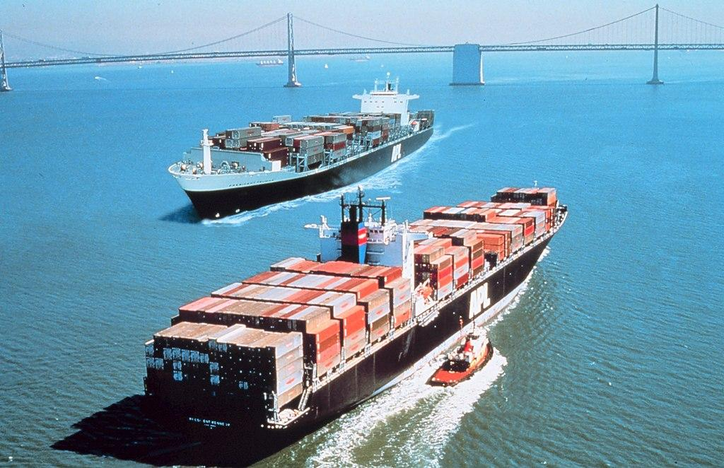
ALL HANDS ON DECK Module 12 – Environment & Sustainability
1. EU regulation on ship recycling
Introduction to ship pollution and emission worldwide
Black carbon accounts for 21% of CO2-equivalent emissions from ships, making it the second most important driver of shipping’s climate impacts after carbon dioxide.
Currently, there are no regulations controlling shipping/boat black carbon emissions.

Slide 5

ALL HANDS ON DECK Module 12 – Environment & Sustainability
1. EU regulation on ship recycling
Introduction to ship pollution and emission worldwide
In April 2018 the International Maritime Organization (IMO) agreed to a draft greenhouse gas strategy for shipping requiring the shipping sector to reduce its emissions by at least 50% by 2050 compared to 2008’ while pursuing efforts towards phasing them out as soon as possible.

Slide 6
ALL HANDS ON DECK Module 12 – Environment & Sustainability
1. EU regulation on ship recycling
Introduction to ship pollution and emission worldwide
The IMO’s Energy Efficiency Design Index (EEDI), approved in July 2011, is the first globally-binding design standard aimed at abating climate change from shipping. It entered into force in 2013.
The index requires new ships to become more energy-efficient, with standards that will be made increasingly more stringent over time.

Slide 7
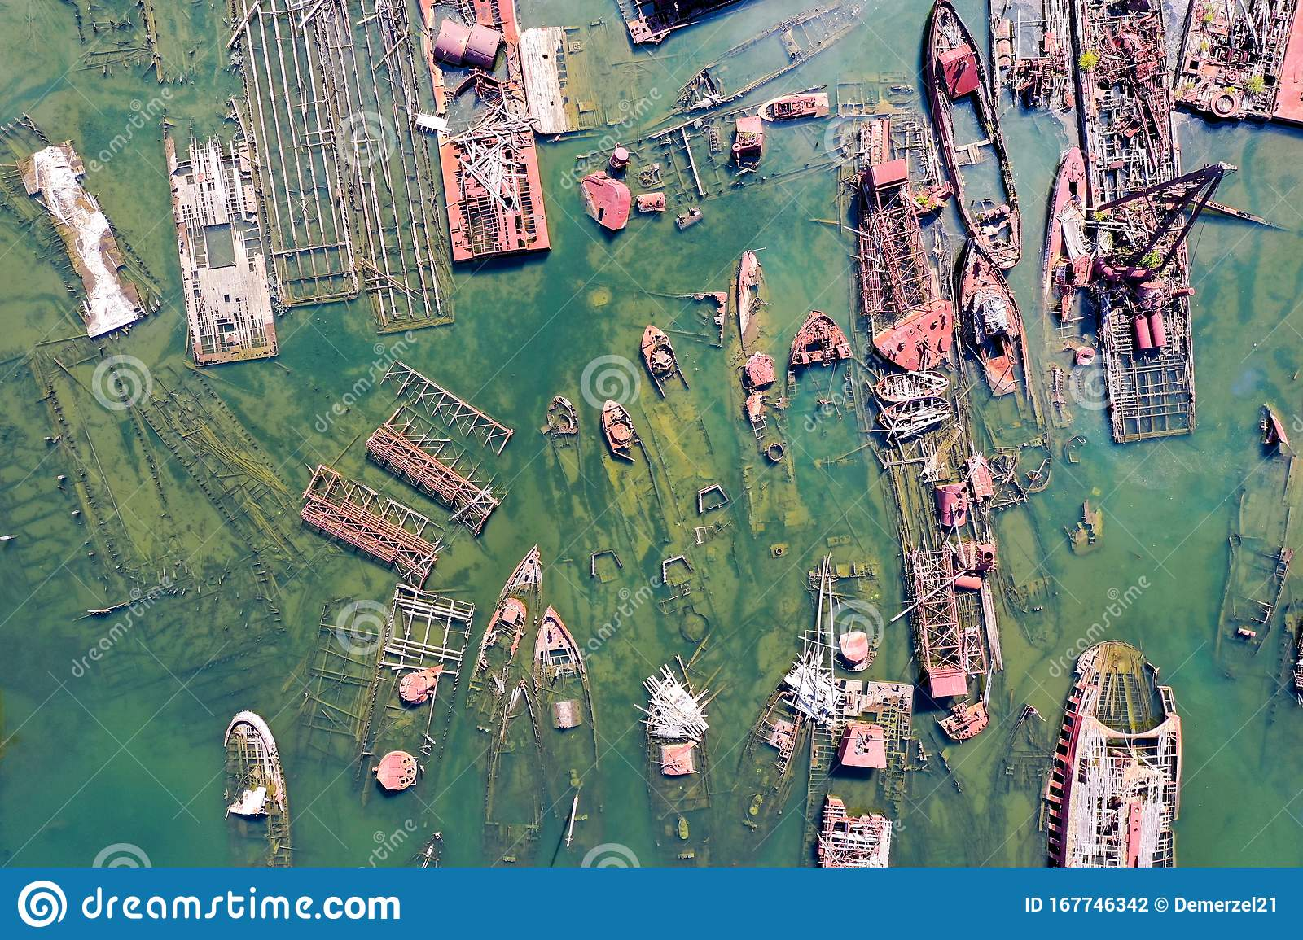
ALL HANDS ON DECK Module 12 – Environment & Sustainability
1. EU regulation on ship recycling
Introduction to ship pollution and emission worldwide
Ship recycling is a highly complex and controversial issue. Nowadays, most ship dismantling activities take place in India, Pakistan or Bangladesh, in substandard facilities that lack the technology needed to ensure the safe and environmentally sound management and disposal of hazardous materials contained in ships.
From a different perspective, ship dismantling represents a sustainable method of disposing of end-of-life vessels; it provides employment opportunities and leads to reuse of large amounts of valuable resources.

Slide 8
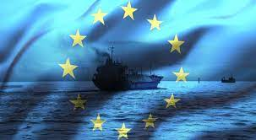
ALL HANDS ON DECK Module 12 – Environment & Sustainability
1. EU regulation on ship recycling
The regulation (EU) No. 1257/2013 on ship recycling
This EU Regulation covers the design, construction, operation and preparation of ships with a view to facilitating safe and environmentally friendly recycling, without compromising the safety and efficiency operations of the ships. It also affects the operation of the second ship recycling facilities, safe and environmentally friendly methods, and the establishment of an adequate enforcement mechanism for ship recycling.

Slide 9
ALL HANDS ON DECK Module 12 – Environment & Sustainability
1. EU regulation on ship recycling
The regulation (EU) No. 1257/2013 on ship recycling
Control of hazardous materials
The EU legislation on ship recycling is framed by several international instruments concerning mainly two issues, that we take in due account:
The transboundary movement of waste
The protection of the marine environment
Inventory of hazardous materials
General requirements for shipowners
The regulation address the main issues linked to boat pollution:
Ship recycling plan
Surveys
Issue and endorsement of certificates
Duration and validity of the certificates
Port State Control

Slide 10
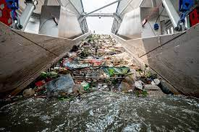
ALL HANDS ON DECK Module 12 – Environment & Sustainability
1. EU regulation on ship recycling
The transboundary movement of waste
Under the Basel Convention, ships containing hazardous materials and wastes have to be considered hazardous waste themselves at the time of their disposal. Exporting ship containing hazardous materials, has to be considered a transboundary movement of hazardous waste.
As a consequence, the EU Shipments of Waste Regulation stops the export of end-of-life ships to developing countries, even for recycling.

Slide 11
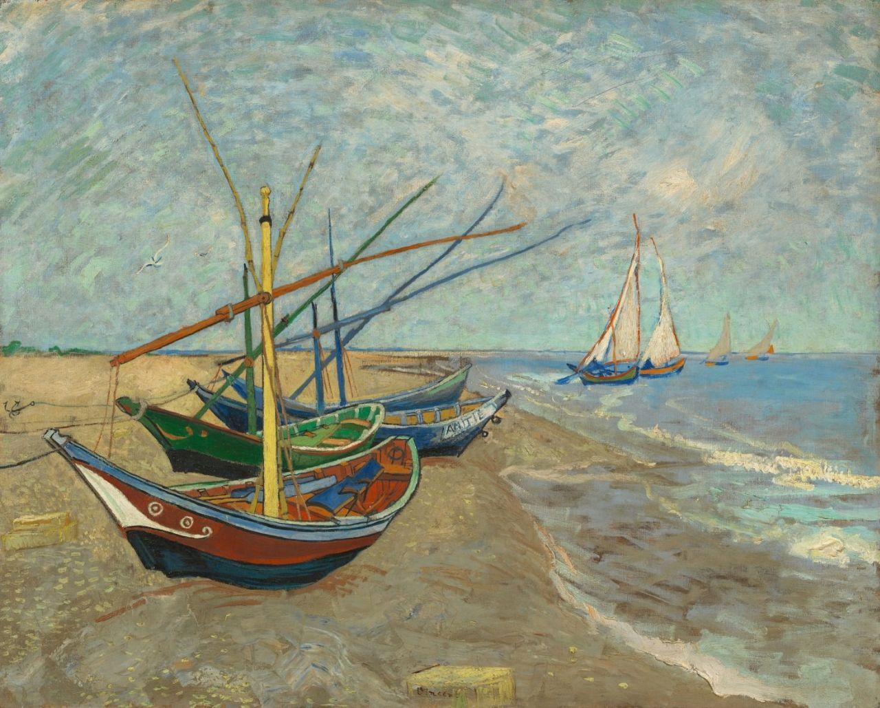
ALL HANDS ON DECK Module 12 – Environment & Sustainability
1. EU regulation on ship recycling
Protection of the marine environment
The EU regulation addressed a number of critical issues related to marine environment protection, including the ban of the beaching method and the control of downstream waste and on-the-ground conditions in recycling facilities.
At the same time, as underlined by Valentina Rossi in Maritime Safety and Environmental Protection in Europe. Multiple Layers in Regulation and Compliance : “the Regulation postpones the creation of a financial mechanism to finance environmentally sound ship recycling and counterbalance the incentive for the last ship owner to go to low-standard facilities as well as the possibility of reflagging to escape the export ban”.

Slide 12

ALL HANDS ON DECK Module 12 – Environment & Sustainability
2. Disposal of a boat procedures and costs
Re-use, recycling and restoration
There has been a flurry of interest in Europe recently about what happens to boats that have reached the end of their life or have been abandoned. Such vessels can lead to pollution, navigational hazards and removal costs for marinas, ports and recreational craft owners.

Slide 13
ALL HANDS ON DECK Module 12 – Environment & Sustainability
2. Disposal of a boat procedures and costs
Re-use, recycling and restoration
It is claimed that Europe has one of the largest concentrations of recreational craft in the world, with over 6 million in the European Union alone. It is estimated that as many as 95% of these are made from Fiber Reinforced Plastic.
Because Fiber Reinforced Plastic is highly durable, end-of-life disposal has not been a major issue so far. However, the time is coming when even these boats will reach the end of their lives and will have to be disposed of.
As regulation is starting to restrict the disposal of FRP to landfill, recycling will become the only realistic option. Unfortunately FRP recycling procedure is highly regulated and expansive.

Slide 14
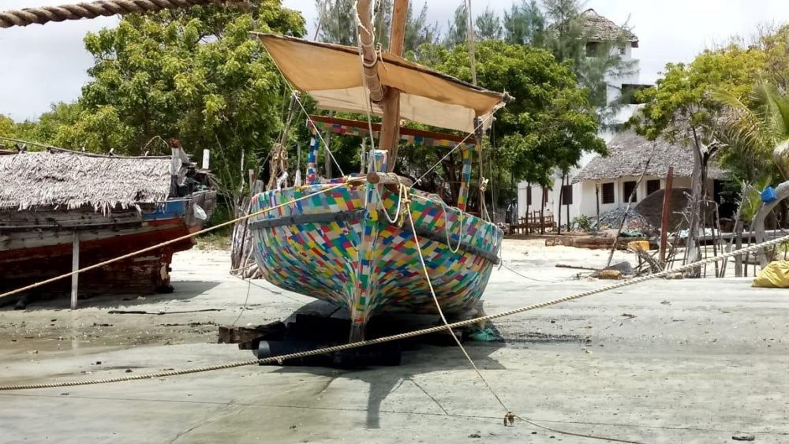
ALL HANDS ON DECK Module 12 – Environment & Sustainability
2. Disposal of a boat procedures and costs
Re-use and restoration
Due to the high costs of dismantling, wreck of boats represent a cause of sea, fluvial and earth pollution.
Find a new use for an old boat, maybe on the ground (as furniture, artistic installation, house, scenery, …) could be a smart and less expensive way to prolong the life of a former great product.

Slide 15
ALL HANDS ON DECK Module 12 – Environment & Sustainability
2. Disposal of a boat procedures and costs
Recycling and dismantling
The owner who intends to scrape his boat must, therefore, necessarily contact a shipyard or a specialized company.
Dismantled the boat/ship, the shipowner will then issue a demolition certificate, to be kept and presented to the harbor master's office together with the appropriate form to request cancellation from the register of registered vessels.

Slide 16

ALL HANDS ON DECK Module 12 – Environment & Sustainability
2. Disposal of a boat procedures and costs
Re-use, recycling and restoration
Find a new use for a boat could be a way to prevent disposal costs and be creative at the same time.
You can transform your old boat in a bookcase, or in a piece of furniture as a bed or a sofa for indoor or outdoor spaces.

Slide 17
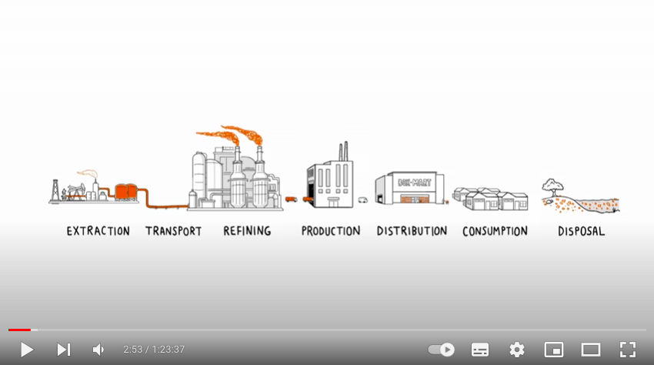

ALL HANDS ON DECK Module 12 – Environment & Sustainability
2. Disposal of a boat procedures and costs
Pollution, reuse and recycling
Before examining sustainable materials and PIA measurement methods, this Emmy winning documentary shows incredibly well how plastics waste contribute to sea and rivers pollution.

Slide 18
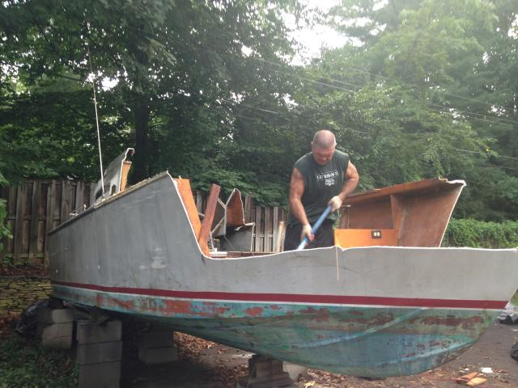
ALL HANDS ON DECK Module 12 – Environment & Sustainability
3. Environmental impacts of a product's life cycle
Product impact assessment (PIA)
The theoretical concept of life cycle thinking has continuously gained acceptance in environmental assessments over the past few years.
This concept presents a transition from traditional environmental protection strategies illustrating the growing awareness of modern societies about the long-term impacts of human activities.

Slide 19
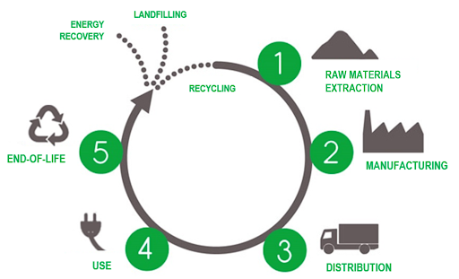
ALL HANDS ON DECK Module 12 – Environment & Sustainability
3. Environmental impacts of a product's life cycle
When studying industrial systems through this approach some important benefits may evolve such as the avoidance of shifting the environmental impact from one stage of the life cycle to another, or altogether to other (external) systems, thus creating external cost phenomena.
A well-structured method observing the above theoretical concept is the Life Cycle Assessment (LCA).
PIA Methodologies

Slide 20
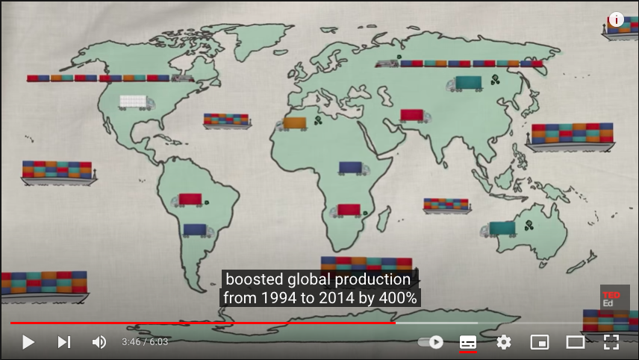
ALL HANDS ON DECK Module 12 – Environment & Sustainability
3. Environmental impacts of a product's life cycle
PIA Methodologies
Environmental impacts are assessed from raw material extraction and processing (cradle), through the product's manufacture, distribution and use, to the recycling or final disposal of the materials composing it (grave).
LCA is standardized under the framework of ISO and considers the full life cycle of the system it examines.
Here is a short video from TED-Ed explaining the entire Life Cycle of a simple t-shirt
https://www.youtube.com/watch?v=BiSYoeqb_VY

Slide 21
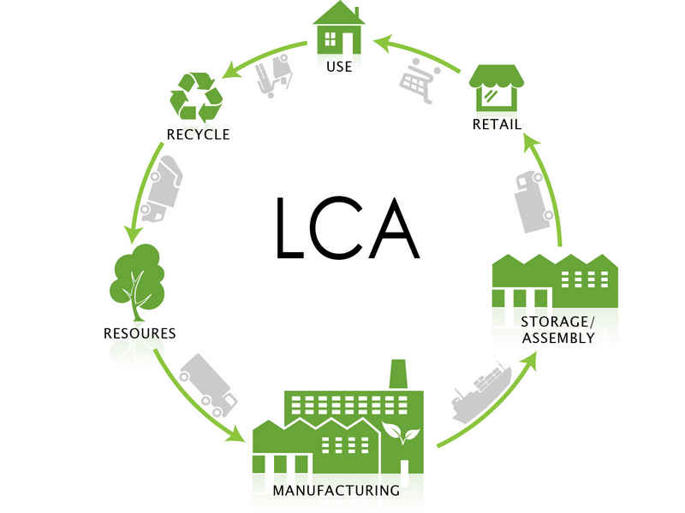
ALL HANDS ON DECK Module 12 – Environment & Sustainability
3. Environmental impacts of a product's life cycle
In particular, the environmental impact of a product is determined by measuring the inputs and outputs of each individual phase of the entire life cycle. Input flows are resources used such as energy, water, etc. The outputs are, for instance, emissions to air, water and soil.
The LCA tool aims to quantify the environmental impacts that occur at these stages.
LCA

Slide 22

ALL HANDS ON DECK Module 12 – Environment & Sustainability
3. Environmental impacts of a product's life cycle
Another important product impact assessment method, developed and continuously improved by the European Commission, and specifically tailored to environmental impact measurement of a product’s life cycle is the:
Product Environmental Footprint (PEF).
PIA Methodologies

Slide 23

ALL HANDS ON DECK Module 12 – Environment & Sustainability
3. Environmental impacts of a product's life cycle
PEF is a multi-criteria measure of the environmental performance of a good or service throughout its life cycle.
PEF information is produced for the overarching purpose of seeking to reduce the environmental impacts of goods and services taking into account supply chain activities (from the extraction of raw materials, through production and use, to final waste management).
PIA Methodologies

Slide 24
ALL HANDS ON DECK Module 12 – Environment & Sustainability
3. Environmental impacts of a product's life cycle
LCA in Shipping
For the particular case of shipping the LCA method has a short application record so far the main reason being the complexity of the ship system.
The Laboratory for Maritime Transport of the National Technical University of Athens presented a theoretical framework to examine the impact of important air emissions throughout the life cycle of ships. The framework scheme is outlined in the next slide.

Slide 25
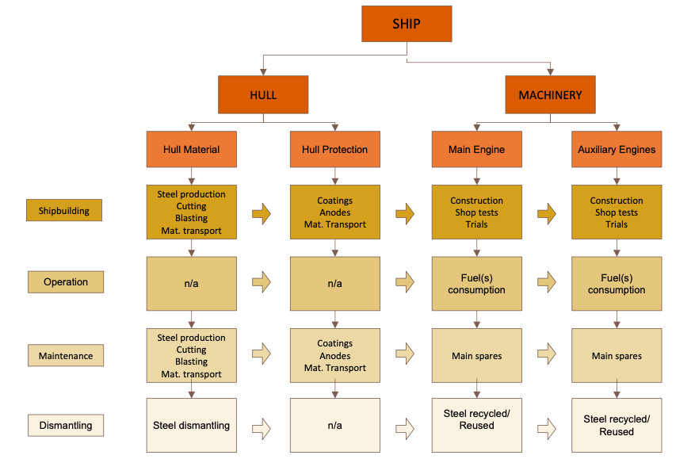
ALL HANDS ON DECK Module 12 – Environment & Sustainability
3. Environmental impacts of a product's life cycle
LCA application: shipping air emission impact study.

Slide 26



ALL HANDS ON DECK Module 12 – Environment & Sustainability
4. Design to limit environmental impact
Eco-design
Which are the most environmentally relevant stages of a product’s lifecycle?
The main questions to be answered to approach eco-design are:
Is the energy used for extraction renewable?”
Are the materials used biodegradable?

Slide 27
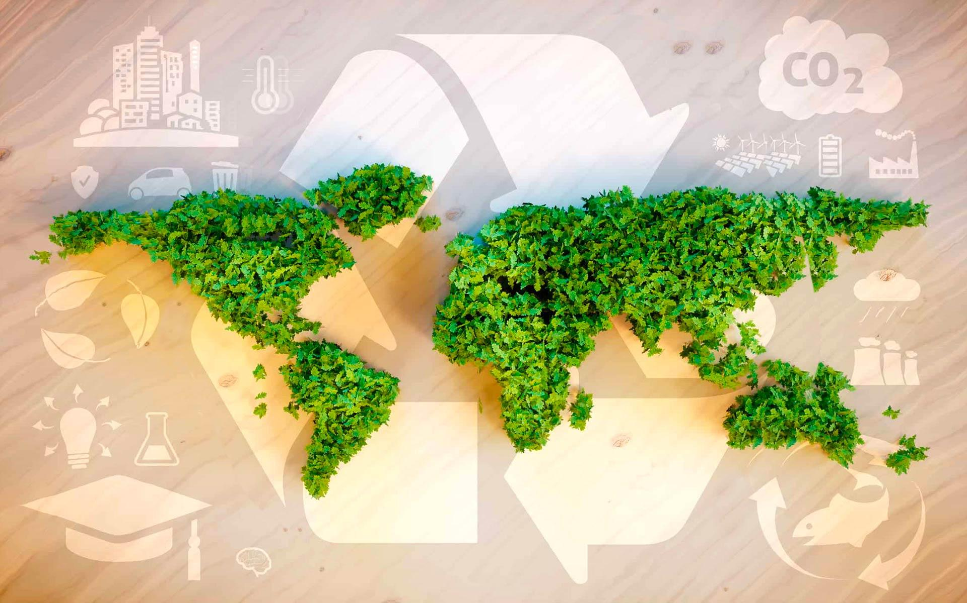
ALL HANDS ON DECK Module 12 – Environment & Sustainability
4. Design to limit environmental impact
Eco-design
When it comes to design your products, considering the environmental impacts of the whole life cycle for that product is known as eco-design. Eco design is both a principle and an approach. It consists of integrating environmental protection criteria over a service/product's lifecycle. The main goal of eco design is to anticipate and minimize negative environmental impacts (of manufacturing, using and disposing of products).

Slide 28
ALL HANDS ON DECK Module 12 – Environment & Sustainability
4. Design to limit environmental impact
Eco-design
Principle: it is "any form of design that minimizes environmentally destructive impacts by integrating itself with living processes."
As approach, Ecological design can also be defined as the process within design and development of integration of environmental consideration into product and service design and development with the aim of reducing environmental impacts of products through their life cycle.
Eco-design improves the environmental outcome, and reduce your costs in the long-term, that is why is considered an integrative ecologically responsible design discipline.

Slide 29

ALL HANDS ON DECK Module 12 – Environment & Sustainability
4. Design to limit environmental impact
Eco-design & impact
Impacts:
The design and creation of products can require the extraction of natural resources, manufacturing, transportation, and waste disposal at the end of life. As a product goes through these stages energy and water are used, and waste, pollutants, and greenhouse gas emissions are created.
Resource extraction and manufacturing
End of life (recovery, recycling)
Materials with Eco-sustainable certification
Improve recyclability
Transport
Product use

Slide 30
ALL HANDS ON DECK Module 12 – Environment & Sustainability
4. Design to limit environmental impact
Eco-design in the EU
In the framework of the EU Sustainable products policy, The EU ecodesign directive (Directive 2009/125/EC) prescribe that in every production phase there should be a reduced energy consumption, and, when the product cannot be fixed, it enters the natural cycle.
Certain production standards check at any time any criticality of the life cycle of the product and green solutions are proposed to ensure savings in terms of sustainable recovery of materials and energy consumed.
At international level, there are specific standards (ISO 14040 and 14044) that allow to monitor all stages of conception, production, distribution, use, reuse and final disposal of everything that falls into ecodesign.

Slide 31
ALL HANDS ON DECK Module 12 – Environment & Sustainability
4. Design to limit environmental impact
Eco-design in the EU
The Ecodesign Directive provides consistent EU-wide rules for improving the environmental performance of products, such as household appliances, information and communication technologies or engineering.
The directive sets out minimum mandatory requirements for the energy efficiency of these products.
https://eur-lex.europa.eu/legal-content/EN/TXT/?uri=CELEX:32009L0125

Slide 32
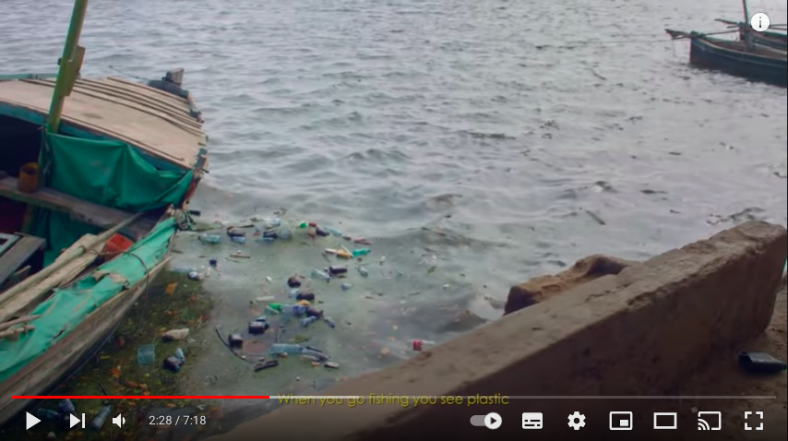
ALL HANDS ON DECK Module 12 – Environment & Sustainability
4. Design to limit environmental impact
Recycled boat
By watching this extract from a video-documentary by National Geographic you will discover the story of a group of local fisherman in Kenya that built a boat entirely from plastic waste to raise awareness about marine plastic pollution.

Slide 33
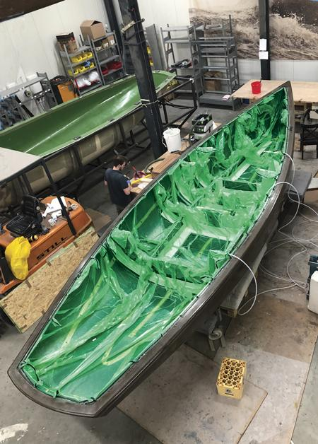
ALL HANDS ON DECK Module 12 – Environment & Sustainability
5. Technologies and materials for sustainable boats
The best alternatives to using the traditional high strength-to-weight.
We’ll need to adopt some radical changes in all lifestyles. Thankfully sailing is, by its very nature, a green activity.
Boatbuilders are progressively incorporating greener propulsion and sustainable power sources and are turning to natural and recyclable materials.

Slide 34
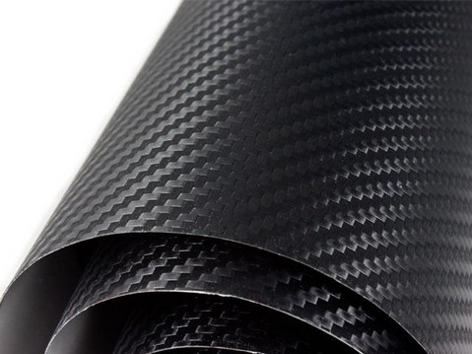
ALL HANDS ON DECK Module 12 – Environment & Sustainability
5. Technologies and materials for sustainable boats
Composite materials
Composite materials are broadly defined as those in which a binder is reinforced with a strengthening material. The binder is usually a resin, and the reinforcing material consists of glass strands (fiberglass), carbon fibers or aramid fibers.

Slide 35
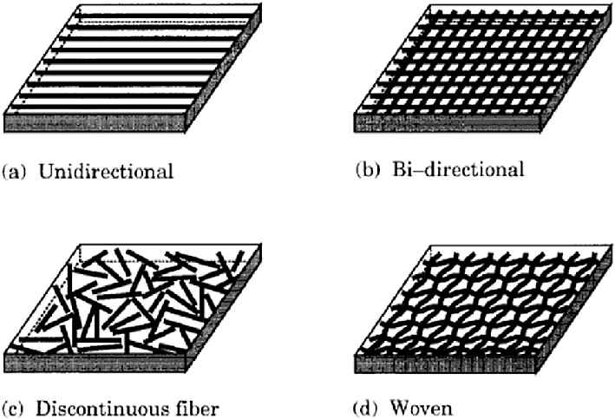
ALL HANDS ON DECK Module 12 – Environment & Sustainability
5. Technologies and materials for sustainable boats
Composite materials
Composites bring a higher strength-to-weight ratio than traditional wood or steel methods, and they require lower skill levels to produce. Lightness, strength, durability, and ease of production mean that composites play and will play an increasing part in boat construction.The weak point of composite materials such as carbon fiber lies in the high degree of polluting waste production and in the difficulty of recycling.

Slide 36

ALL HANDS ON DECK Module 12 – Environment & Sustainability
5. Technologies and materials for sustainable boats
Greener composites
The composites destined for disposal and processing waste will be transformed again into valuable resources to be transformed into new products while protecting the environment and the territory thanks to the reduction of waste, waste of raw materials and the energy necessary in the production process.
To this extent, the large amount of research project on Green Carbon Fiber production and Carbon Fiber Recycling methods are shaping a greener future for composite materials such as Carbon Fiber polymers
New sustainable production methods based on the reuse of waste materials are helping to guarantee the possibility of a new life for those products that are destined for disposal.

Slide 37
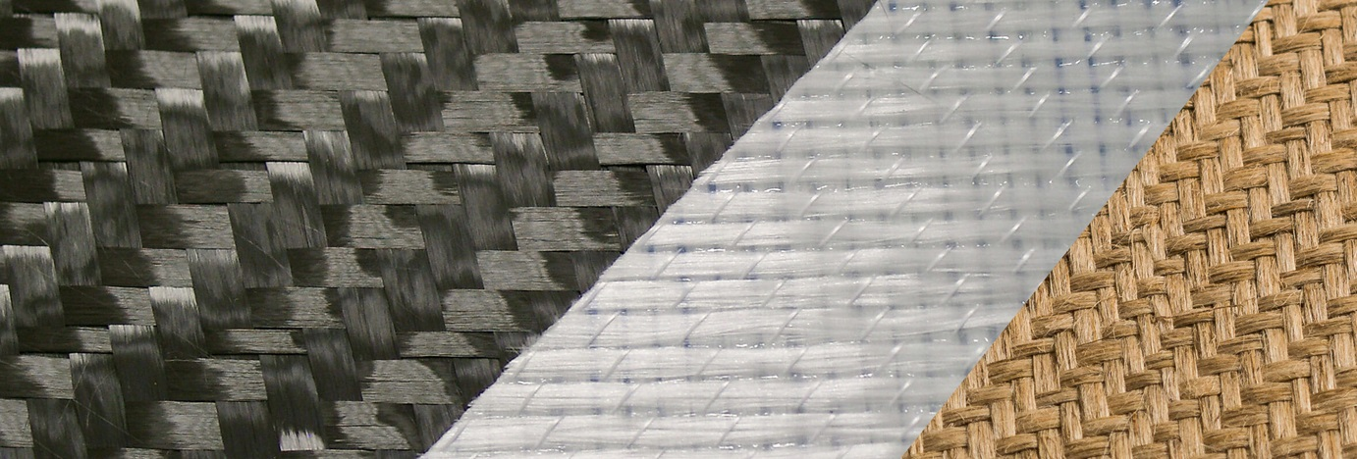

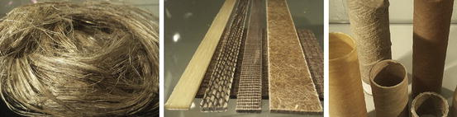
ALL HANDS ON DECK Module 12 – Environment & Sustainability
5. Technologies and materials for sustainable boats
New green fibers.
As we already underlined, achieving good navigation/sailing performances require minimizing weight. Research is running fast on the best alternatives to using the traditional high strength-to-weight ratio synthetic fibers such as glass and carbon, we presented before.
Some of the main innovative and less polluting materials are:
Basalt Fibers
PET cores
Fibers from plants

Slide 38


ALL HANDS ON DECK Module 12 – Environment & Sustainability
5. Technologies and materials for sustainable boats
Green future materials.
Basalt fiber: Basalt fiber is a material made from extremely fine fibers of basalt, which is composed of the minerals plagioclase, pyroxene, and olivine. It is similar to fiberglass, having better physico-mechanical properties than fiberglass, but being significantly cheaper than carbon fiber.

Slide 39
ALL HANDS ON DECK Module 12 – Environment & Sustainability
5. Technologies and materials for sustainable boats
Green future materials.
PET (recycled plastic bottles) cores: Polyethylene Terephthalate (PET) is a thermoplastic that produces a lower cost, yet structurally sound core product. PET cores can be heated and conformed to specific shapes

Slide 40
ALL HANDS ON DECK Module 12 – Environment & Sustainability
5. Technologies and materials for sustainable boats
Green future materials.
Fibers from plants, that could offer the most environmental friendly potential for boatbuilding.
In particular, high-performance natural fiber reinforcements ampliTex ™ (technical fabrics), powerRibs ™ and the bCores ™ (balsa core) materials offer viable alternatives to carbon- and glass fibers.
These technologies enable new opportunities in the construction of more sustainable and lightweight structures, from structural (hull, stringers, bulkheads) to semi- and non-structural (floorboards, cable trays and furniture) components.

Slide 41
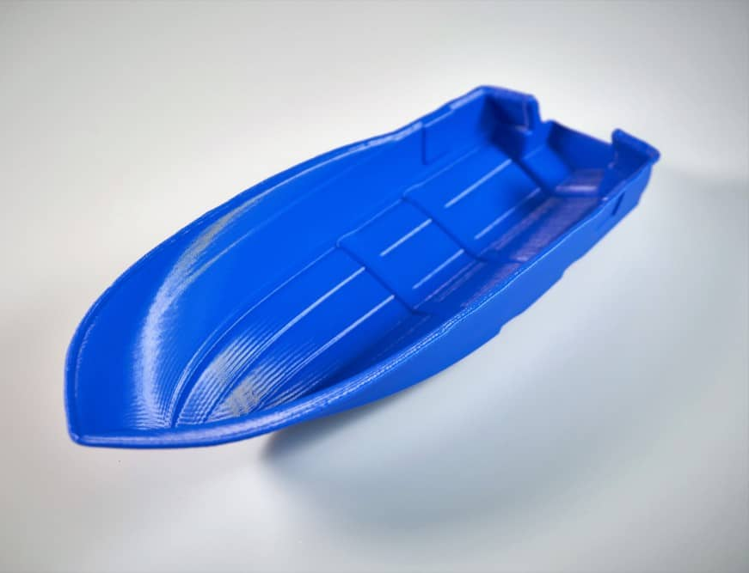
ALL HANDS ON DECK Module 12 – Environment & Sustainability
5. Technologies and materials for sustainable boats
The best alternatives to using the traditional high strength-to-weight.
In the next decade, we’ll certainly see a marked increase in the use of 3D printing in boatbuilding. This increasing trend is clearly visible.
Additive Manufacturing is already employed for custom parts, this technology could be used to build hulls and decks – printed structures with natural fiber skins surrounding them could eliminate the need for wasteful molds.

Slide 42

ALL HANDS ON DECK Module 12 – Environment & Sustainability
5. Technologies and materials for sustainable boats
The best alternatives to using the traditional high strength-to-weight.
Along with 3D printing, computerized numerical control machines (CNCM) are commonly used to design and build boats with many different materials.
CNCM are machine tools that use computerized numerical control. Until the eighties they were used only for high precision machining. Today they are very widespread and used in almost every field of mechanics even in boatbuilding.
Click on the link below to watch Francesco Belvisi CEO and President of YAM discussing over boatguilding tecniques and tools:
https://www.youtube.com/watch?v=6xUoPC5G7UI

Slide 43
ALL HANDS ON DECK Module 12 – Environment & Sustainability
5. Technologies and materials for sustainable boats
Protecting marine environment: emissions control
Exhaust emissions from marine and boating diesel engines present an important issue to the industry largely because of the untreated exhaust emitted from internal propulsion engines and onboard power generators.
Also retailers should consider undertaking more sustainable behaviours when sailing.

Slide 44

ALL HANDS ON DECK Module 12 – Environment & Sustainability
5. Technologies and materials for sustainable boats
Protecting marine environment: emissions control
Due largely in part to the high levels of harmful emission concentrations in a confined area, the health, performance, and safety of workers, passengers and vessels are jeopardized when exposed to diesel exhaust.

Slide 45
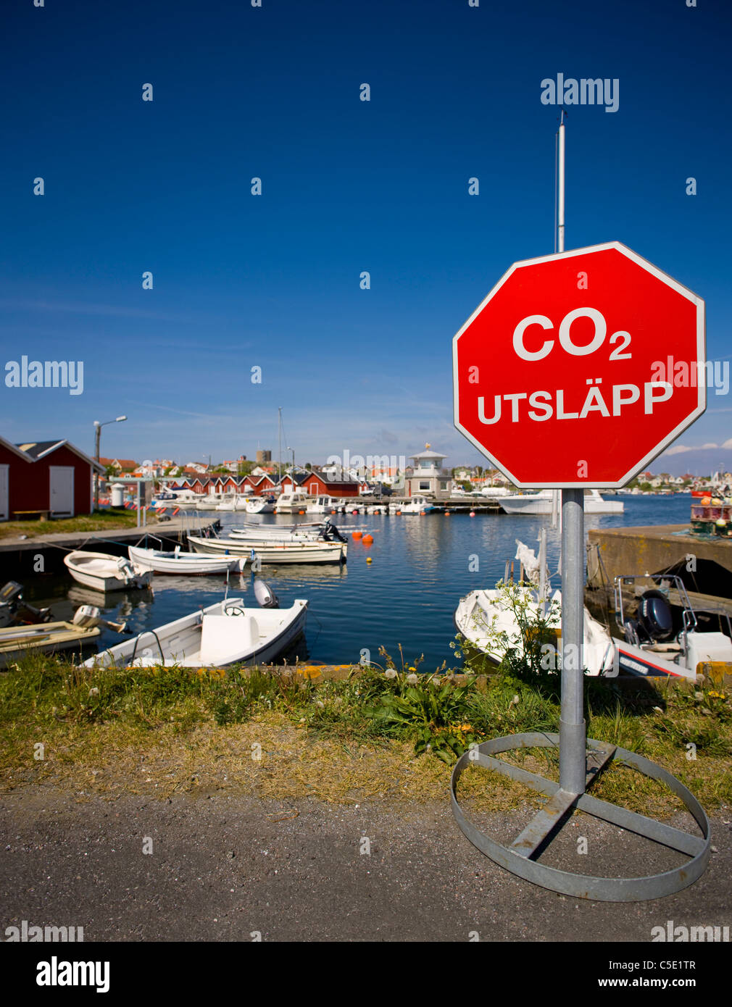
ALL HANDS ON DECK Module 12 – Environment & Sustainability
5. Technologies and materials for sustainable boats
Protecting marine environment: emissions control
Environmental regulations on exhaust gases are getting tougher, and the marine industry is under increasing pressure to reduce emissions of nitrogen oxides (NOx), sulfur oxides (SOx), particles, and more.
Especially NOx emission can be reduced by primary methods such as retard injection, fuel nozzle modification, change of compression ratio, water direct injection, water emulsification, exhaust gas recirculation (EGR).

Slide 46
ALL HANDS ON DECK Module 12 – Environment & Sustainability
5. Technologies and materials for sustainable boats
Protecting marine environment: emissions control
The diesel exhaust harmful components, Carbon Monoxide (CO), Hydrocarbons, and Particulate Matter (PM) can easily be removed by secondary methods like an emissions control system from Marine technology companies.
They manage and use many different tools to reduce boat and vessel emissions: components to improve engine environmental performance and systems to treat waste.
Some of the most common tools are:
3-Way Catalytic Converters, Diesel Oxidation Catalysts (DOC), Diesel Particulate Filters (DPF), Selective Catalytic Reduction (SCR) systems, Generator Silencers.

Slide 47
ALL HANDS ON DECK Module 12 – Environment & Sustainability
5. Technologies and materials for sustainable boats
EU policy and regulation pill
The European Maritime Safety Agency implemented the CleanSeaNet service.
It is a European satellite-based oil spill and vessel detection service which offers assistance to participating States for the following activities:
Identifying and tracing oil pollution on the sea surface;
Monitoring accidental pollution during emergencies;
Contributing to the identification of polluters.

Slide 48
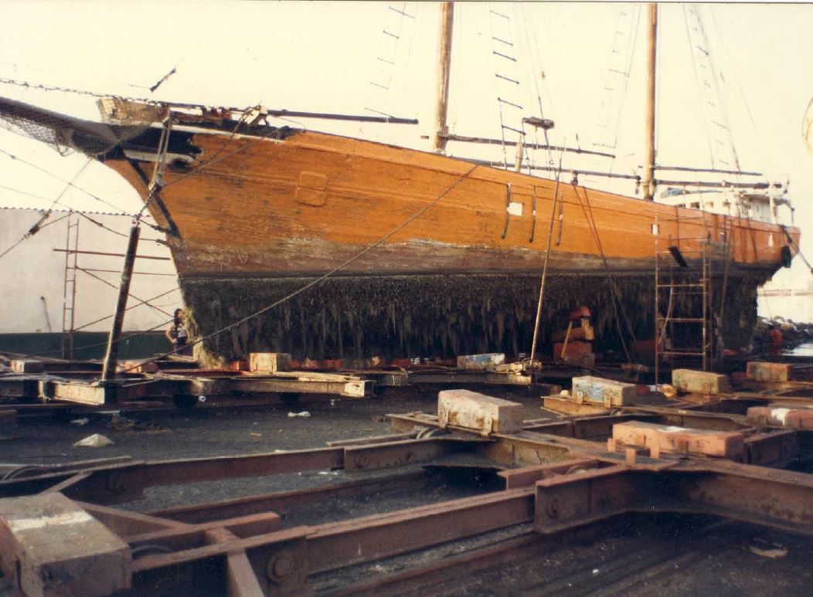
ALL HANDS ON DECK Module 12 – Environment & Sustainability
In conclusion
This is the end of Module 13.
Now take your time to complete the relevant test.

Slide 49
ALL HANDS ON DECK Module 12 – Environment & Sustainability
Bibliography
REGULATION (EU) No 1257/2013 OF THE EUROPEAN PARLIAMENT AND OF THE COUNCIL, on ship recycling
Ship Emissions Toolkit: Guide No.1: Rapid assessment of ship emissions in the national context, Institute of Marine Engineering, Science and Technology (IMarEST), IMO, 2018
Applications of Life Cycle Assessment in Shipping, S. Chatzinikolaou, N.P. Ventikos, INT-NAM 2014, Istanbul.
Directive 2009/125/EC of the European Parliament and of the Council of 21 October 2009 establishing a framework for the setting of ecodesign requirements for energy-related products
https://ec.europa.eu/environment/eussd/smgp/ef_pilots.htm
https://www.imo.org/en/MediaCentre/PressBriefings/pages/DecadeOfGHGAction.aspx#:~:text=In%20April%202018%2C%20IMO%20adopted,towards%20phasing%20out%20GHG%20emissions
https://ec.europa.eu/clima/system/files/2020-05/swd_2020_82_en.pdf
https://ec.europa.eu/environment/eussd/pdf/footprint/PEF%20methodology%20final%20draft.pdf
Required reading:
Identifying criteria for determining whether a ship produces reduced quantities of waste and manages it in a sustainable and environmentally sound manner, Jasper Faber, Anne Kleijn (CE Delft), Josephine Sturiale (CHEW Consultancy)Delft, CE Delft, March 2021

Slide 50
Don’t forget to follow AHOD on Facebook, and for the last news go visit the project website.
https://allhandsondeck.eu/
THANK YOU!

