Slide 1
Module 13 – Buildings & Structures
Topics of the module:
Importance of ports through centuries
Knowledge on the coast geography
Navigation Structures, Harbours, Natural and Artificial.
The Port as hub
Safety on board

Slide 2
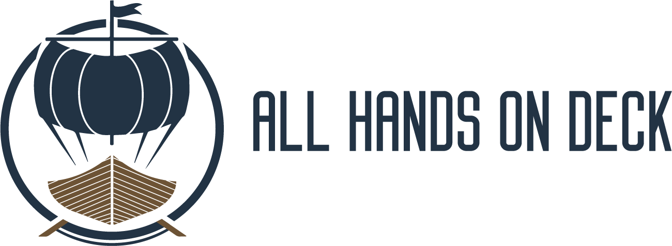
ALL HANDS ON DECK Module 13 – Buildings & Structures
Introduction to the module 13
Buildings & Structures
1. European Harbors
2. Coastal geography
3. Natural and Artificial Harbors
4. Discovering the port structures
5. General safety requirements

Slide 3
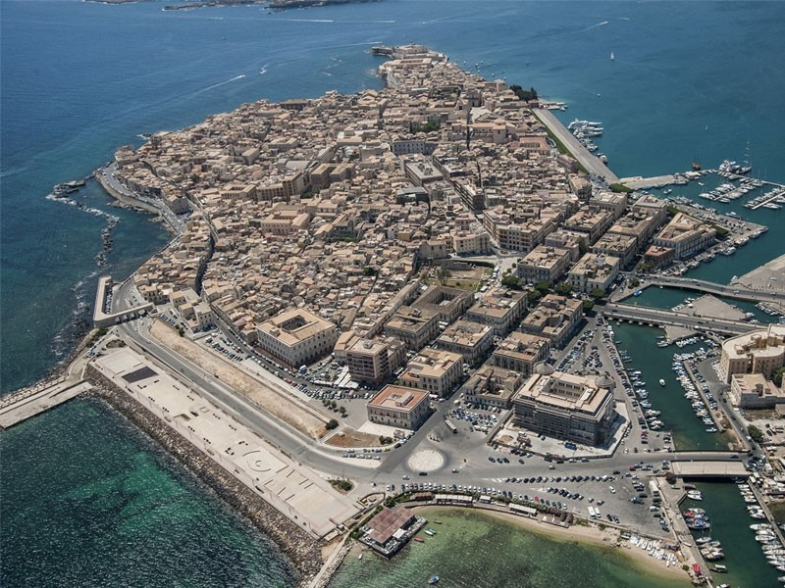
ALL HANDS ON DECK Module 13 – Buildings & Structures
1. European Harbors
Historical prominence
“Ports have been, for centuries, focal points of local, regional, national, and international economic development and social change. Its projection to the hinterland (...) led seaports history to become a significant field of research to support the study of evolving trade networks, as well as technological and industrial development and social and urban changes.

Slide 4
ALL HANDS ON DECK Module 13 – Buildings & Structures
1. European Harbors
Historical prominence
“Seaports are no longer studied exclusively as infrastructures or economic centres, but as a complex system, resulting from economic, political, social and cultural forces; the gateways between land and sea, between the hinterland and the vorland, a nodal axis with repercussions on the territorial, economic, social and mental structures.”
“Ports are also active agents in the process of modernization and change, having a role to play in the fields of technological innovation and in the urbanization process.”

Slide 5
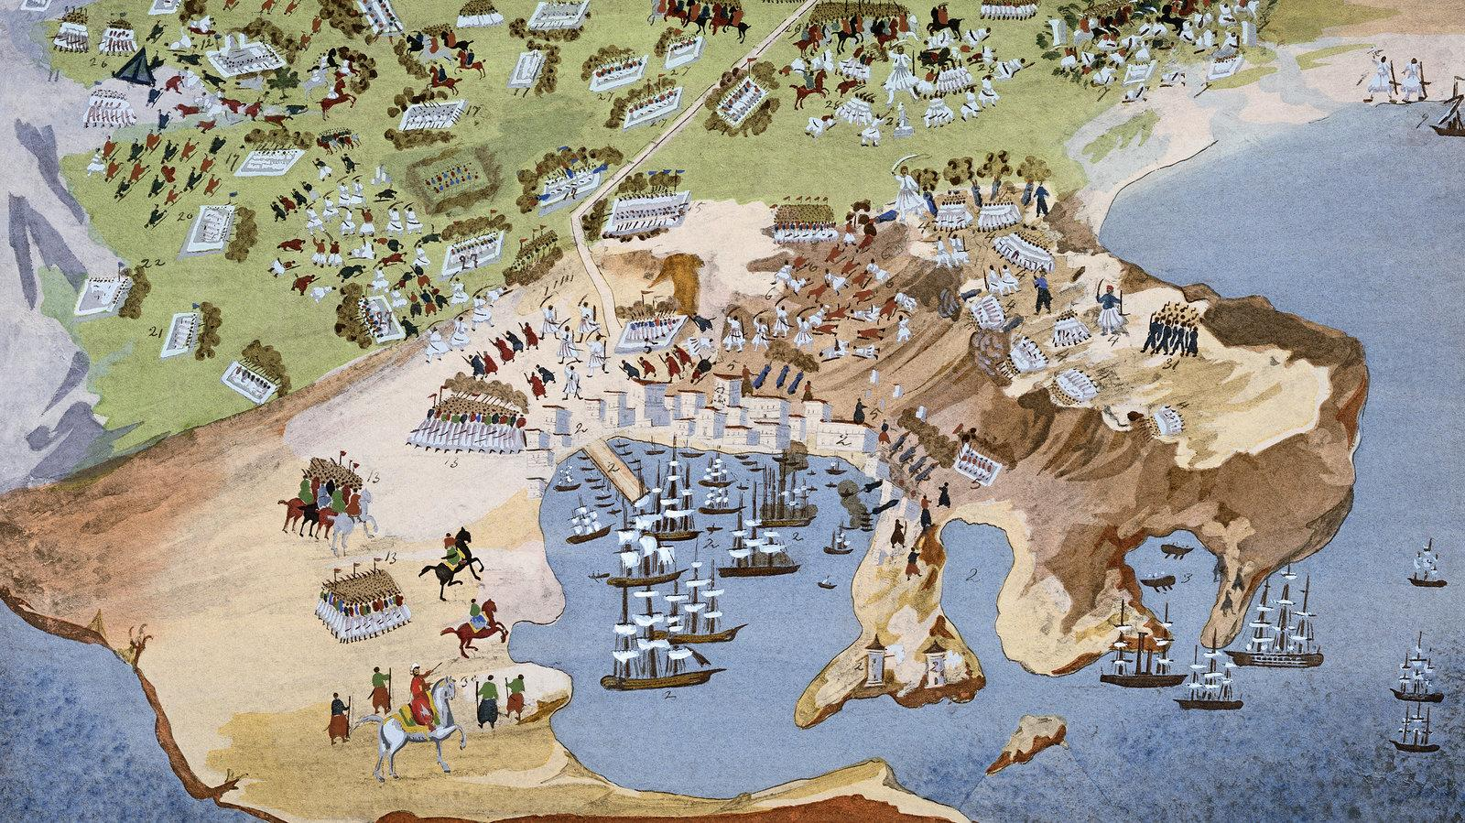
ALL HANDS ON DECK Module 13 – Buildings & Structures
1. European Harbors
Innovation throughout centuries
The role played by European seaports in the early modern period seems undeniable. They were essential for structuring economic spaces. Their functioning was critical to the efficiency of shipping. The definition of networks of trade and maritime routes, the increasing tonnage of seagoing vessels, the definition of a world economy, everything worked to increase the importance and prominence of maritime activity and the importance of seaports.”

Slide 6
ALL HANDS ON DECK Module 13 – Buildings & Structures
1. European Harbors
Society and urban space
“Seaports became crucial to structure political and economic spaces and essential junctions in supra-regional spaces. The mastery of new nautical techniques, and the building of maritime empires, have also consequently increased the importance and prominence of maritime communication routes, from the coastal to the trans-oceanic circuits.”
“The strategic centrality of ports, especially seaports, in the Early Modern Age, has given rise to specific historic phenomena and dynamics that claim for more accurate studies. The world economic context, the concentration of population, plus the centripetal nature of these maritime complexes, certainly generated demographic, social, and mental phenomena that clearly set port zones apart from inland areas.”

Slide 7
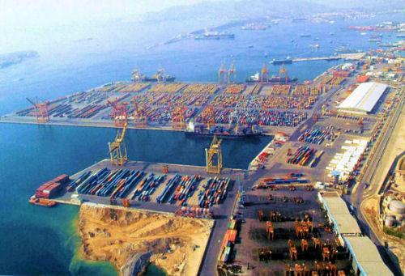
ALL HANDS ON DECK Module 13 – Buildings & Structures
1. European Harbors
Modern role
The industrial revolution triggered several changes on port activities.
Quays were expanded and jetties were constructed to handle the growing amounts of freight and passengers as well as larger ships.
Shipbuilding became an activity that required the construction of docks.
States started to integrate the rail lines with port terminals.
Port-related activities expanded to include industrial activities. This, expansion mainly occurred downstream.

Slide 8
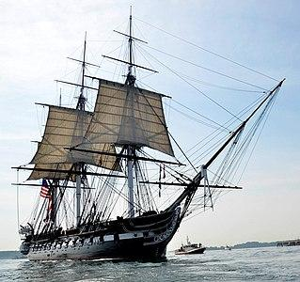
ALL HANDS ON DECK Module 13 – Buildings & Structures
2. Coast Geography
Political geography
Today, the international sea law governs relations between States in the maritime sphere. For many centuries this branch of international law has been characterized by the "freedom of the seas" regime and, therefore, the absence of rules.
This served the commercial and strategic interests of the major European maritime powers, especially at the time of the colonization of overseas territories.
In the second half of the nineteenth century, the phenomenon of the progressive extension of the jurisdiction of the coastal State on the adjacent seas began to manifest itself.

Slide 9
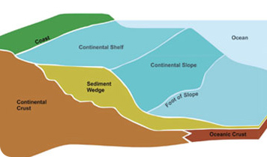
ALL HANDS ON DECK Module 13 – Buildings & Structures
2. Coast Geography
Political geography of coastal and maritime areas
Thanks to the Montego Bay Agreement, The UN Convention on the Law of the Sea (UNCLOS, treaty that establishes a legal framework for all marine and maritime activities), from 1982 we’ve got a standardized definition of:
Continental Shelf: the natural prolongation of the land territory to the continental margin's outer edge, or 200 nautical miles (370 km) from the coastal state's baseline, whichever is greater. A state's continental shelf may exceed 200 nautical miles (370 km) until the natural prolongation ends.

Slide 10
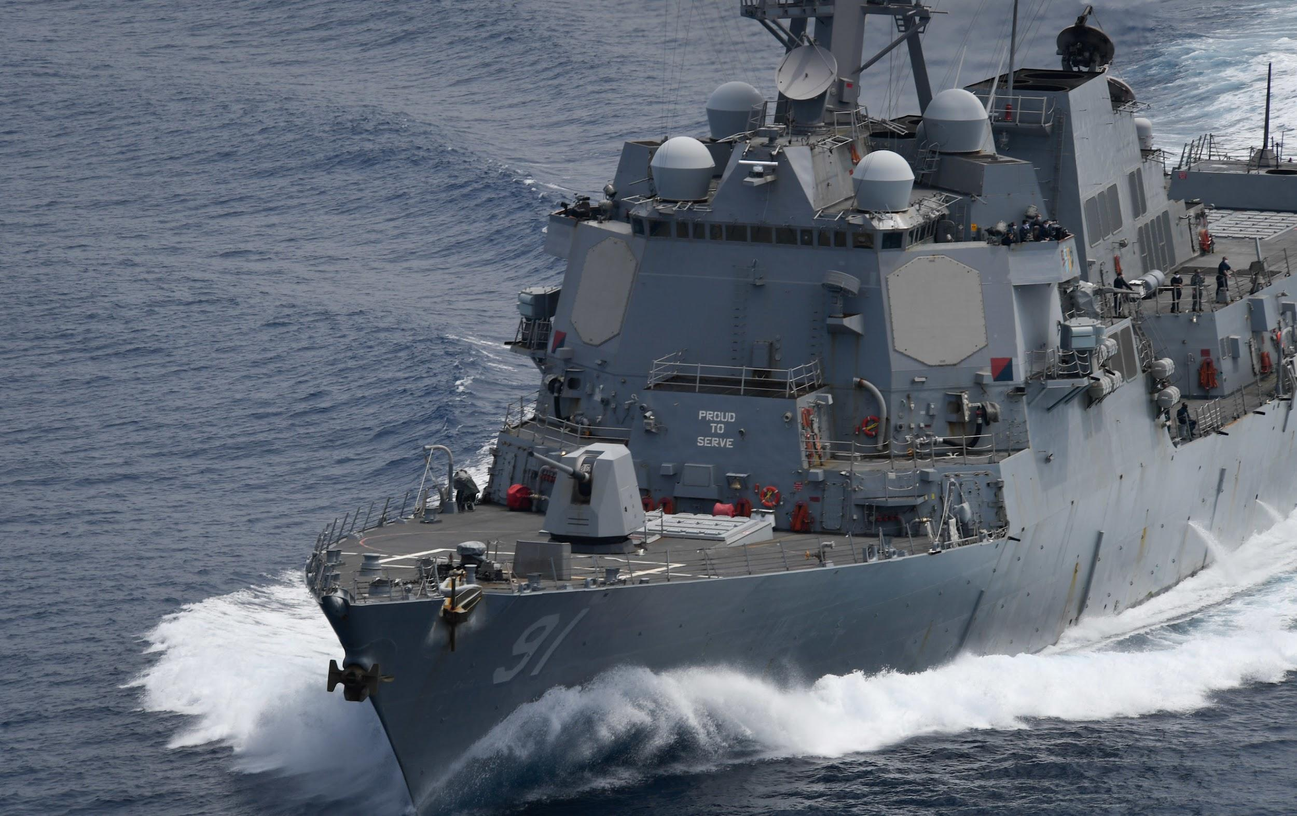
ALL HANDS ON DECK Module 13 – Buildings & Structures
2. Coast Geography
Political geography of coastal and maritime areas
Internal waters: all water and waterways on the landward side of the baseline. The coastal state is free to set laws, regulate use, and use any resource. Foreign vessels have no right of passage within internal waters.
Territorial waters: In an area of sea adjacent to its coasts, the State exercises full sovereignty as on its land territory. Sovereignty extends to the air space above, to its bottom and to its subsoil. Within twelve miles of the baseline, each coastal state may determine the extent of its territorial waters. The twelve-mile measure is the result of a compromise between States traditionally in favour of extensive freedom of trade and the developing countries in favour of exclusive exploitation of marine resources.

Slide 11
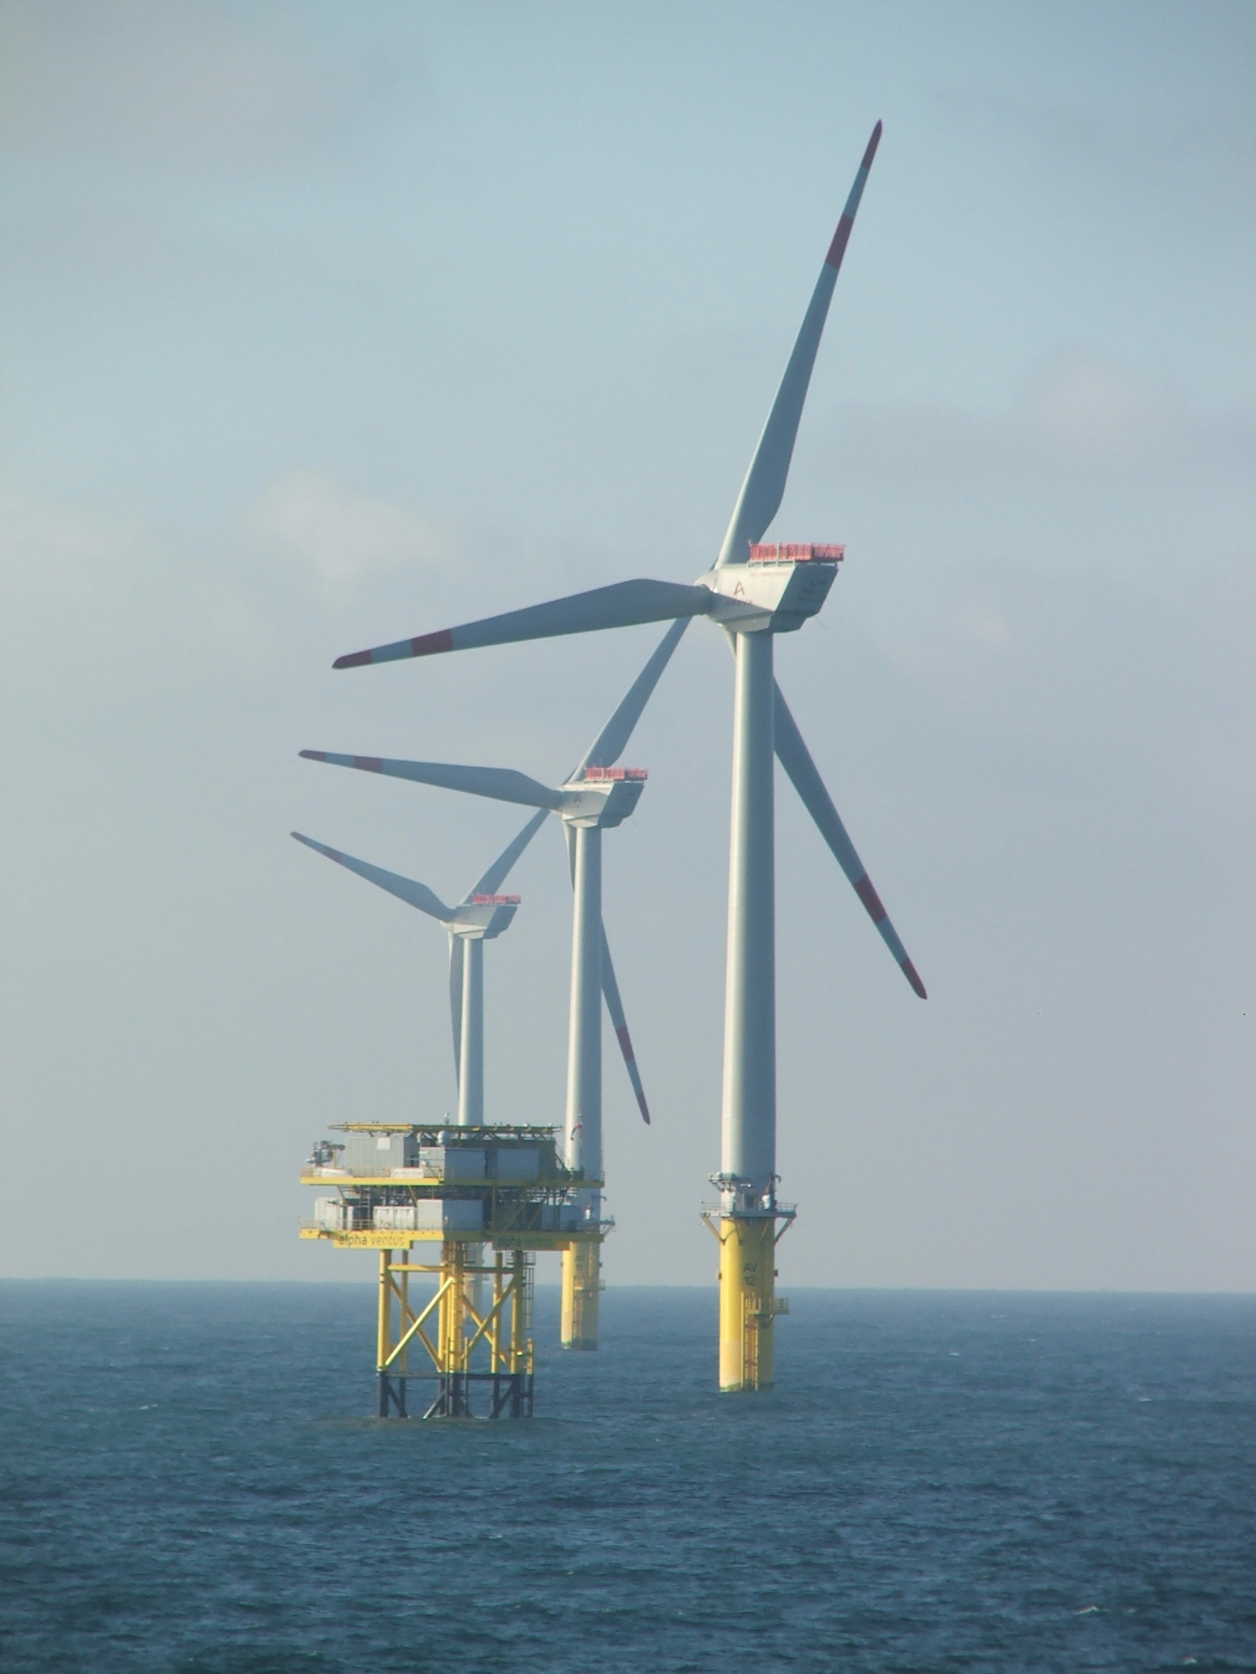
ALL HANDS ON DECK Module 13 – Buildings & Structures
2. Coast Geography
Political geography of coastal and maritime areas
Exclusive Economic Zones (EEZs): These extend 200 nmi (370 km; 230 mi) from the costal baseline. The coastal nation has sole exploitation rights over all natural resources. The EEZs were introduced to halt the increasingly heated clashes over fishing rights, and oil extraction.
High seas: begins beyond the limits determined by the areas over which coastal States exercise their sovereignty or jurisdiction (art. 86 UNCLOS). On the high seas, all States exercise the freedoms provided for in international law on an equal basis.

Slide 12
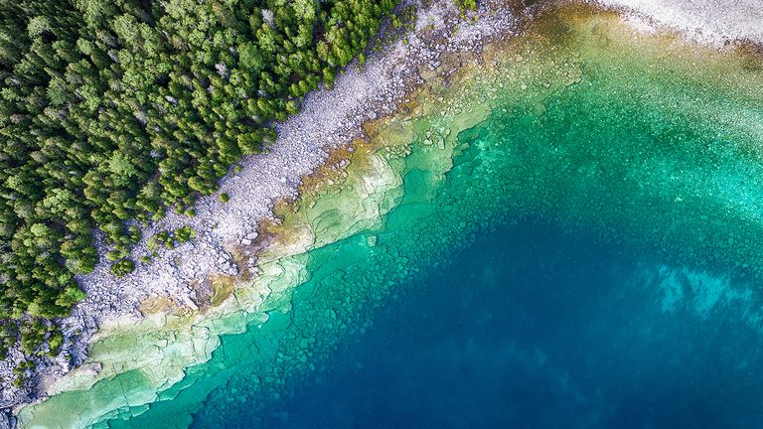
ALL HANDS ON DECK Module 13 – Buildings & Structures
2. Coast Geography
The coastline
The coast (coastline or seashore) is the area between the mainland and the sea, intended as an area partly submerged and partly emerged, generally sinuous, in which act the wave motion and the tides.
Because coasts are constantly changing, a coastline's exact perimeter cannot be determined; this measurement challenge is called the coastline paradox. The term coastal zone is used to refer to a region where interactions of sea and land processes occur.

Slide 13
ALL HANDS ON DECK Module 13 – Buildings & Structures
2. Coast Geography
Coastal areas
The coast is divided into 3 significant areas:
Backshore or back beach: is the area from the shore line until a net change in flora or physiological conditions occurs;
Nearshore: is the area that goes from the shore line to where the cracks begin to occur.
Offshore: from the end of the break zone to the edge of the continental shelf.

Slide 14
ALL HANDS ON DECK Module 13 – Buildings & Structures
2. Coast Geography
Coastal areas
The Nearshore is divided in turn into 3 layers:
- Breaker zones: where breakdowns begin to occur
- Surf zone: he surf zone is narrow and close to the shoreline in a gentle wave climate and can be very wide under storm conditions, extending from the seaward boundary of the upper shoreface to the dunefoot.
- Swash zone: the nearest area to shore

Slide 15
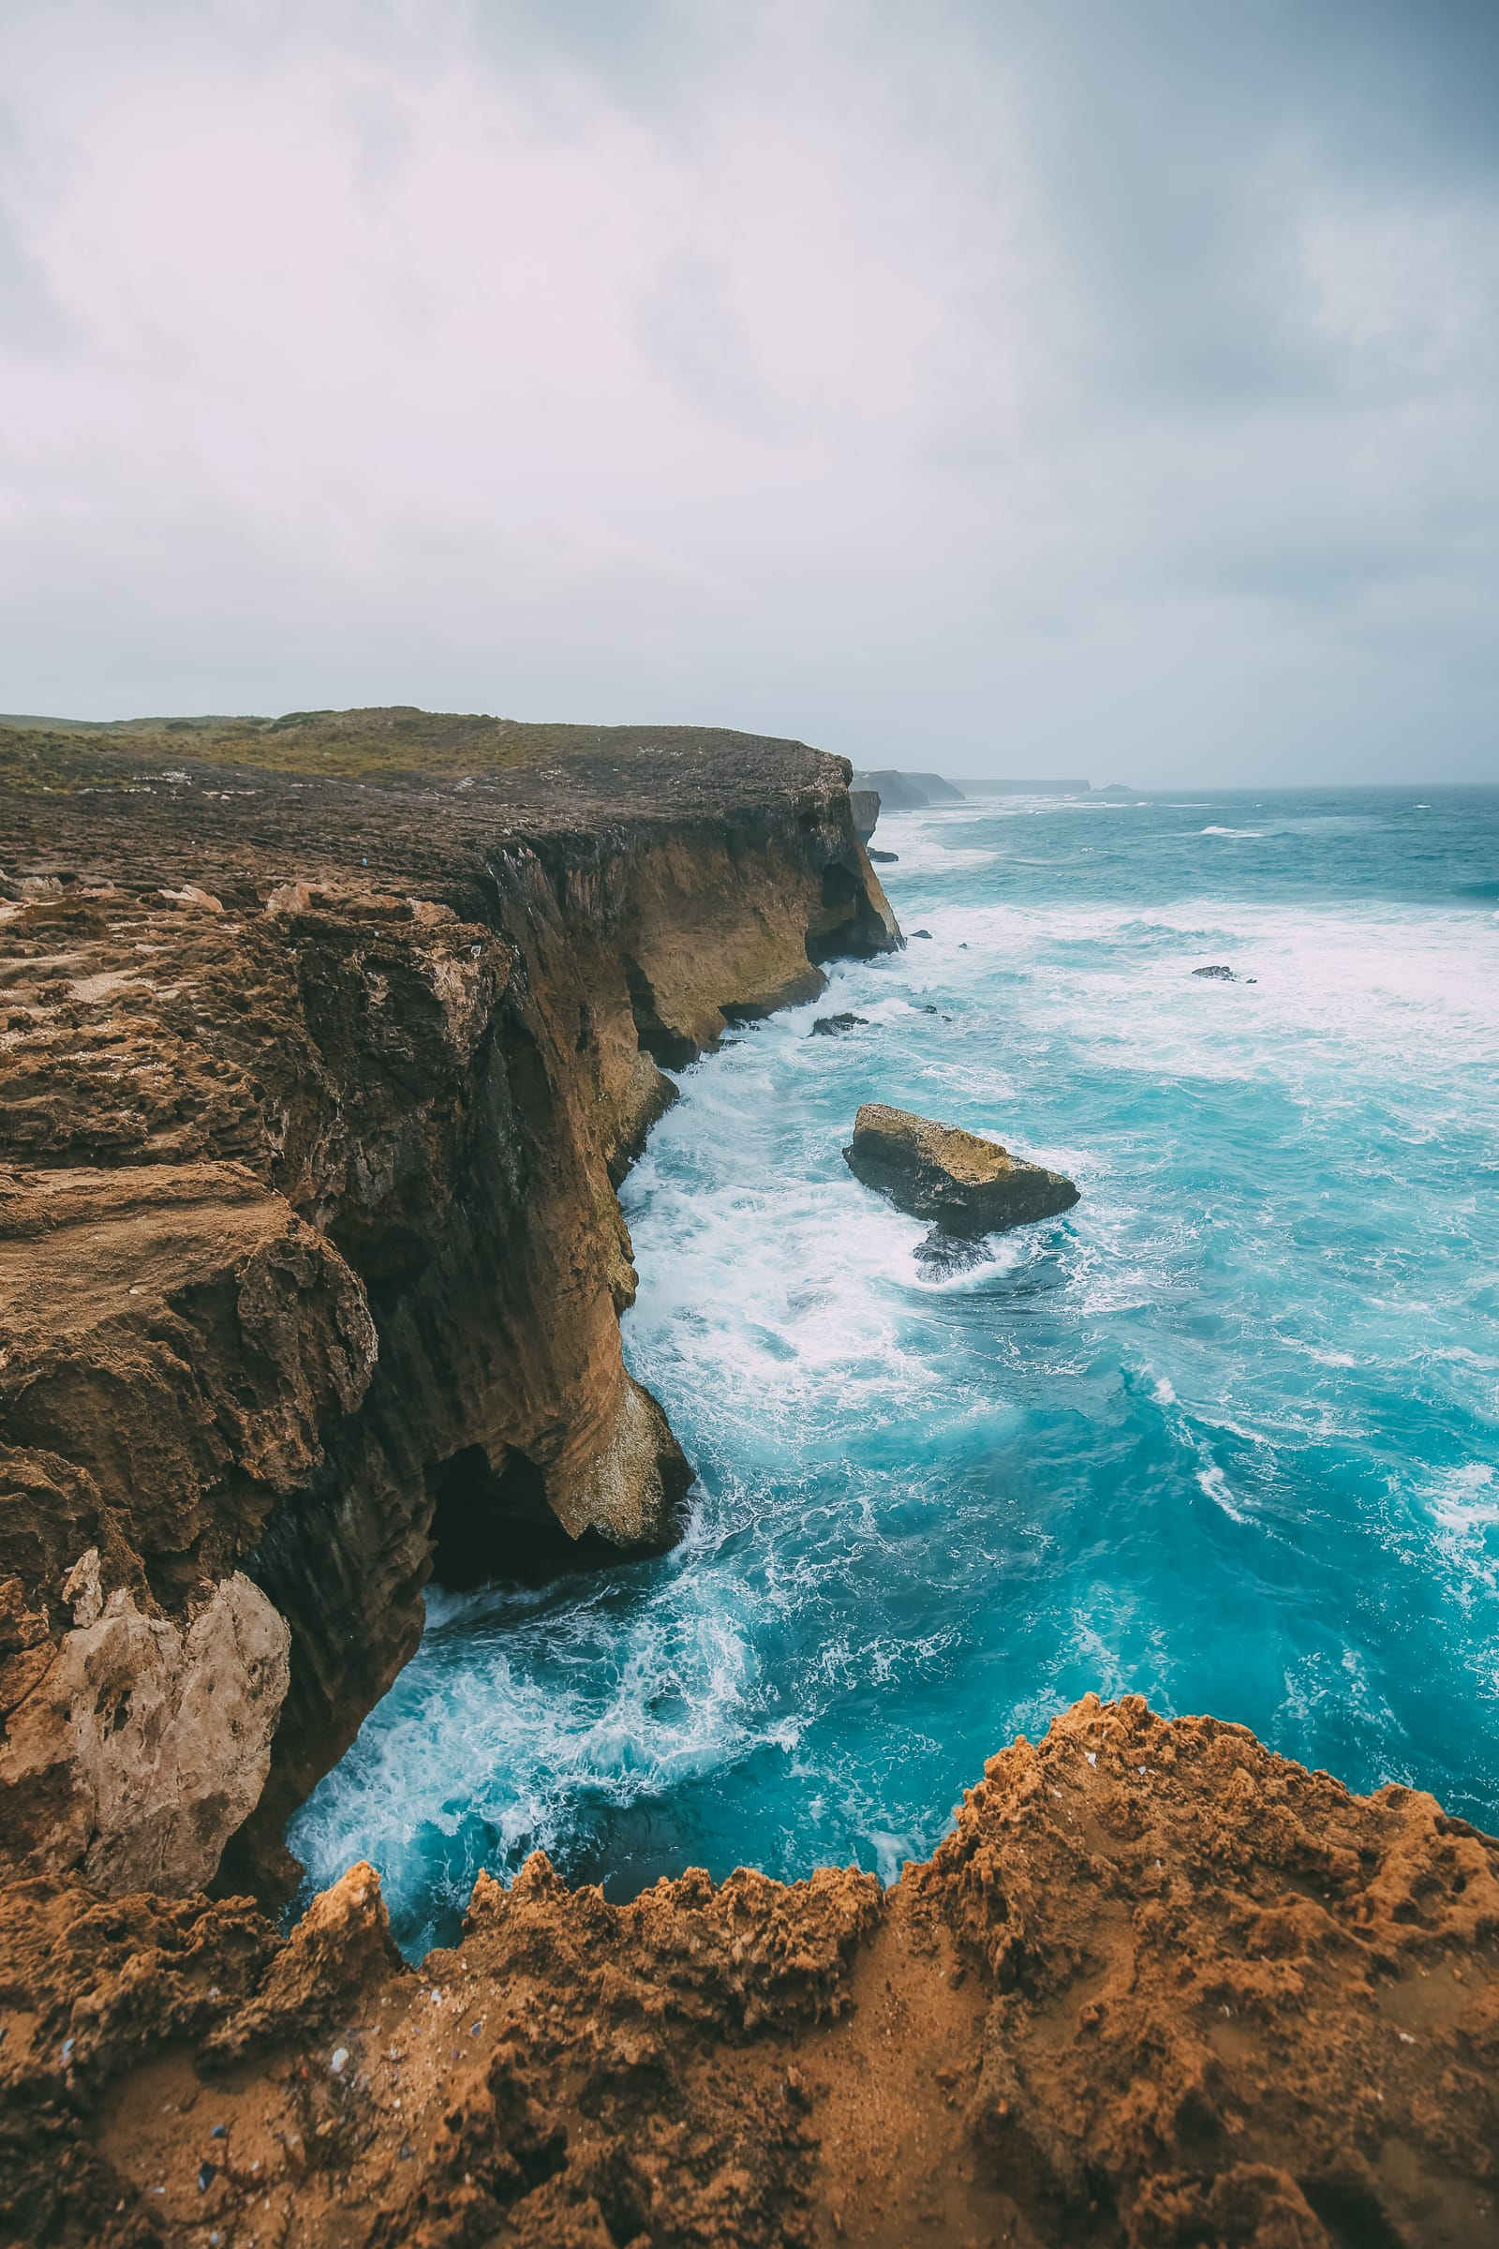
ALL HANDS ON DECK Module 13 – Buildings & Structures
2. Coast Geography
Different kind of coast. Natural and artificial.
Rocky coasts: living and dead cliffs
Submerged coasts: rias
Low coasts: beaches, coastal dunes, lagoons, coastal ponds
Coastal plains
Marine terraces
Submerged morphology
Coastal defences (seawalls)

Slide 16
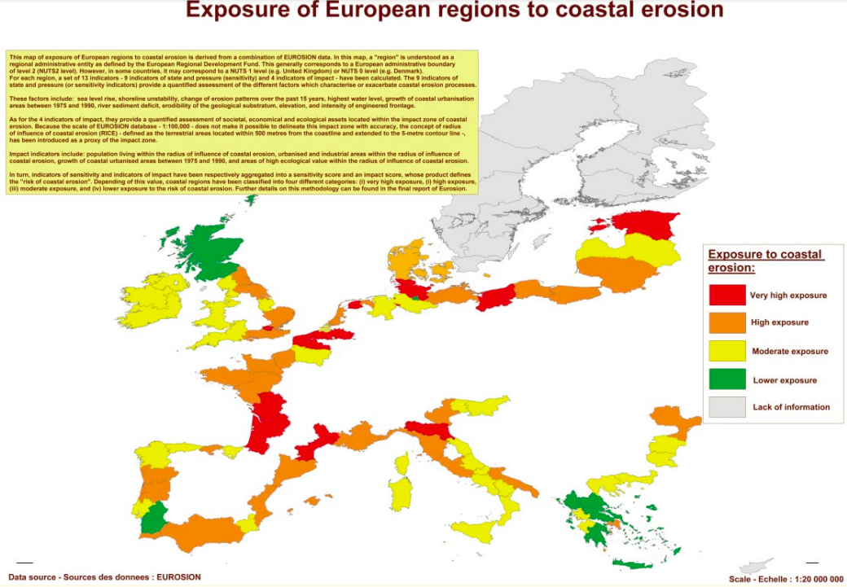
ALL HANDS ON DECK Module 13 – Buildings & Structures
2. Coast Geography
Erosion: coastal shaping.
The shoreline, being the meeting point between the land and the water, is an environment in which continually occur erosion processes (removal of material, due to waves and tides, coastal currents and wind) and sedimentation (supply of material from rivers or neighbouring stretches of coastline).
Living with coastal erosion in Europe, EC DG ENV, 2003.

Slide 17
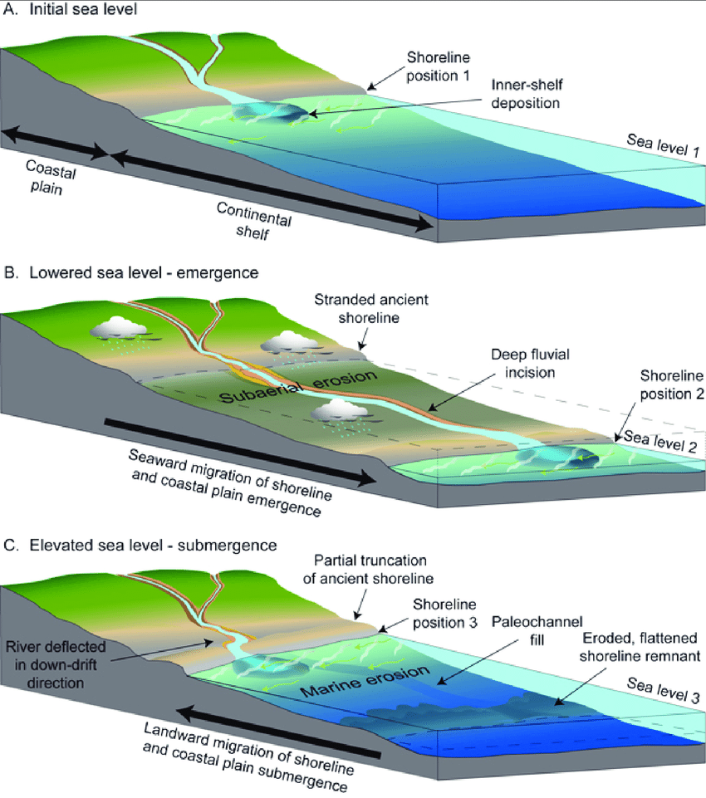
ALL HANDS ON DECK Module 13 – Buildings & Structures
2. Coast Geography
Erosion: coastal shaping.
The sum of these processes is the sedimentary balance of the coast. The sedimentary balance heavily affects the shape of the coast: if the balance is negative, the erosion is prevalent, the coast will be high, characterized by cliffs; if the balance is positive, depositional phenomena are prevalent, the coast will be low.
In this case we can also distinguish different possibilities: - open shorelines, when there is a clear and linear separation between water and land; - protected shorelines when other bodies of water more or less connected to the sea open after a first line of land emerged (this is the case of the lagoons).

Slide 18
ALL HANDS ON DECK Module 13 – Buildings & Structures
2. Coast Geography
Erosion: coastal shaping.
The State of the World’s Beaches, by Arjen Luijendijk, Gerben Hagenaars, Roshanka Ranasinghe, Fedor Baart, Gennadii Donchyts & Stefan Aarninkhof (Nature, 2018) discusses about the issue of coastal erosion worldwide, stating that the majority of the sandy shorelines in marine protected areas are eroding, raising cause for serious concern, mainly because coastal zones constitute one of the most heavily populated and developed land zones in the world.

Slide 19
ALL HANDS ON DECK Module 13 – Buildings & Structures
2. Coast Geography
Seawalls
When coastal buildings or roads are threatened, usually the first suggestion is to "harden" the coast with a seawall.
Seawalls are structures built of concrete, wood, steel, or boulders that run parallel to the beach at the land/water interface. They may also be called bulkheads or revetments.
They are designed to protect structures by stopping the natural movement of sand by the waves. If the walls are maintained they may hold back the ocean temporarily.

Slide 20
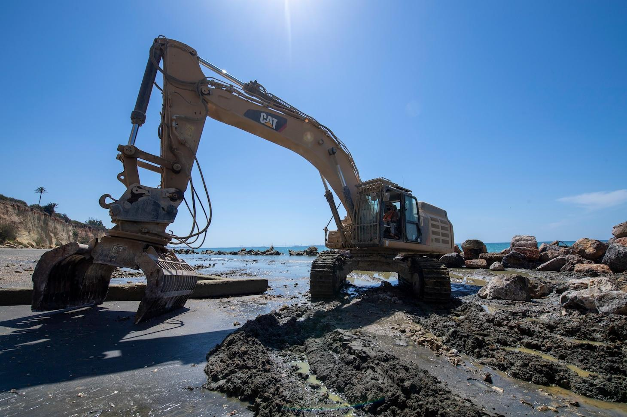
ALL HANDS ON DECK Module 13 – Buildings & Structures
2. Coast Geography
Seawalls
The construction of a seawall usually displaces the open beach that it is built upon. They also prevent the natural landward migration of an eroding beach.
But the strong impact of defensive structures (as seawalls) on the coastal landscape and on the sedimentary balance of adjacent beaches has led to the search for softer solutions.

Slide 21
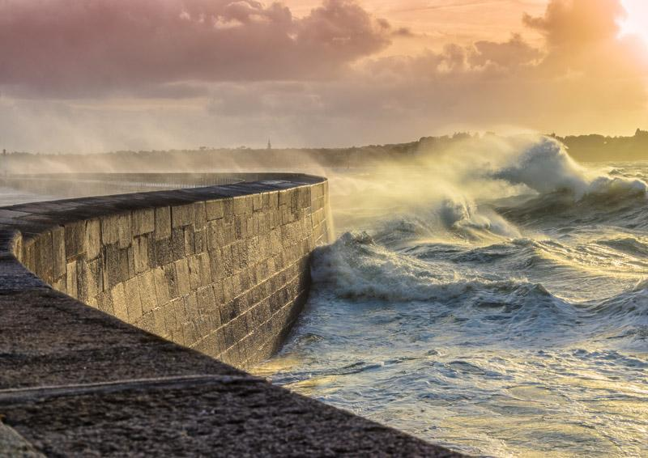
ALL HANDS ON DECK Module 13 – Buildings & Structures
2. Coast Geography
Seawalls
Many of the solutions consist of both submerged works and from the artificial feeding of the shorelines with sediments taken from land or submarine quarries, up to the adoption of systems of drainage of the beach that limit the ebb currents.
Unfortunately, these works are not reported in cartography, it becomes increasingly difficult to draw information on the dynamics of the coast from the simple reading of topographical maps.

Slide 22
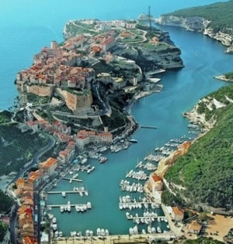
ALL HANDS ON DECK Module 13 – Buildings & Structures
3. Natural and Artificial Harbors
Different kind
Natural harbors, formed naturally they are protected from the sea/ocean’s fury by bays, fiords, mountains, but are still subject to tidal and wave energy.
This causes water mixing and circulation.

Slide 23
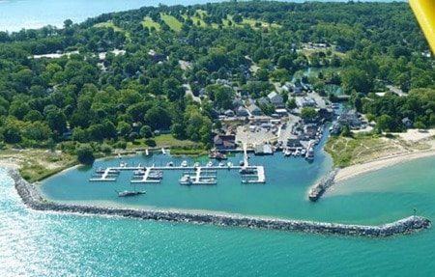
ALL HANDS ON DECK Module 13 – Buildings & Structures
3. Natural and Artificial Harbors
Different kind
Semi-Natural harbors, also formed naturally, but integrated with artificial structures to make protections from waves stronger and facilitate the entrance of boats and ships.

Slide 24
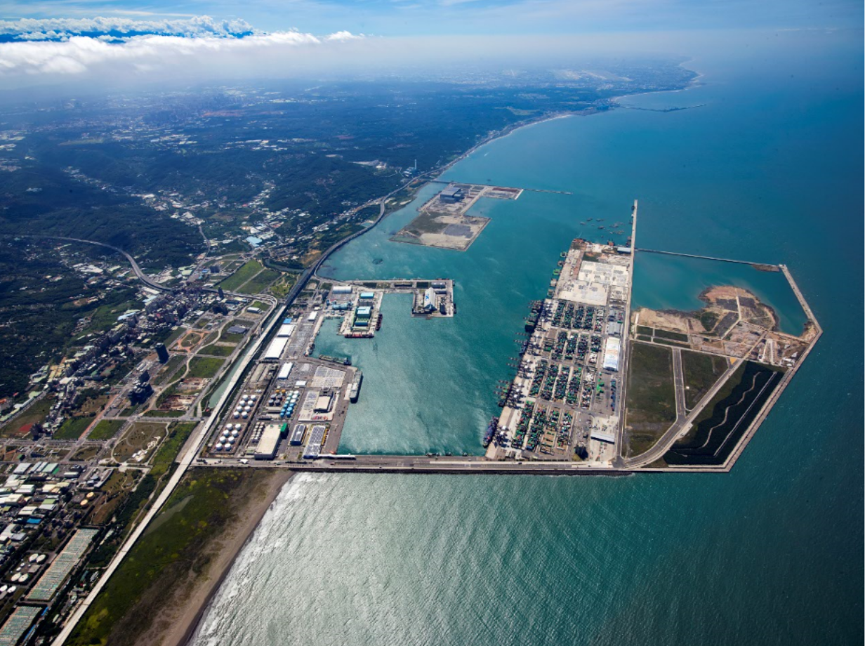
ALL HANDS ON DECK Module 13 – Buildings & Structures
3. Natural and Artificial Harbors
Different kind
Artificial harbors have been constructed by building a series of breakwaters and jetties. When an artificial harbor is built in an area that is subject to high-energy wave action, it will invariably interrupt the longshore flow of sand. This will cause serious downdrift erosion. Stagnant artificial harbors are easily polluted by boating activities: paint, oil, grease, garbage and illegally dumped sewage. These wastes can poison the living creatures that swim in these waters.

Slide 25
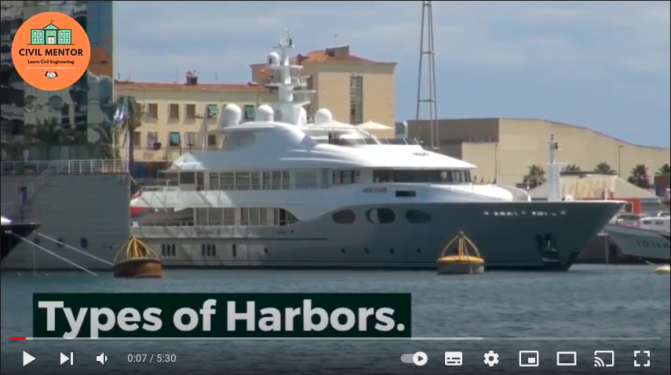
ALL HANDS ON DECK Module 13 – Buildings & Structures
3. Natural and Artificial Harbors
Types of Harbor
Check this video out to go deeper into the classification of Harbors.

Slide 26
ALL HANDS ON DECK Module 13 – Buildings & Structures
3. Natural and Artificial Harbors
Environmental threat
Some harbor designs force the longshore current to make a 90-degree turn towards the ocean. This causes a large rip current that may carry sand offshore that might otherwise remain in the surf zone. This will have the effect of completely changing the shape of the ocean bottom.
An artificial harbor mouth can act as a trap for the longshore sand transport causing it to clog up with sand, which makes costly periodic dredging projects necessary.

Slide 27
ALL HANDS ON DECK Module 13 – Buildings & Structures
3. Natural and Artificial Harbors
Environmental threat
New green materials
Discover Module 13 to have a better overview of:
EU requirements on ship pollution
Boat recycling procedures

Slide 28
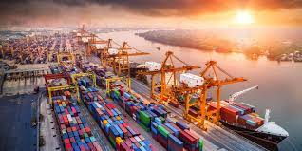
ALL HANDS ON DECK Module 13 – Buildings & Structures
4. Discovering the Port
Introduction
The structures around a boat can be different, the place where we can find all or almost all of them is in the port. A port is a natural or artificial structure placed on the sea coast or on the shore of a lake or a watercourse, designed to allow the landing and mooring of boats and ships, and their protection from adverse conditions of the waters. A port is usually located near an estuary, in a bay, lagoon or protected by a fiord.

Slide 29
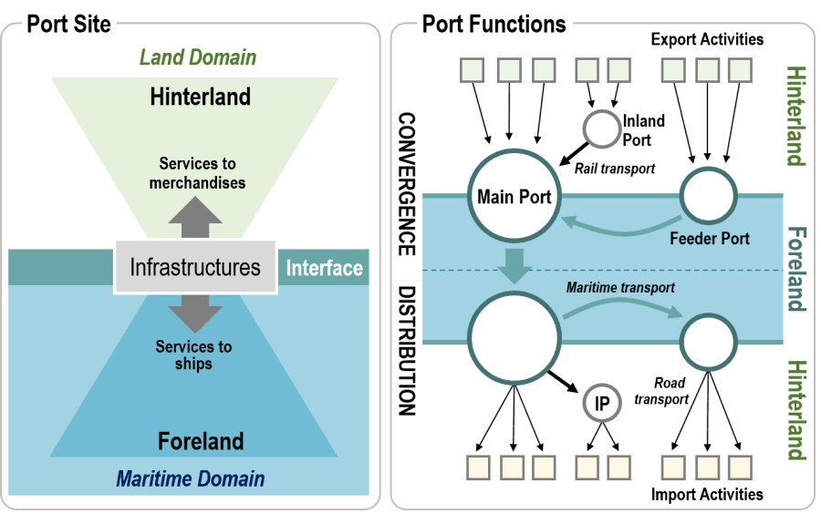
ALL HANDS ON DECK Module 13 – Buildings & Structures
4. Discovering the Port
Infrastructure and Buildings
The primary function of a port is to supply services to freight (warehousing, transshipment, etc.) and ships (piers, refueling, repairs, etc.). It allows and facilitates the loading and unloading of goods and people. Besides of being the link to maritime access and infrastructure development, ports are the gateways of continental distribution systems. In this view, containerization has substantially changed port dynamics.

Slide 30
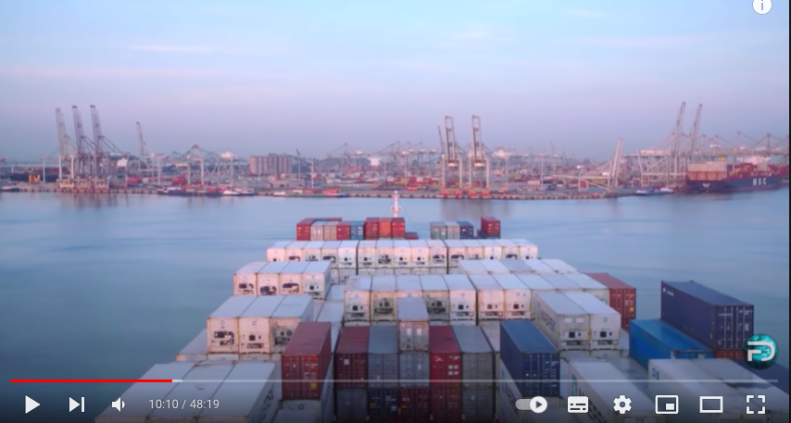
ALL HANDS ON DECK Module 13 – Buildings & Structures
4. Discovering the Port
Infrastructure and Buildings
This video-documentary will bring you inside the Port of Rotterdam one of the biggest and most important logistics hub of Europe.

Slide 31
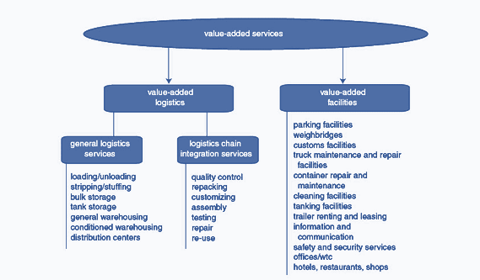
ALL HANDS ON DECK Module 13 – Buildings & Structures
4. Discovering the Port
Types
Monofunctionnal ports: Transit a limited array of commodities, most often dry or liquid bulks. Composed of specialized piers.
Polyfunctionnal ports: Several trans-shipment and industrial activities are present. Variety of specialized and general cargo piers.

Slide 32
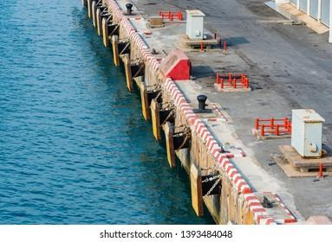
ALL HANDS ON DECK Module 13 – Buildings & Structures
4. Discovering the Port
Structures
Breakwater/seawall: a wooden or stone wall that extends from the shore into the sea and is built in order to protect a harbor or beach from the force of the waves
Fender: a plastic cylinder, tyre, piece of old rope or matting, etc., hung over a ship's side to protect it against impact.

Slide 33
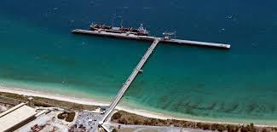
ALL HANDS ON DECK Module 13 – Buildings & Structures
4. Discovering the Port
Infrastructures and minor maritime buildings
Quay: a structure built parallel to the bank of a waterway for use as a landing place.
Bollard: a short, thick post on the deck of a ship or a quayside, to which a ship's rope may be secured.
Pier/Jetty: a structure (such as a breakwater) extending into navigable water for use as a landing place or promenade or to protect or form a harbor. It may also refer more specifically to a walkway accessing the centre of an enclosed waterbody.

Slide 34
ALL HANDS ON DECK Module 13 – Buildings & Structures
4. Discovering the Port
Physical capacity of the port to accommodate ship operations.
Tidal range: difference between the high and low tide. Ship operations cannot handle variations of more than 3 meters.
Channel and berth depths: very important to accommodate modern cargo ships. (e.g.) Panamax ship: (65,000 deadweight tons) requires more than 12 meters (40 feet) of depth. Many port sites are unable to handle modern maritime access.
Maritime interface: amount of space that is available to support maritime access. Related to the amount of shoreline. Guarantee its future development and expansion.

Slide 35
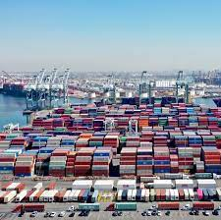
ALL HANDS ON DECK Module 13 – Buildings & Structures
4. Discovering the Port
Facilities
Berth / mooring availability: always check mooring places available
Port Authority / Harbor Office: a governmental commission empowered to manage or construct port facilities.
Customs house: a government building or office, as at a seaport, for collecting customs, clearing vessels, etc.
The Harbor Master: the officer who executes the regulations respecting the use of a harbor.
Water charger
Gas & Oil station
Wharehouses and containers

Slide 36
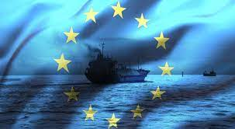
ALL HANDS ON DECK Module 13 – Buildings & Structures
4. Discovering the Port
EU internal market Competition rules
Ports are interested in European Commission action on Competition.
In May 2016 the Commission published the Notice on the notion of State Aid of the preceding, which gives guidance on when public investments do not involve State aid.
An Analytical grid for ports infrastructure was published on 2 December 2016 to provide further guidance on the rules and case practice applicable in the port sector.

Slide 37
ALL HANDS ON DECK Module 13 – Buildings & Structures
4. Discovering the Port
EU internal market Competition rules
Among the multitude of possible measures to tackle adverse environmental impacts of maritime operations, ‘Port pricing’ or ‘environmental charging’ has been receiving increasing attention in the last few years, having generated a considerable maritime transport economics literature, as well as a number of concrete, bottom-up initiatives voluntarily implemented by port managing bodies (e.g. the Environmental Ship Index, Clean Baltic Sea Shipping, Green Award, etc.).
Check also the Cogea and EC Study on differentiated port infrastructure charges to promote environmentally friendly maritime transport activities and sustainable transportation to discover more on the issue.

Slide 38
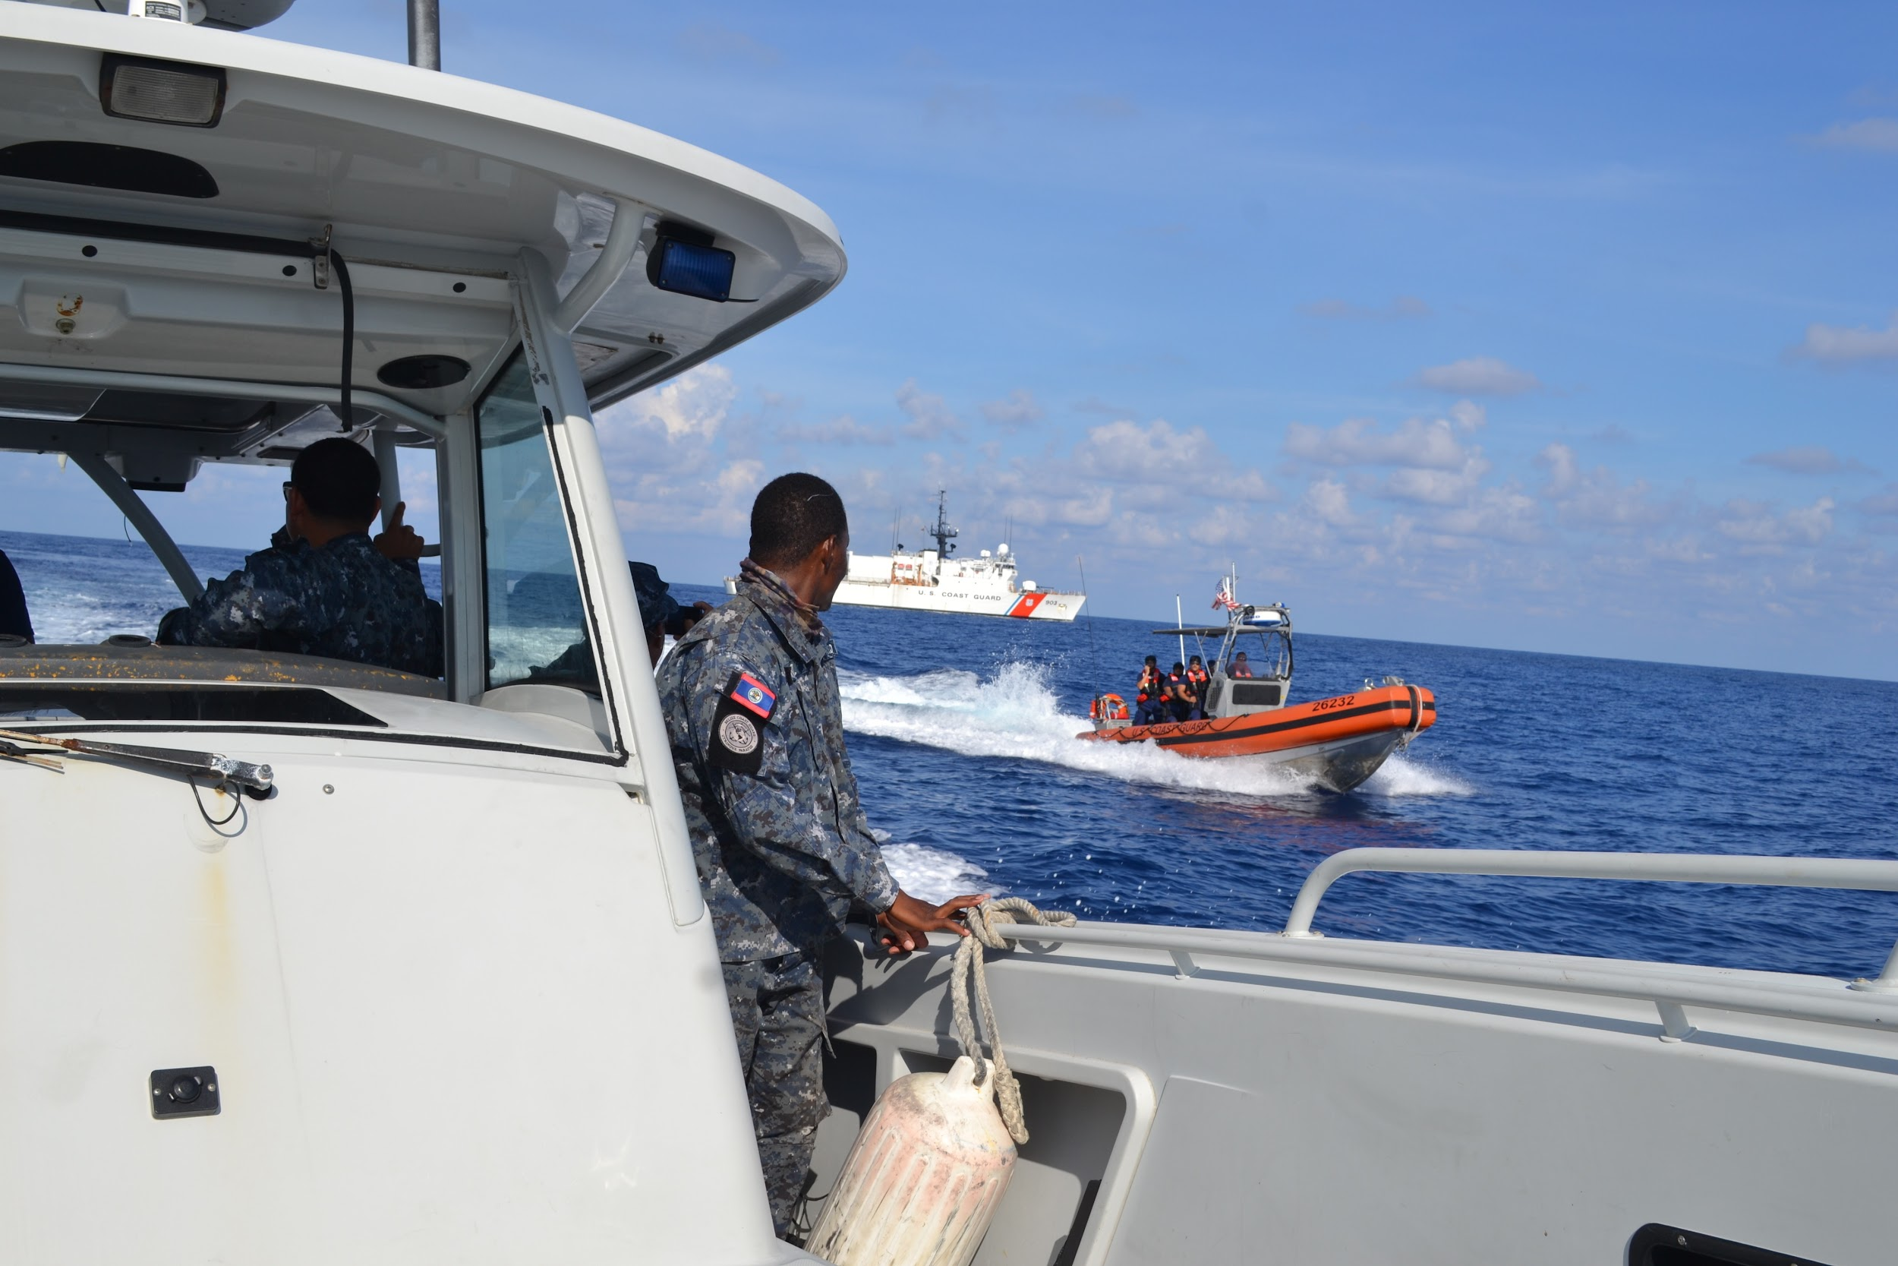
ALL HANDS ON DECK Module 13 – Buildings & Structures
5. General safety requirements
Obligations at the port
A boat entering or transiting to a port must follow rules that, with some exceptions, are international standards worldwide accepted.
In the following slides of section 5, we present some of the most important ones.

Slide 39
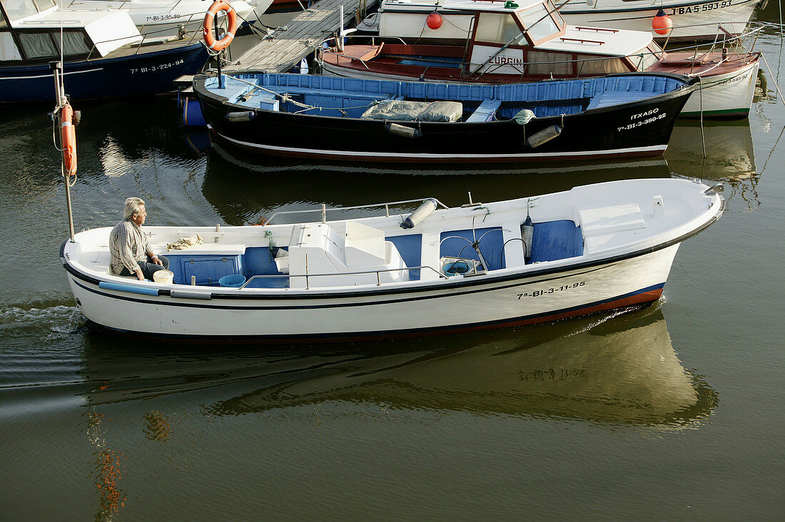
ALL HANDS ON DECK Module 13 – Buildings & Structures
5. General safety requirements
Behaviour into the port
1. Departure from the port
Before leaving the berths, it is a good idea to safely store items and clothing that could hinder manoeuvre operations.
To better understand the departure procedure, it is useful to take as an example a common mooring in windward (a boat perpendicular to the dock with the stern on the ground), two mooring cables on the ground, and one or two also on the side of the channel (trap).

Slide 40
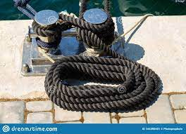
ALL HANDS ON DECK Module 13 – Buildings & Structures
5. General safety requirements
Behaviour into the port
2. Releasing the mooring cables
To break free from the ropes that bind the boat, it is important to find out where the wind comes from. Then, we will proceed by releasing the downwind cable before the others. The remaining cables will still hold the boat steady enough until they’re loose. In the absence of wind, it is preferable that the last cable to be dropped is the bow one, so as to avoid that the stern can hit the dock.
If your crew is large enough, you can release all the mooring cables at the same time.

Slide 41
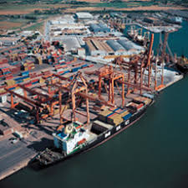
ALL HANDS ON DECK Module 13 – Buildings & Structures
5. General safety requirements
Behaviour into the port
3. Transit through the port
In port you must advance slowly, without raising annoying waves for the boats moored. The allowed speed limit is set by the competent Maritime Authority by territory (usually 2 or 3 knots).
Inside ports and canals, you keep the starboard. It is very important to observe the movements and intentions of others, making sure that they do the same. If, for example, a boat is going to get in the way of our journey, we must immediately slow down and stop at a safe distance. If necessary, the audible warning device can be switched on during the manoeuvre to attract attention. Prudence, understanding, and mutual respect are never excessive in port.

Slide 42
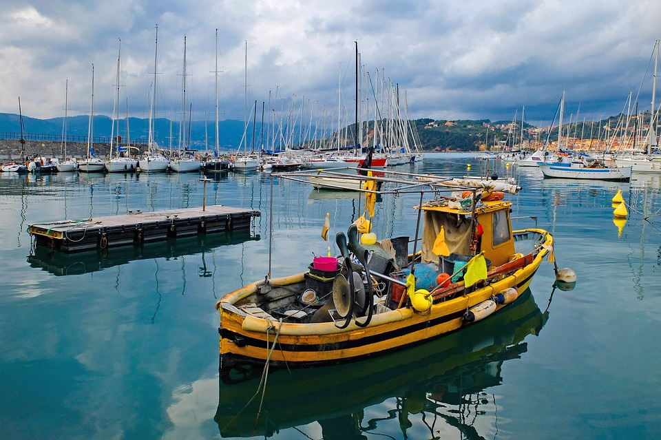
ALL HANDS ON DECK Module 13 – Buildings & Structures
5. General safety requirements
Behavioural tips
4. Boat leaving the port
Generally, outgoing units take precedence over incoming units.
Therefore, both inside and in the vicinity of the port, it is necessary not to hinder in any way the manoeuvres and the transit of large ships, from which it is obligatory to keep a proper distance.
Leaving the port you can pick up the fenders and put them in a locker or below deck so that they can not be an obstacle.

Slide 43
ALL HANDS ON DECK Module 13 – Buildings & Structures
5. General safety requirements
European Union Regulation
At EU level the Regulation (EU) 2017/352 of the European Parliament and the Council of Ministers establishing a framework for the provision of port services and common rules on the financial transparency of ports defines the conditions under which the freedom to provide port services applies; for instance the type of minimum requirements that can be imposed for safety or environmental purposes, the circumstances in which the number of operators can be limited and the procedure to select the operators in such cases

Slide 44
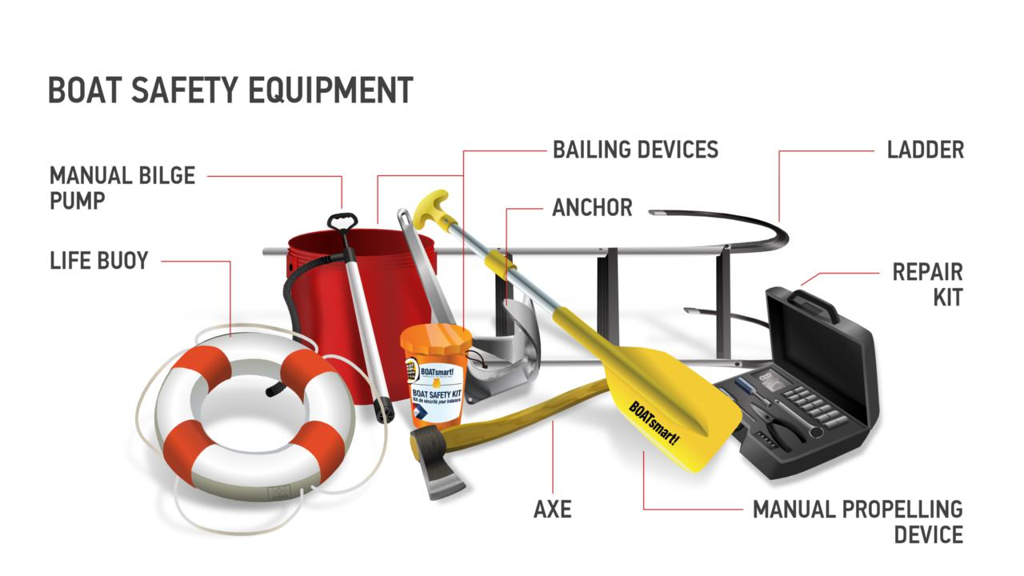
ALL HANDS ON DECK Module 13 – Buildings & Structures
5. General safety requirements
Useful tips
Pay attention to the weather forecast, take into account winds and sea conditions
Plan the sea route carefully, and in due time
Make sure boat safety tools (visual/sound signalling devices, towable/waerable flotation devices, axe, ..) work correctly
Check this video out!

Slide 45
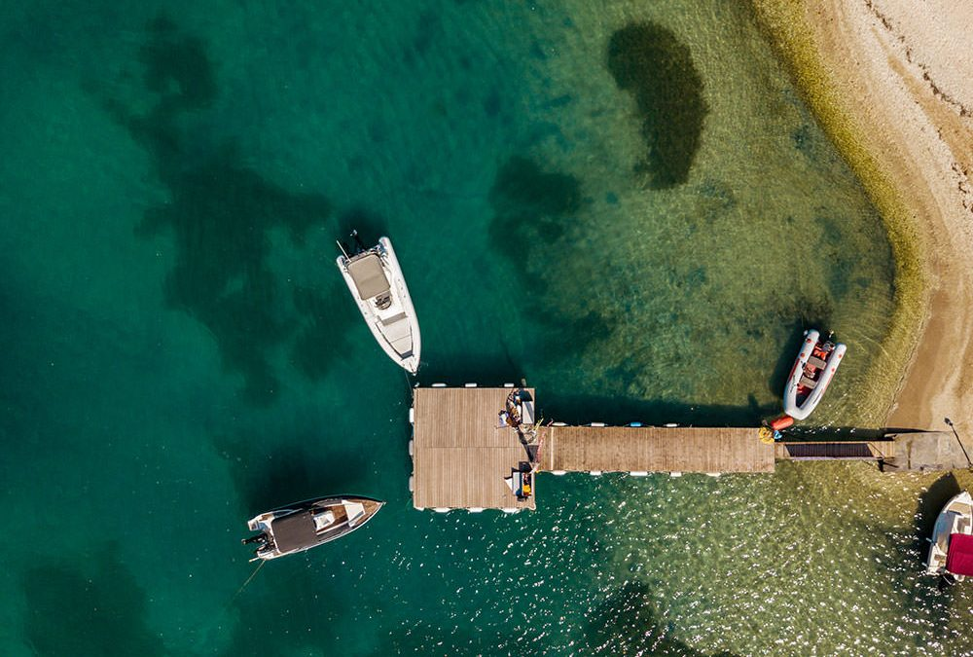
ALL HANDS ON DECK Module 13 – Buildings & Structures
In conclusion
Summary of the contents
This is the end of Module 12.
Now take your time to complete the evaluation test concerned.

Slide 46
ALL HANDS ON DECK Module 13 – Buildings & Structures
Bibliography
European seaports in the Early Modern Age: concepts, methodology and models of analysis, Amélia Polónia, Cahiers de la Mediterranèe, 2010.
The State of the World’s Beaches, Arjen Luijendijk, Gerben Hagenaars, Roshanka Ranasinghe, Fedor Baart, Gennadii Donchyts & Stefan Aarninkhof, Nature, 2018
Regulation (EU) 2017/352 of the European Parliament and the Council of Ministers establishing a framework for the provision of port services and common rules on the financial transparency of ports.
https://transport.ec.europa.eu/transport-modes/maritime/ports_en
https://ec.europa.eu/competition/state_aid/modernisation/grid_ports_en.pdf
Compulsory reading:
Living with Coastal Erosion in Europe, EC - DG ENV study, 2004
Study on differentiated port infrastructure charges to promote environmentally friendly maritime transport activities and sustainable transportation, Cogea and European Commission, 2017.

Slide 47
Don’t forget to follow AHOD on Facebook and Linkedin, and visit the project website.
https://allhandsondeck.eu/
THANK YOU!

